Slide 1
Strategies for Bringing New Dimensions to Intercultural Learning into the Classroom and Beyond
Celebrate Learning Week 2021 Panel Discussion
Notes:
‹#›

Slide 2
BEFORE WE BEGIN:
Land Acknowledgement:
We would like to begin by acknowledging that the land on which we gather is the traditional, ancestral, and unceded territory of the xʷməθkʷəy̓əm (Musqueam) People.
We will be recording this webinar for teaching and learning purposes. If you would prefer not to be recorded, please keep your video and microphone off.
We will have an open question period at the end of the presentation. Before then, please post your questions in the chat so the moderator can keep track of the questions and make sure they get answered.

Slide 3
MODERATOR:
Brianne Orr-Álvarez, Assistant Professor of Teaching, FHIS Learning Center Director, Spanish Language Program Director | Department of French, Hispanic and Italian Studies
PANELISTS:
Strang Burton, Associate Professor of Teaching, Language Diversity, Linguistic Pedagogy
Department of Linguistics
Luisa Canuto, Assistant Professor of Teaching, Italian Language Program Director
Department of French, Hispanic and Italian Studies
Misuzu Kazama, Lecturer, Japanese Language | Department of Asian Studies
Saori Hoshi, Assistant Professor of Teaching, Japanese Language | Department of Asian Studies
Joenita Paulrajan, Program Leader, Intercultural, Equity, Diversity, and Inclusion Programs
UBC Extended Learning

Slide 4
Strategies for Bringing New Dimensions to Intercultural Learning into the Classroom and Beyond Strang Burton, LING

Slide 5
LING 101 “Languages of the World”– How I used to teach it:
Sound systems (vowels and consonants)
Affixation (prefixes and suffixes)
Word order
Features of various dialects
Features of various languages
Language families and patterns of historical change

Slide 6
How I teach LING 101 now:
ALSO ask a QUESTION :
Still teach:
Sound systems
Affixation
Word order
Features of various dialects
Features of various languages
Language families and patterns of historical change
How do people’s intercultural JUDGEMENTS about other languages and dialects HOLD UP to linguistic analysis?

Slide 7
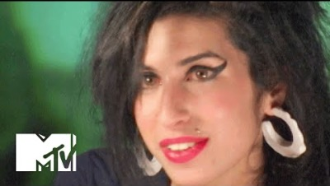
Example One
The Queen vs. me vs. Amy Winehouse
Pronounces /t/ without a flap
Some vowel differences with N. American (/dans/, /gras/, /məʊmənt/)
Drops / ɹ / at end of syllables
(etc.)
Pronounces /t/ without a flap
Some vowel differences with N. American, as for RP and also /lɑɪk/, /
Drops / ɹ / at end of syllables
Also ‘drops’ / t / at end of syllable (becomes / ʔ /)
(etc.)

Slide 8
Social prejudice about other social groups based on dialect differences is STRONG!
“One 2013 poll of more than 4,000 people found RP and Devon accents the most trustworthy, while the least trustworthy was deemed to be Liverpudlian (from Liverpool). The Cockney accent came a close second for untrustworthiness. These accents scored similarly when asked about intelligence.”
https://www.bbc.com/future/article/20180307-what-does-your-accent-say-about-you (emphasis added)

Slide 9
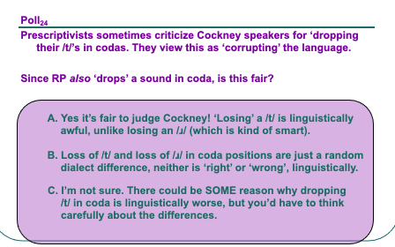
Once we know the LINGUISTIC features of the dialects, I ask the students to REFLECT in various ways on these social judgements.

Slide 10
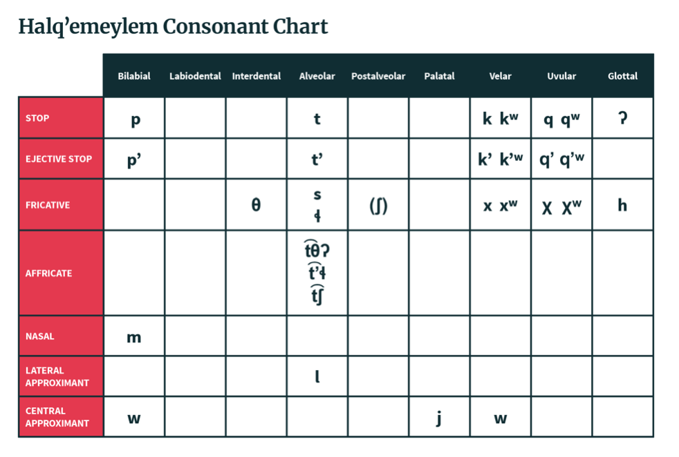
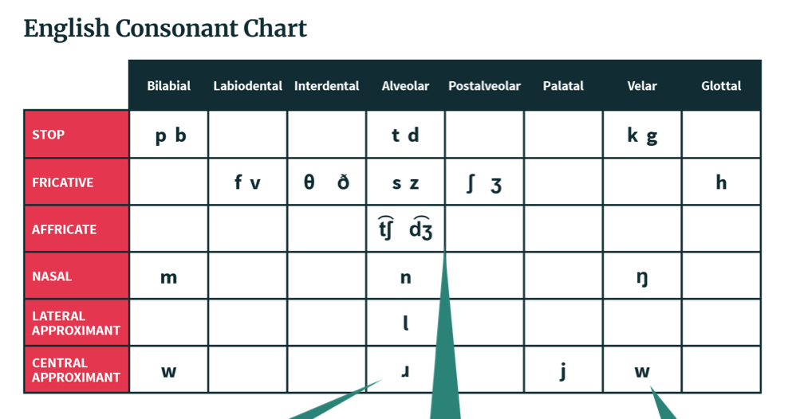
Example Two
The ‘Savage Tongues’ Prejudice
Vocal cord vibration distinguishes sounds
8 distinctive places
6 distinctive Manners
Etc.
No contrasts based on vocal fold vibration
But additional contrasts based on ‘popping’ the consonants (ejectives), and lip rounding
9 distinctive places
7 distinctive manners,
Etc.

Slide 11
Social prejudice about other social groups based on language differences is ALSO very strong!
Languages of certain groups are assumed to be ‘crude’, ‘unsystematic’, and ‘savage’
Richard Pratt, (1892)

Slide 12
Once we know the LINGUISTIC features of some relevant languages, I ask the students to REFLECT on these social judgements

Slide 13
What I found when asking these questions
Though I was clear that NO-ONE would lose points for disagreeing with me about these conclusions, a substantial number of students DID indicate that they re-thought these issues through the course.
My perception is that connecting the linguistic analysis to these broader questions was an interesting and positive step, which made the class more meaningful with just a small number of questions.
I have also definitely had students tell me that they appreciate it when people stop pre-judging THEM as ‘untrustworthy’ or ‘unintelligent’ based on their dialects!

Slide 14
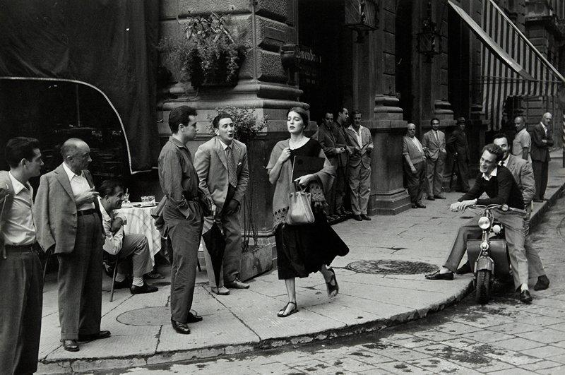
Integrating intercultural perspective into all levels of language courses (in Covid times and beyond)
Luisa Canuto, FHIS

Slide 15
What is intercultural competence?
Intercultural competence is a lifelong process that includes the development of the attitudes (respect and valuing of other cultures, openness, curiosity), knowledge (of self, culture, sociolinguistic issues) skills (listen, observe, interpret, analyze, evaluate, and relate), and qualities (adaptability, flexibility, empathy and cultural decentering) in order to behave and communicate effectively and appropriately to achieve one’s goals to some degree. Deardorff (2006: 254)
Notes:
Here, I can first ask participants to describe what intercultural competence is in 2 to 4 words and then show them this quote, which I really like. I expect them to use words such as “appreciation, respect, knowledge.’ etc.

Slide 16
Collaborative Online International Learning (COIL): An international collaboration (‘virtual mobility’) to develop intercultural and cross-cultural skills
Key elements:
Involves a cross-border collaboration
Engages students in online interaction (synchronous or asynchronous)
Aims at fostering students’ intercultural competences
Includes a reflection component

Slide 17
R.Orkin, An American Girl in Italy (1951)
Notes:
“American girl in Florence” (1951), by Ruth Orkin. I ask participants to describe what ‘it is going on’ and explain how I used this to encourage students to check their biases

Slide 18
Project 1:
Three universities (UBC, Purdue, FIU), 46 students (in groups)
Intermediate level
4 components:
Share a self-identity worksheet
Engage in a D.I.E/D.A.E. activity
Describe this photo
Are you Describing or Interpreting or Evaluating?
Produce a visual representation of what ‘Italianità’ (italianness) means
Create a video and present

Slide 19
Project 2
Two universities (UBC, FIU), 22 students (in groups)
Beginner level
4 components:
Take a short survey on your intercultural attitude
Analyze and Compare different commercials from different countries
IDENTIFY and SELECT ONE RELEVANT SOCIAL TOPIC and the MARKETING STRATEGIES which were used to communicate that topic.
Create a video and present

Slide 20
[Very short] Bibliography
Byram, Michael. 2008. From Foreign Language Education to Education for Intercultural Citizenship. Clevedon: Multilingual Matters
Deardorff, Darla. 2006. “Identification and Assessment of Intercultural Competence as a Student Outcome of Internationalization,” Journal of Studies in International Education, vol. 10: 3: 241- 266
Kramsch, Claire. 2013. “Culture in foreign language teaching,” Iranian Journal of Language Teaching Research 1.1: 57-78.
Spitzberg, B. H., & Changnon, G. 2009. “Conceptualizing intercultural competence.” In The Sage handbook of intercultural competence, edited by Darla Deardorff , 2–52. Thousand Oaks, CA: Sage.
https://idiinventory.com/generalinformation/the-intercultural-development-inventory-idi/
https://www.tru.ca/intercultural/faculty-staff/coil.html
https://coil.suny.edu/
http://www.ufic.ufl.edu/uap/forms/coil_guide.pdf
https://www.purdue.edu/cie/globallearning/Intercultural%20Knowledge%20and%20Competence.html

Slide 21
Strategies for Bringing New Dimensions to Intercultural Learning into the Classroom and Beyond
Language-exchange learning as changing participation in virtual L2 communities of practice
Saori Hoshi & Misuzu Kazama (Dep. of Asian Studies)
Notes:
We can use Zoom background https://asia.ubc.ca/news/asian-centre-zoom-backgrounds/
Saori: Thank you for joining us today. Our presentation title is “language-exchange learning as changing participation in virtual L2 communities of practice”. My name is Saori Hoshi and the other presenter is my colleague, Misuzu Kazama. We are going to talk about our synchronous and asynchronous online activities we conducted over the past year in Japanese language classes. (Next slide please)

Slide 22
Agenda
Theoretical Frameworks
Synchronous & Asynchronous Online Activities
Activity 1 (Beginning-level Japanese classes: JAPN 100&101)
Activity 2 (Intermediate-level Japanese class: JAPN322&323)
Findings
Discussions
Notes:
Saori Here is our agenda. We would like to start with the theoretical frameworks as the basis of our studies, and then talk about synchronous and asynchronous online activities that we did in the 1st-year and 3rd-year Japanese classes during the past online teaching periods, and then we would like to briefly share our findings and end our presentation with the discussions. (Next side please)

Slide 23
Theoretical Frameworks
COIL (Collaborative Online International Learning)
Collaboration or interaction with students from different backgrounds and cultures
Developing global perspectives & intercultural competencies
Reflective component that helps students think critically about such interactions
Situated learning (Lave & Wenger, 1991; Wenger, 1998)
Communities of practice between speakers of the target languages
Learning as changing participation in mutual L2 communities (Sfard, 1998)
Notes:
Saori Our projects were basically informed by these two theoretical frameworks, COIL(collaborative online international learning) and Situated Learning. As in her presentation Luisa already described COIL as a pedagogical approach to fostering student learning, we would like to skip this concept. Another construct we adopted for our projects is situated learning, originally proposed by Lave and Wenger back in 1991. Lave and Wenger developed this concept to describe the social dynamics of learning as situated activity towards participation in a so-called community of practice. Therefore, our projects focus on how language-exchange learning manifests itself as learners of Japanese and English participate and interact with each other in these mutual L2 communities of practice. (Next slide please)

Slide 24
Our language-exchange activities
Participants
1st-year Japanese class students at UBC & English learners at a partner institute & university
3rd-year Japanese class students at UBC & English learners in a partner institute
Synchronous activity as virtual communities of practice
Joint conversation sessions on Zoom (using Japanese and English as the target languages)
2 - 3 times per semester
Notes:
Saori Participants of our language-exchange activities consisted of first-year and third-year Japanese class students at UBC and Japanese speakers who are learning English at a partner institute in Vancouver and Japanese university. These online activities took place 2 or 3 times over one semester were conducted on Zoom as virtual communities of practice where students of Japanese classes at UBC interact with Japanese learners of English by practicing Japanese and English respectively as the target languages. First, my colleague Misuzu will talk about the activities that she did in her first-year Japanese classes. (Next slide please)

Slide 25
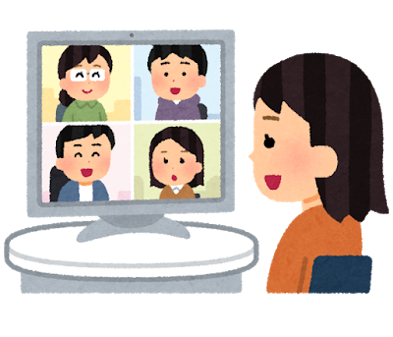
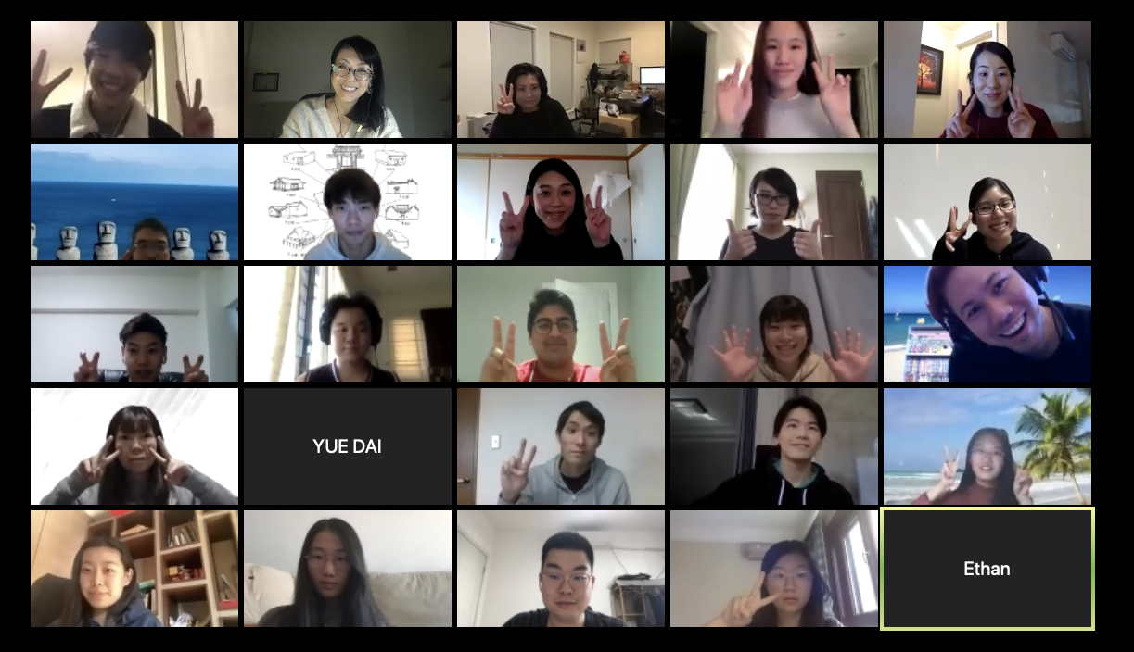
Joint Session in Beginning level Japanese course
Activity 1
① in 50 min. Class session → ② Final Presentation (CLAS)
Notes:
Misuzu sensei
(Next slide please)

Slide 26
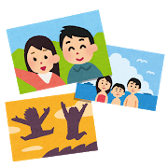
Time Table
(50 min.class)
Discussion in small group in 日本語 & English 5 min.for each language per topic
Getting to know each other
Presentation
Discussion１: Have you been to Japan / Canada? Exchange information of fun things about the places.
Discussion 2: Things you want to try in Japan/ Canada.
Notes:
Misuzu sensei
(Next slide please)

Slide 27
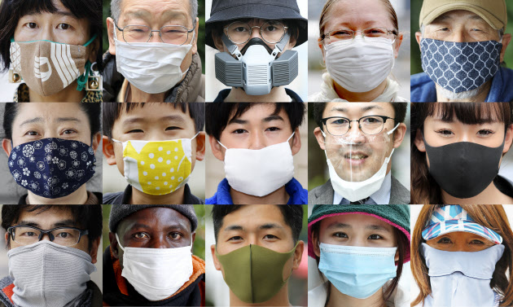
Activity ２
Participants
The 3rd-year students of Japanese at UBC Japanese learners of English at a partner institution
Asynchronous activity | Synchronous activity
Discussion boards on Canvas (prior to synchronous joint sessions) Written reflections in English (after synchronous joint sessions) | Discussion on a given topic (cultural/social issues) in Japanese and English Covid-19 Subcultures Impact of social media
Notes:
Saori: This activity was implemented in my 3rd-year classes who paired with Japanese learners of English at a partner institution based in Vancouver. Asynchronous activity was to prepare students to formulate their opinions about a given topic and respond to their peer posts on Canvas discussion boards, prior to their participation in the synchronous zoom activity with Japanese native speakers who are learners of English. The purpose of the synchronous activity is to develop their linguistic and intercultural knowledge through discussion on cultural and social issues (such as Covid-19, subcultures, and impact of social media) in Japanese and English as the target languages. After the zoom conversation sessions, my students would return to the asynchronous activity where they write their reflections in English regarding their overall language-exchange learning with Japanese students and any evidence of learning through changing participation in these virtual communities of practice. (Next slide please)

Slide 28
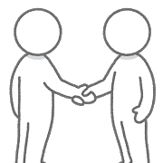
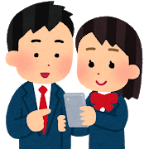
Student Reflections
1st-year Japanese class
I liked the Joint Session, and enjoyed talking with them. (x many) Their presentation was great! I enjoyed learning about them, school, tradition, and lifestyles in Japan. I want to go to Japan and see them next year. I want to keep in touch with them! → Use Canvas Catalog?
Notes:
Reflections from students
Misuzu
(Next slide please)

Slide 29
Student Reflections
3rd-year Japanese class
Impact of social media and influencers “It was definitely interesting to see a different take on influencers and how they differ from different cultures or countries. The cultural impact on how influencers behave and how they present themselves definitely became more apparent as I discussed it with the Japanese students. “ Difference in conversation structures between Japanese and English “Japanese people would always send out signals, such as nodding or saying “ええ？”“うん”“そう”etc., to let the speaker know that they are listening...We would usually let the speaker finish before commenting instead. I guess knowing this part of cultural difference is really important to understand the speaking culture in Japanese and do well in conversations.”
Notes:
Reflections from students
Saori For the 3-year Japanese class, I had students write their reflections in English about the synchronous sessions with Japanese students. Due to the time constraint, I’m only going to introduce a few of them. One student in my 3rd-year Japanese class commented on her discussion about the cultural impact of social media and influencers in different cultures and countries (READ). Another student talked about the difference in conversation structures between Japanese and English and what it takes to be good conversationalists of Japanese (READ). These excerpts show that participating in language-exchange interactions as mutual L2 communities of practice enabled students to gain new perspectives of values and practices of the target culture, while challenging and reflecting on their assumptions of cultural norms. (Next slide please)

Slide 30
Findings
The 1st year Japanese class
Gained confidence in speaking target languages
Expanded cultural view
Motivated to continue participating in future language-exchange activities
The 3rd year Japanese class
Growing empathy and respect for peer learners
Lowered anxiety in communicating in another language
Changes in participation from passive to more active speaker/listener
Shifting roles as expert and novice for exchanging intercultural knowledge
Exposure to turn-taking structures and language resources that are normally unlearned in classroom instruction
Notes:
Misuzu sensei Our findings drawn from student reflections on the synchronous activity are as follows:
For the 1st-year Japanese classes, the students….
Saori For the 3rd-year Japanese classes, the socialization with speakers of the target language enabled students to have more empathy and respect for their peers as they share the experience of learning a foreign language. This experience also helped to lower learner anxiety in communicating in another language and to demonstrate changes in participation from being passive to more active speaker and listener. Another finding is that participants are constantly shifting their roles as expert and novice for exchanging intercultural knowledge; for example they were able to learn a new set of phrases and expressions that are specific to the Covid-19 when they were discussing different measures against the spread of coronavirus adopted by Japanese and Canadian governments. One Japanese student commented that she learned a new Japanese word ‘kimehara’ from a Japanese-learning peer who is more familiar with Japanese animation than herself. Lastly, interacting with native speakers of the target language allowed students to observe turn-taking structures of conversation and language resources that are normally unlearned in classroom instruction. (Next slide please)

Slide 31
Pedagogical implications
Learners transcend their assumption of cultural norms to gain new perspectives of values and practices of the target culture as situated knowledge
Shift of learners’ roles as both expert and novice by creating learning and teaching opportunities for both participants
Potential of tandem learning for the development of linguistic, interactional and intercultural competencies
Notes:
As the pedagogical implications of our projects, the language-exchange interactions with the speakers of the target languages served a situated learning context that enabled students to transcend their assumption of cultural norms and gain new perspectives of values and practices of the target culture. In such learning contexts, there was evidence in which the learners of Japanese and English shifted their roles as both expert and novice by creating learning and teaching opportunities for both participants. In conclusion, our projects informed the potential of tandem learning for the development of linguistic, interactional and intercultural competencies in second language education. (Next slide please)

Slide 32
Thank you!
Notes:
This is the end of our presentation. Thank you!

Slide 33
Equity, Diversity, and Inclusion (EDI) Programming
with an
Intercultural Lens
___________________________________________
Joenita Paulrajan Phd, UBC Extended Learning

Slide 34
Context
Nearly three decades of programming to increase intercultural competencies
Online courses for adult learners from various professions and across sectors
Based on peer learning and with an emphasis on theoretical framework, reflection, and practical application
Building knowledge, skills and awareness of cultural differences
A critical focus on power, privilege, and identity

Slide 35
Scenarios
Holding a senior leadership position and uncertain of the differences between equity, diversity, and inclusion.
Succession planning and wanting to consider candidates from diverse backgrounds but challenged by unemployment realities faced by members of their own mainstream culture.
Working with international students and wanting them to ‘succeed’ but uncertain of the distinctions between assimilation and adaptation.
Recognizing the lack of representation in the workplace.

Slide 36
Challenges and Opportunities
Recognizing the importance of centering race
Extending beyond the individual to systemic issues
Having a more nuanced understanding of center and margins
Increasing awareness of biases and uncertainties around one’s own approach to EDI
Language and terminology to talk about equity from an intercultural perspective
Increasing capacity to have an impact on systems within communities and organizations
Networking to break the silos of isolation when doing this work

Slide 37
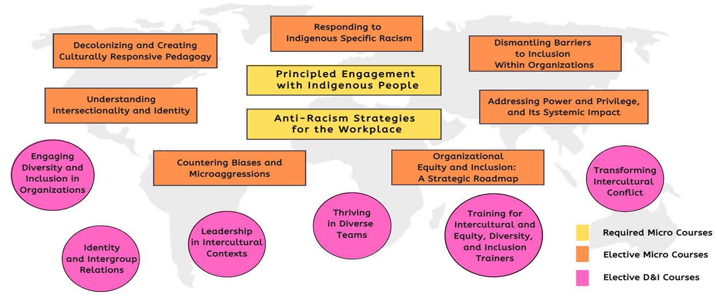
UBC Certificate in Equity, Diversity, and Inclusion
For more info: Equity, Diversity, and Inclusion | UBC Extended Learning (ExL)

Slide 38
Thank you

Slide 39
Feel free to reach out to continue the conversation:
Brianne Orr-Álvarez: brianne.orr@ubc.ca
Strang Burton: strang.burton@ubc.ca
Luisa Canuto: luisa.canuto@ubc.ca
Misuzu Kazama: mkazama@mail.ubc.ca
Saori Hoshi: shoshi01@mail.ubc.ca
Joenita Paulrajan: joenita.paulrajan@ubc.ca

