Slide 1
Using the Arts Remote Teaching Template in Your Canvas Course: Setup Tips & Use Cases
Arts ISIT & CTLT
August 12, 2020
As you arrive and wait for the session to start, please introduce yourself in the chat and let us know what you are expecting from today’s webinar.

Slide 2
welcome
  Arts ISIT is hosting webinars all summer to support your online teaching needs, from course delivery to assessment technologies. For more information, please see https://isitworkshops.arts.ubc.ca.
  Please share any questions on https://app.sli.do/event/elzyjs9f and vote on the ones you want answered. A Q&A discussion will take place at the end of the session.
  This webinar will be recorded and uploaded to the ISIT website. Please be mindful of any private information and anonymize personal details about specific students.
  Your cameras and microphones have been disabled to help save on bandwidth.

Slide 3
Presenter INTRODUCTION
  Presenters
    Jason Myers, Faculty Liaison at CTLT
    Bosung Kim, Learning Designer at CTLT
    Meena Kahlon, Educational Technologist at Arts ISIT
    Sara Shneiderman, Associate Professor at the Department of Anthropology and School of Public Policy & Global Affairs
    Zoe Lam, Sessional Lecturer at the Department of Asian Studies
  Topic
    Arts Remote Teaching Template, a blank framework for your Canvas course with useful materials like student resources and surveys
    Arts Remote Teaching Demo, a sample course with modules and assessments
    Practical tips on how to use the Template for your Fall courses
    Instructor experiences with the Template

Slide 4
Jason myers (CTLT)

Slide 5
Student Challenges
  Staying Motivated – Online students can feel isolated. Both instructor and peer interaction are important, but instructor presence is especially important.
  Staying Focused – Online learning requires more self-direction. Clear organization and consistent communication are important to keep students engaged and on track.
  Managing Time – Students often have trouble keeping track of what to do and when to do it, especially across multiple courses. Certain learning activities may take more time.

Slide 6
Focus on Learning Goals
  Align course elements with learning goals to focus student and instructor time on the areas where it will be most meaningful.
Learning Goals
Teaching & Learning Activities
Feedback and Assessment
L. Dee Fink, Creating Significant Learning Experiences

Slide 7
  SIMPLIFY

Slide 8
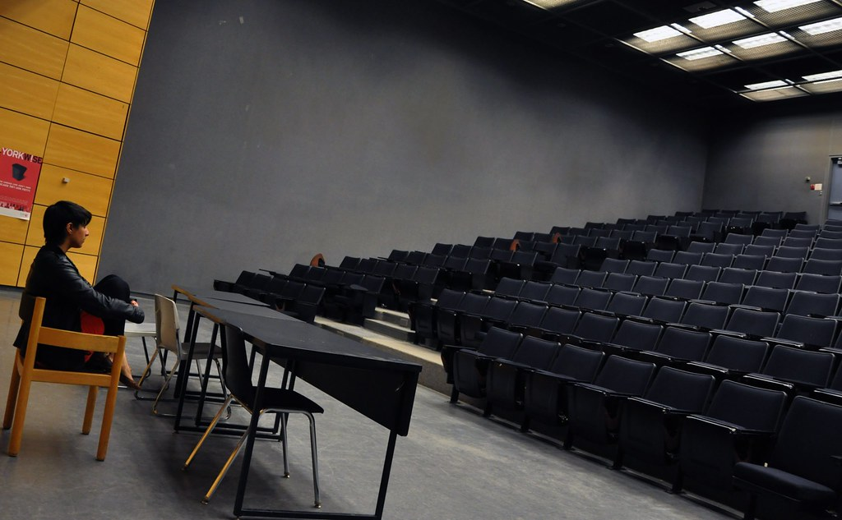
Social Presence
Humanizing the non-human online space
"Silence" by Sixth Lie is licensed under CC BY-NC-ND 2.0
Notes:
Studies show that students appreciate informal class videos that reveal your personality (Guo, 2013; Cavanagh, 2016)

Slide 9
Interaction and Social Presence
Student/Student
Student
Student/Content
Deep and Meaningful Learning
Student/Teacher
Content
Teacher
Teacher/Content
Modes of Interaction in Distance Education from Anderson and Garrison, (1998).
Notes:
Anderson, T. (2003). Getting the Mix Right Again: An Updated and Theoretical Rationale for Interaction. The International Review of Research in Open and Distributed Learning, 4(2). https://doi.org/10.19173/irrodl.v4i2.149

Slide 10
Assessment and Feedback
Frequent checkpoints for students to check their knowledge and for the instructor to see how students are doing
Important to provide timely feedback throughout the learning process, not just in summative or graded work
(Hattie & Timperley, 2007; Shute, 2008; Ambrose et al, 2010)
“…online students would like to receive more instruction from their professors and more comprehensive feedback that would allow them to engage in corrective behaviors to improve performance.”
Gaytan, 2015
Notes:
Jorge Gaytan (2015) Comparing Faculty and Student Perceptions Regarding Factors That Affect Student Retention in Online Education, American Journal of Distance Education, 29:1, 56-66, DOI: 10.1080/08923647.2015.994365

Slide 11
Inclusivity and access
Be mindful of external factors – Students have different living contexts in different locations. They may be experiencing anxiety. Be mindful and provide extra flexibility.
Accessible course design – Make sure materials are accessible and be mindful of differing access to technology.
Access to support – Provide access to support resources and information about accommodations
Build flexibility into your design where possible!

Slide 12
How to use the template
  Planning materials and resources
  Demo Site
  Template Site

Slide 13
Organizing your course materials
  Chunking into modules – Try to organize by weekly modules or topics. Include a clear schedule and weekly announcements.
  Consistent structure – Pick one module to prototype in order to fine tune the structure then copy to other modules.
  Time – Think about student time each week and where due dates are clustered. Try to balance synchronous and asynchronous time and allow for student flexibility.

Slide 14
Course Map

Slide 15
 | Asynchronous | Synchronous
Student/ Content | Short, lecture videos Self-assessment quizzes Readings | Presentation of content Poll questions / classroom response questions
Student/ Student | Discussion forum activities Group activities Peer feedback/ assessment Sharing projects | Breakout room discussions Group presentations
Instructor/Student | Weekly announcement posts or videos Discussion forum moderation and responses | Group question and answer Explaining requirements, due dates, expectations

Slide 16
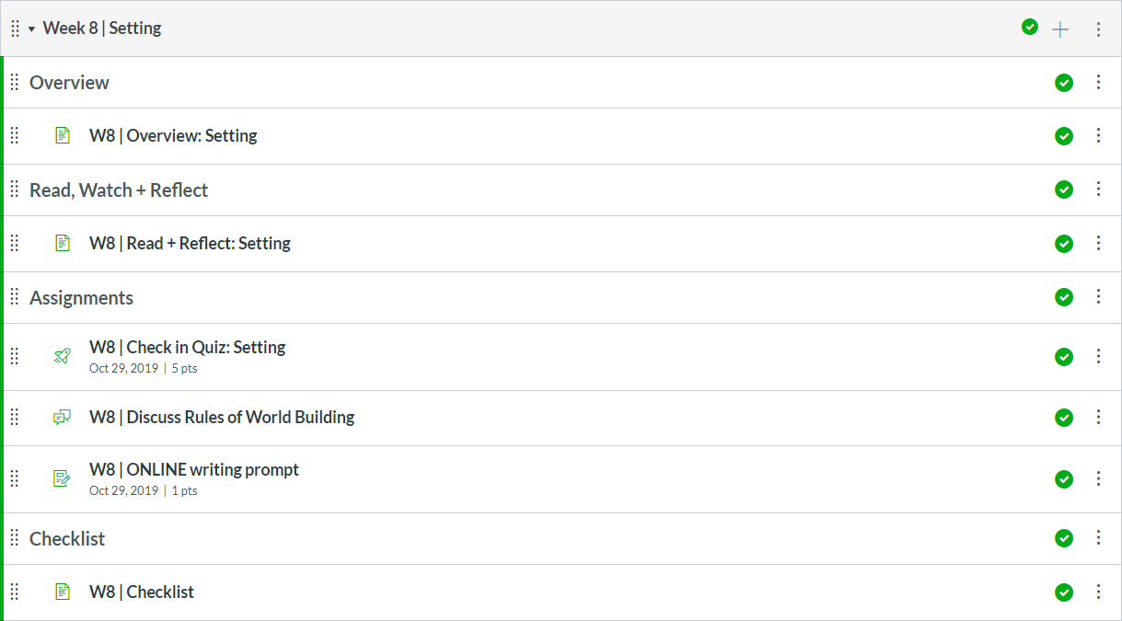
Example of a Module
CRWR 209 – John Vigna and Annabel Lyon

Slide 17
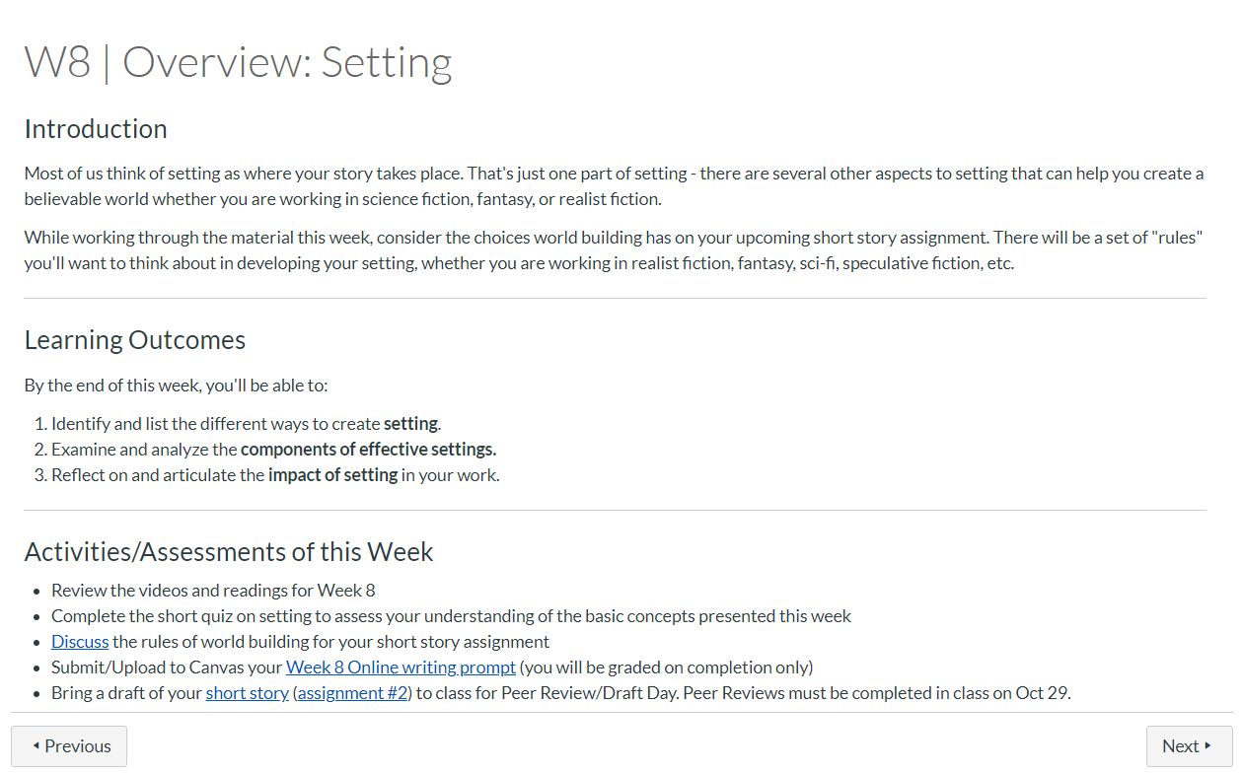

Slide 18
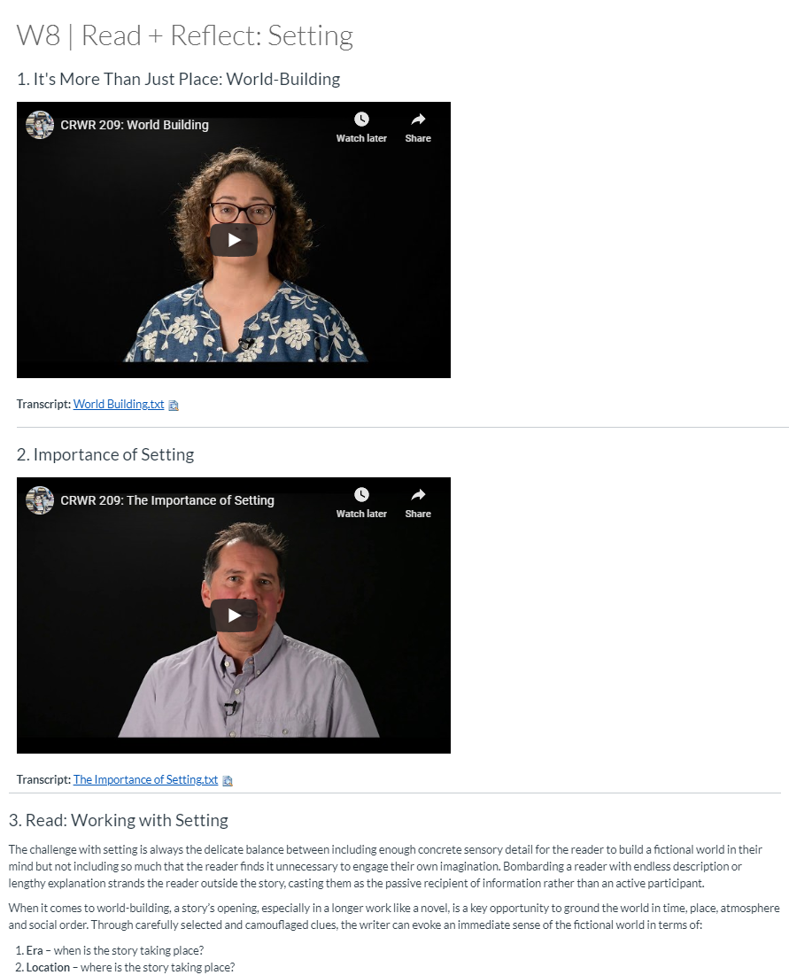

Slide 19
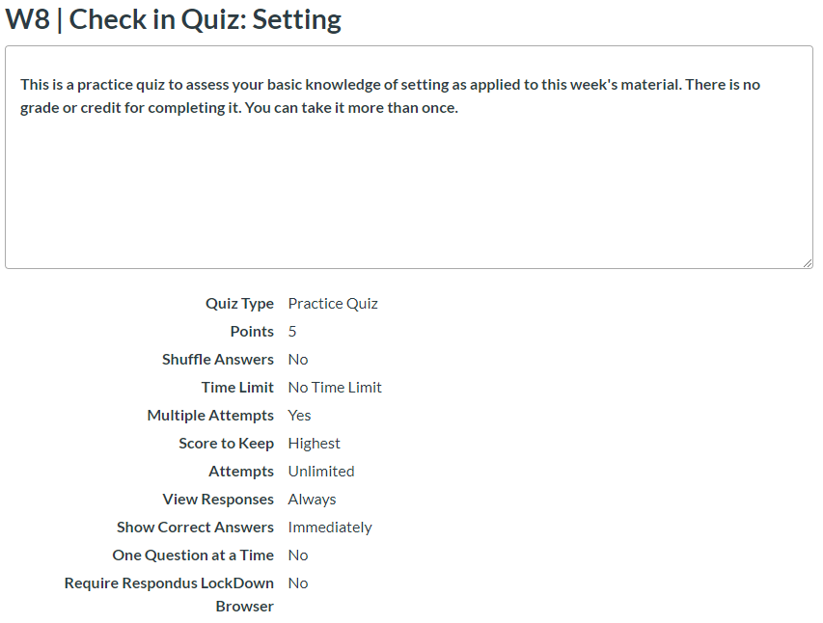

Slide 20
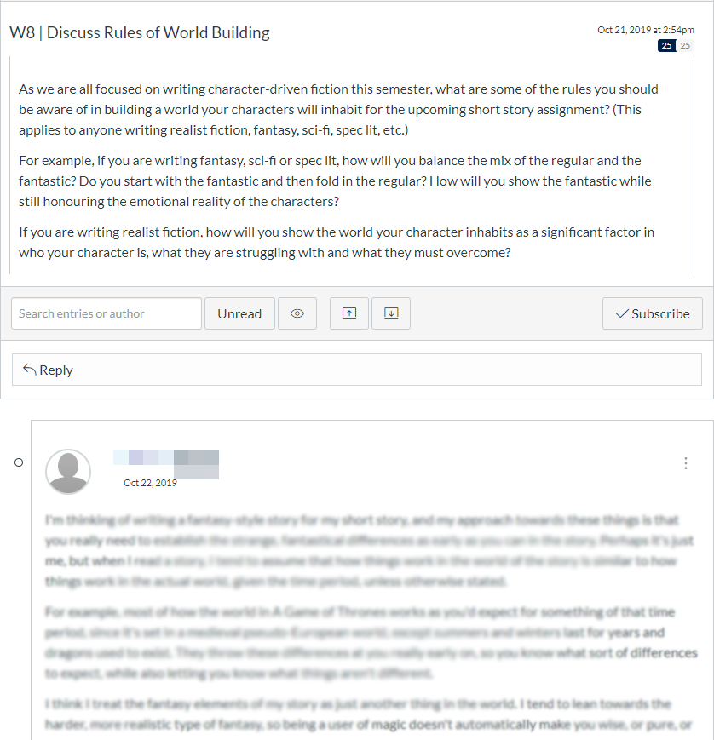

Slide 21
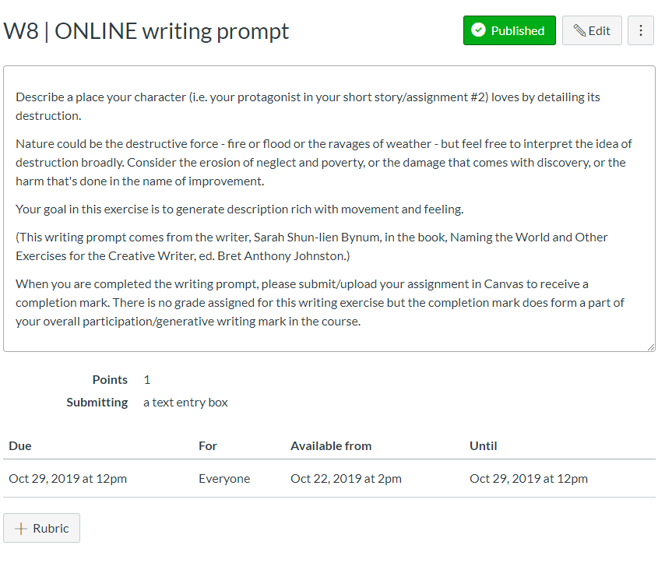

Slide 22
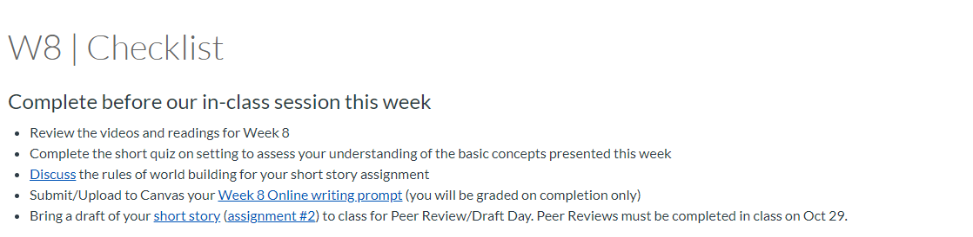

Slide 23
Bosung kim (CTLT)

Slide 24
Faculty presenters:
Sara shneiderman & zoe lam

Slide 25
Template import demo:
Meena kahlon (arts isit)

Slide 26
Q&A Discussion
  To participate:
    Please share any questions on https://app.sli.do/event/elzyjs9f, and comments in the chat.
    Raise your hand if you would like to speak.
  Reminder: This session is being recorded.
    Please anonymize any student information in your discussion.
    If you have any questions that cannot be anonymized, please email us at arts.helpdesk@ubc.ca and we will follow-up with you.

