Slide 1
Practical Strategies for Student Management in Mid- to Large Classes: Engagement, Assessments, and Feedback
Silvia Bartolic
August 6, 2020
As you arrive and wait for the session to start, please introduce yourself in the chat and let us know what you are expecting from today’s webinar.

Slide 2
welcome
Arts ISIT is hosting webinars all summer to support your online teaching needs, from designing online courses to creating engaging assessments using UBC-supported technologies. For more information, please see https://isitworkshops.arts.ubc.ca.
Please share any questions using the chat. A Q&A discussion will take place at the end of the session.
This webinar will be recorded and uploaded to the ISIT website. Please be mindful of any private information and anonymize personal details about specific students.
Your cameras and microphones have been disabled to help save on bandwidth.

Slide 3
Presenter INTRODUCTION
Silvia Bartolic
Associate Professor of Teaching & Undergraduate Chair (Department of Sociology)
Topic
Checklist of pre-course tasks
Techniques that encourage & maintain student engagement
Recommendations for course design that help reduce grading loads & maximize efficiency
Tips for optimizing teaching assistant support
Tools: Canvas, OnTask, iPeer

Slide 4
Practical Strategies for Student Management in Mid- to Large Classes

Slide 5
Workshop Objectives
By the end of this workshop, participants will be able to:
describe pre-course preparation tasks and available UBC resources to assist with these;
consider strategies to use in course design to help maximize course efficiency; and
examine ways to encourage and maintain student engagement.
Our goal is to consider these in the context of remote teaching and learning but most of what will be discussed can be applied to a face to face context as well.

Slide 6
Pre-course Checklist
Well before the start of classes, be sure to complete the following:
Create your syllabus (see UBC Senate syllabus template here).
Request a copy of your old Canvas course or a merge of cross-listed courses (arts.helpdesk@ubc.ca) or work in a new course shell.
Order textbooks and/or reading packages (access to the UBC bookstore service: UBC@verbasoftware.com or check your email for your personalized link).
Place your readings on course reserve via LOCR (https://courses.library.ubc.ca/).
Populate your Canvas (or other platform) course with content.
Confirm TAs/markers have been added to the Canvas course by departmental admin. (For temporary 2-week access, Arts ISIT can help you).
PUBLISH your Canvas course before the start of term!

Slide 7
Available Resources to Save Time
In Canvas Commons, download the remote teaching Canvas template developed by Arts ISIT
Designed to save you time
Link to register to the Arts Remote Teaching Template webinar
Arts ISIT has a demo site with guidelines
Link to self-enroll on Canvas
Pre-course and midpoint student surveys are available on this demo site
Provides info about your students as well as what is working/not working before it’s too late to change
The library can put your readings on reserve for you if you send your syllabus or reading list IN ADVANCE

Slide 8
Don’t forget
Students may be accessing your course from different time zones – plan course design accordingly (e.g.. choice in assignments; recording lectures)
Order textbooks/course packs early so students can purchase and receive by mail in time; consider electronic options
Email students SOON via the Faculty Service Center your course reading list so they can order books ahead of time (Canvas courses open too late to be useful for those not in the Vancouver lower mainland)
Check links in your course to be sure they all work when accessed remotely
Consider lower tech options – not all students have reliable high speed internet

Slide 9
Course Design to Maximize efficiency and Engagement

Slide 10
Organization is Essential!
In an online context you need to be MORE organized than ever
BE CONSISTENT and no last minute changes
Everything should have a PURPOSE
Checklist:
Do students know how to contact you and when you are available? (on syllabus and course site?)
Have you CLEARLY indicated WHEN and WHERE class will be held? (on syllabus and course site?)
For synchronous sessions, plan to record and explain how to use use the software (e.g.. Zoom, Collaborate Ultra)
Are your assessment due dates clearly indicated on the syllabus and course site? Is it obvious where and how to submit assignments?
Have you considered time zone challenges? Do you have an alternate plan for those who can’t meet synchronously in local time?
TIP: Set up step by step course modules

Slide 11
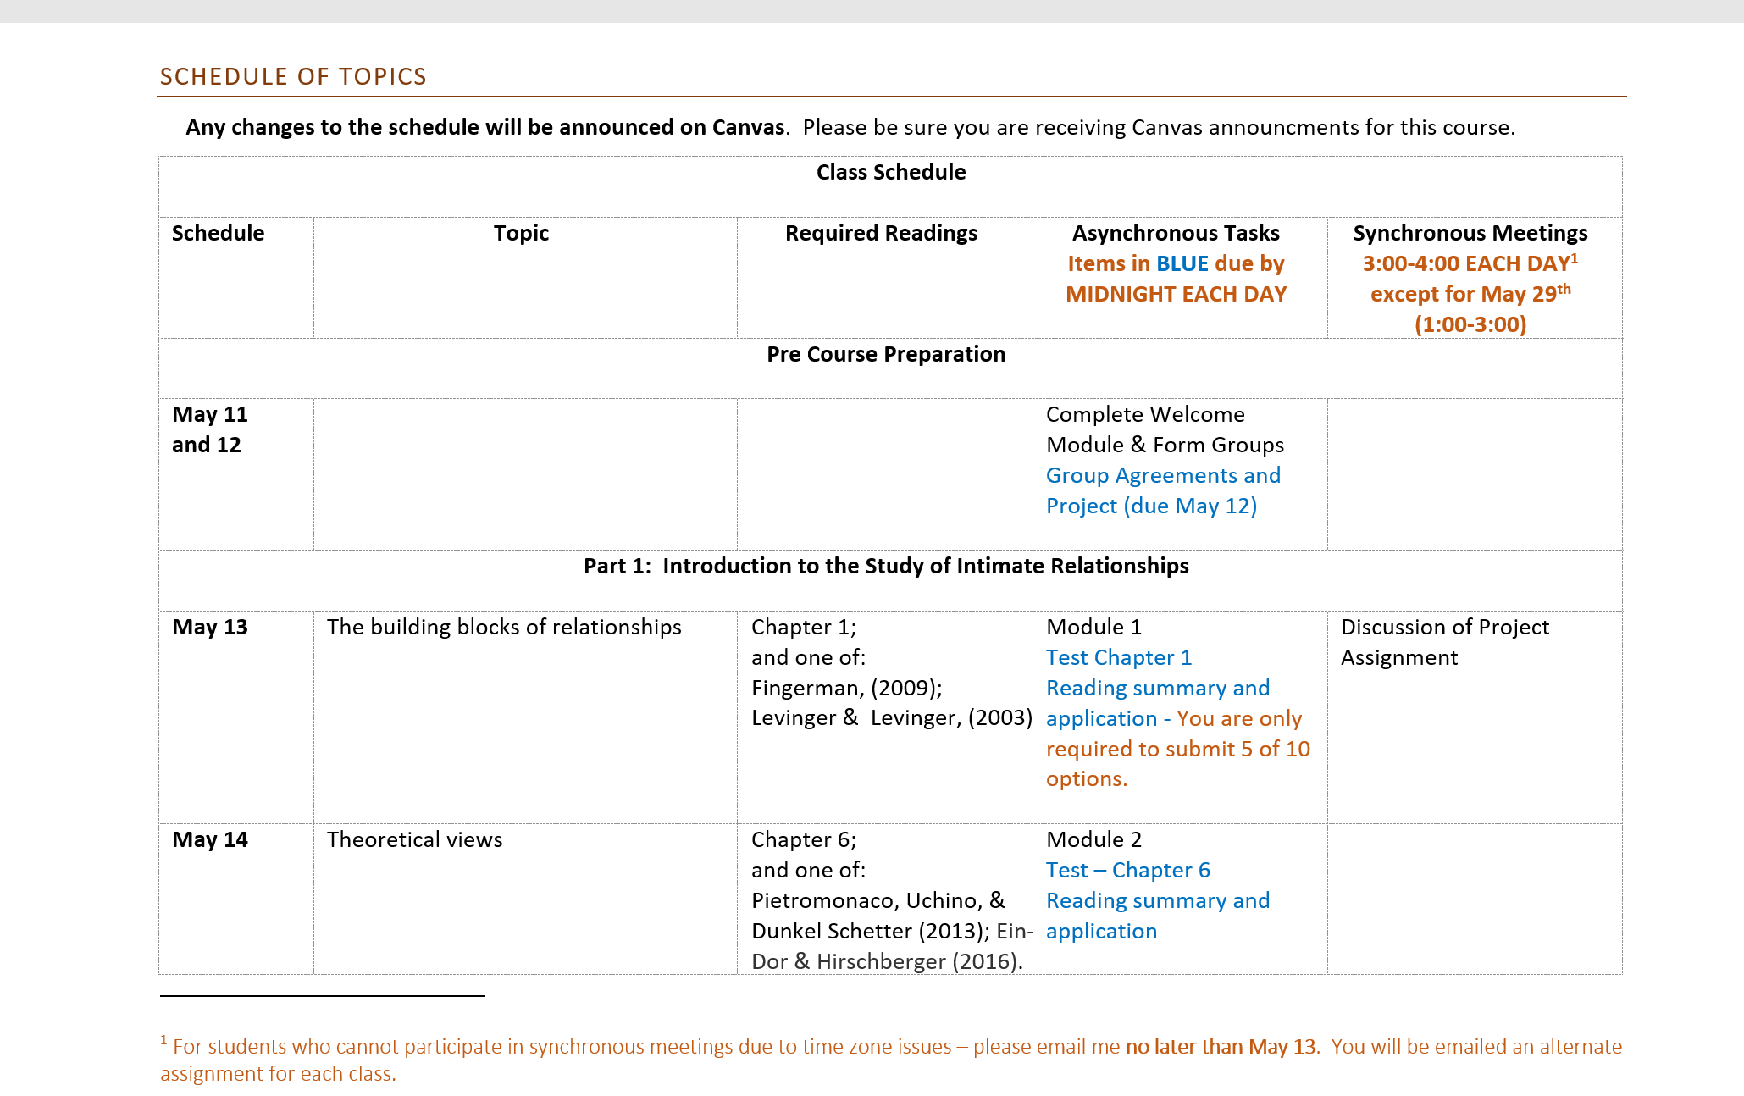
Start with the Syllabus

Slide 12
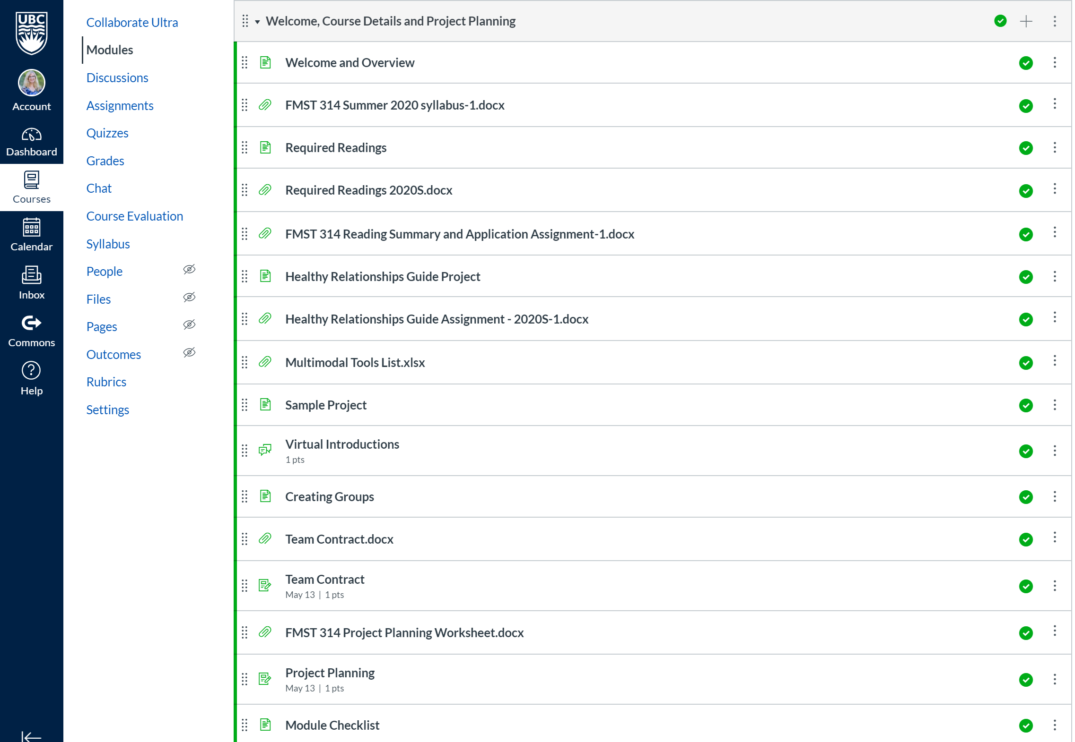
Repeat it in your welcome Module

Slide 13
Repeat it in your welcome message

Slide 14
Decide what to do asynchronously versus synchronously
Create SHORT (video) lessons for asynchronous sessions
These can provide the foundation for work done in synchronous sessions
Be creative here – it doesn’t have to be YOU TALKING – video lecture, podcasts, guided reading questions, movie clips, annotated PowerPoint, news articles etc.
Embed learning objectives and ‘test your knowledge’ questions
Be mindful of how long it will take students to complete these tasks
Create low stakes assignments around asynchronous tasks so that they are actually completed (e.g.. quiz, reflections) or use these to scaffold into a larger assignment
Think flexibly with time

Slide 15
Help students help each other, Connect and Save time
Consider group work – can save you time and help students form support relationships
Help students form groups (e.g.. guided introduction thread, speed meeting in synchronous meeting rooms, google doc with rough topic areas – include section for time zone)
Canvas project groups
Consider peer review – this can be low stakes (e.g.. reviewing draft or one section of an assignment) or not for grades
Be sure to provide training (e.g.. a sample to review together) and a rubric
Use team member assessment (e.g. via iPeer https://ipeer.elearning.ubc.ca/) to prevent ‘free rides’
Begin with team contract/project planning
Canvas peer review

Slide 16
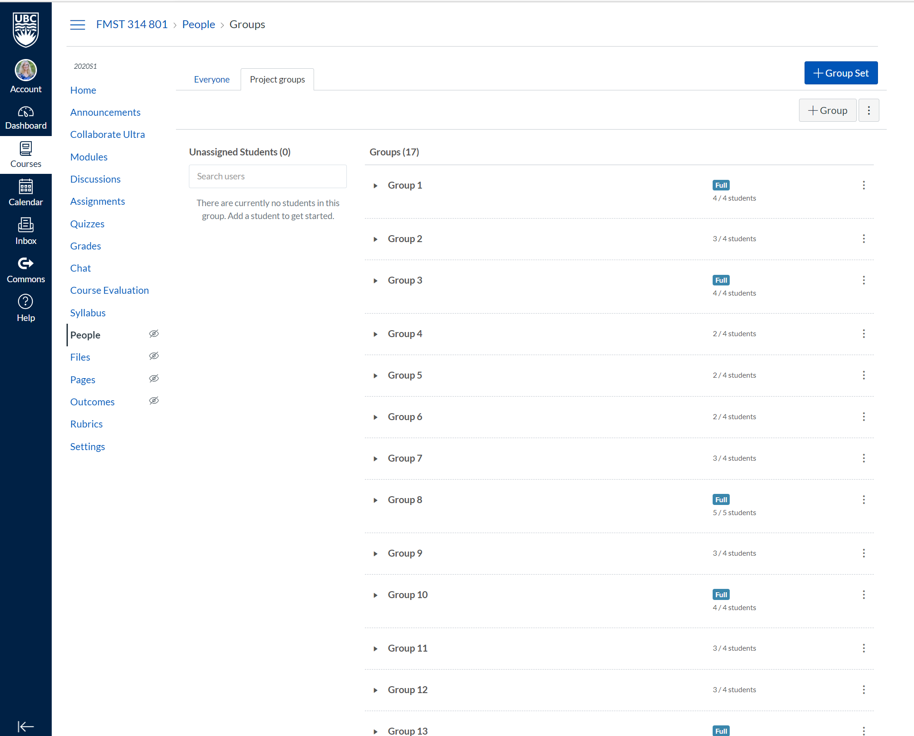
Setting up Groups in Canvas

Slide 17
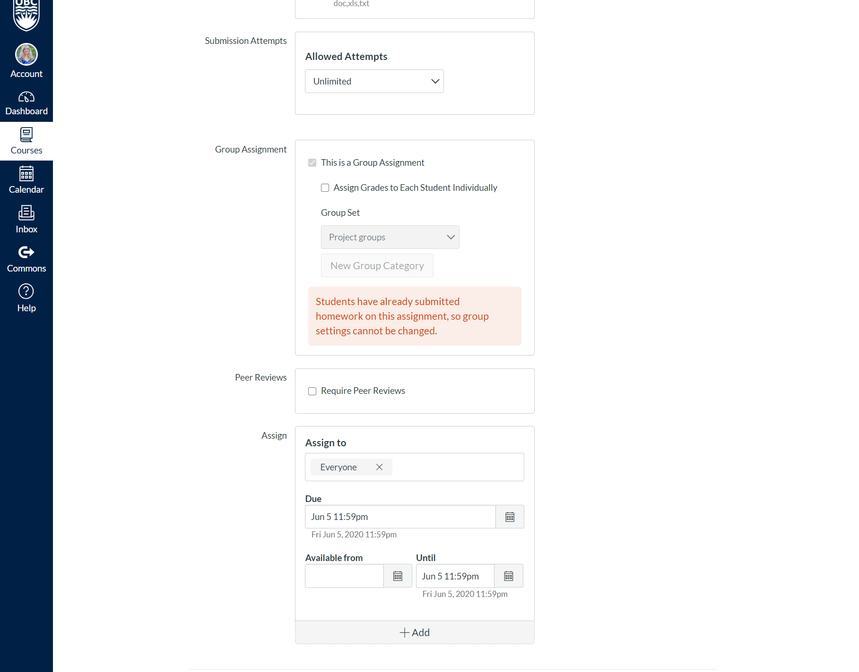
Canvas Peer Review

Slide 18
Rethink your assessments
You cannot prevent cheating on exams in an online context!
Use quizzes as low stakes preparation or knowledge checks
Consider alternate assessment strategies to assess learning objectives
E.g. Multimodal assessments (see BeyondText, a new online resource for multimodal projects)
Includes project ideas, rubrics, tips and best practices, tools list and videos for decision making

Slide 19
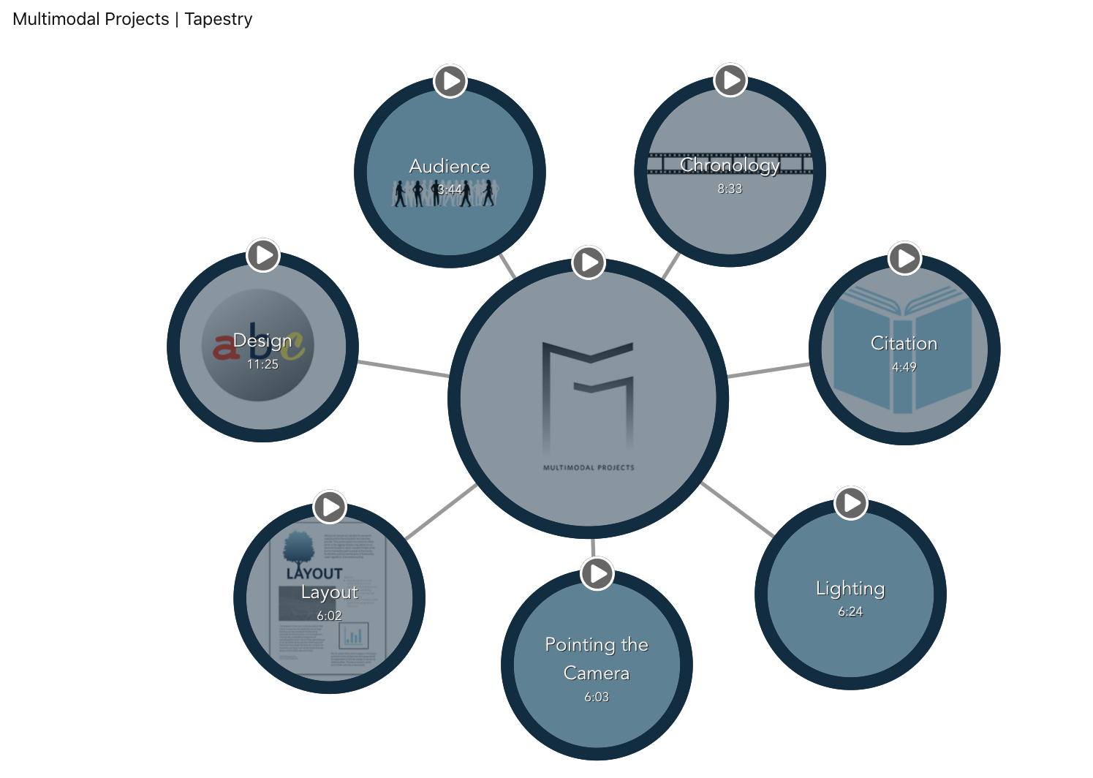
Videos in Canvas Commons and Tapestry

Slide 20
Use Rubrics and Markers
Engaging students online requires incentives (marks)!
Provide points for doing synchronous (group) work – active learning activities
Make these low stakes and simple to grade (not completed, completed minimally, completed well: e.g.. 0, .5, 1 point)
Ask for/use a marker for this!

Slide 21
Using TAs and Markers wisely
TAs are critical in helping you establish and promote course engagement
Have them attend synchronous parts of your course
Work as co-hosts on a radio show – when there is silence, the TA can step in with ideas or additional questions
Have the TA monitor break out rooms with you
Do this randomly so students are exposed to both of you
Have the TA monitor the chat while you are facilitating discussion
TAs can reduce your grading load
Provide a rubric for assignments
Have TAs help you at the early stages (e.g.. checking project topics/thesis statements)
Have TAs provide comments for you (if unable to provide the grade)
Use a marker (or your TA) for low stakes work

Slide 22
Consider Student Wellbeing
Download Student Wellbeing: UBC Wellness Resources module from Canvas creative commons
Set up an ‘open’ virtual space where students can gather informally
An open session in Collaborate Ultra; a longer zoom session
Pop in (you and/or the TA) from time to time for informal discussions
Start your synchronous sessions early and run late so students can informally chat (you don’t have to be there until start time)
Check in with personalized feedback…

Slide 23
Consider Personalized feedback for Relationship building and engagement
There are a number of ways to provide personalized feedback
Guiding questions for incorrect quiz responses (added when setting up the quiz – something your TA can do!)
Canvas email to individuals or groups
Message Students Who – in Canvas gradebook
OnTask – linked to Canvas student list
Course announcements are NOT personal!

Slide 24
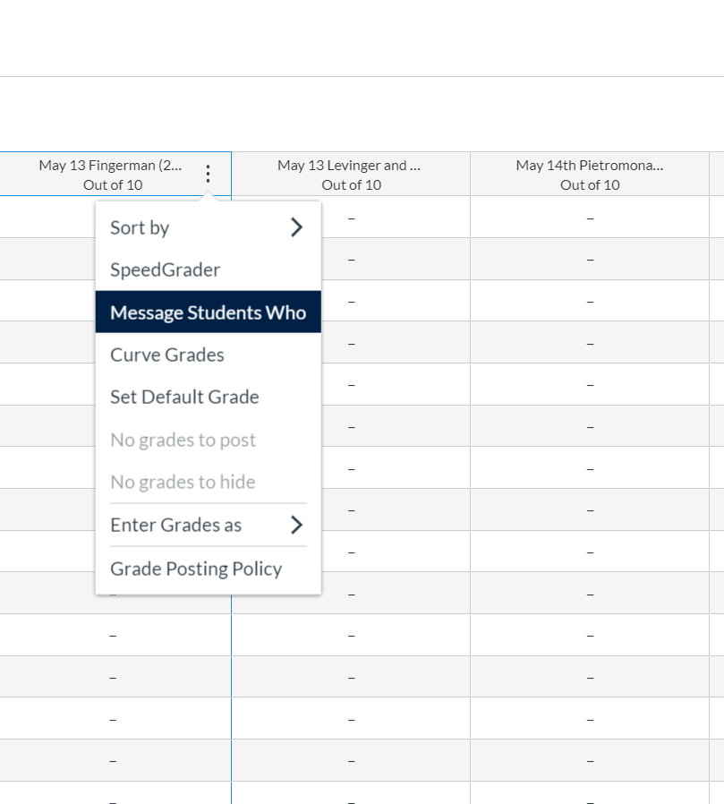
Canvas Message Students Who

Slide 25
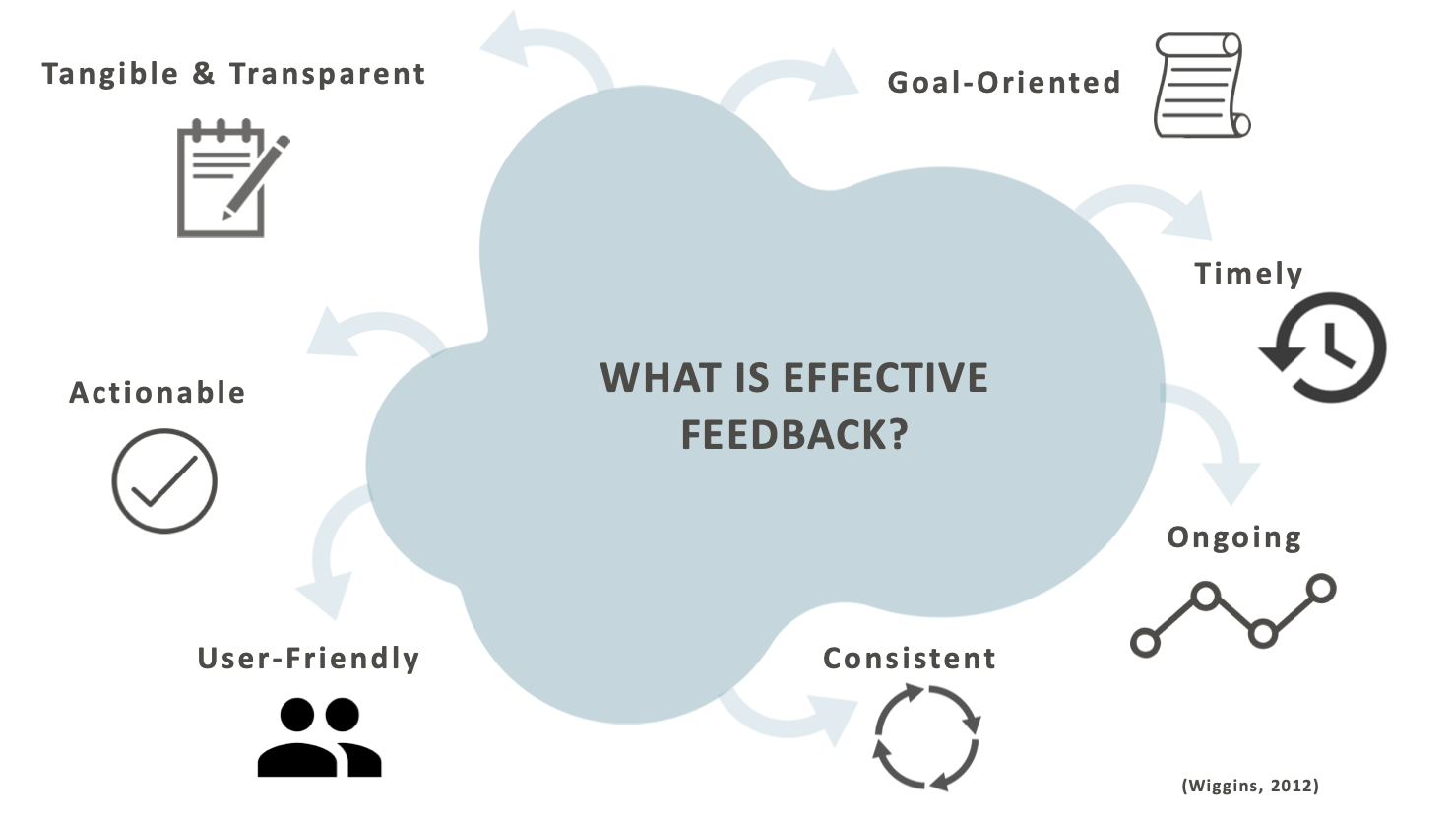
OnTask
Demo of OnTask: https://blogs.ubc.ca/effectivefeedback/what-is-ontask/
Personalized feedback AT SCALE based on student data
Saves time and helps increase engagement

Slide 26
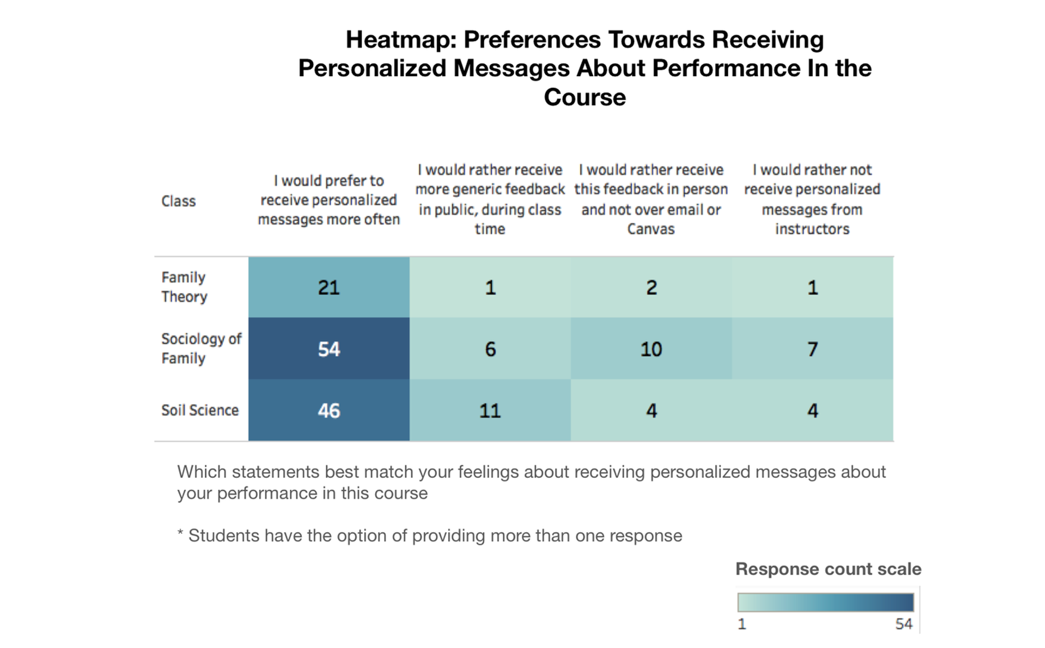
Pilot Data Shows Students Want this feedback

Slide 27
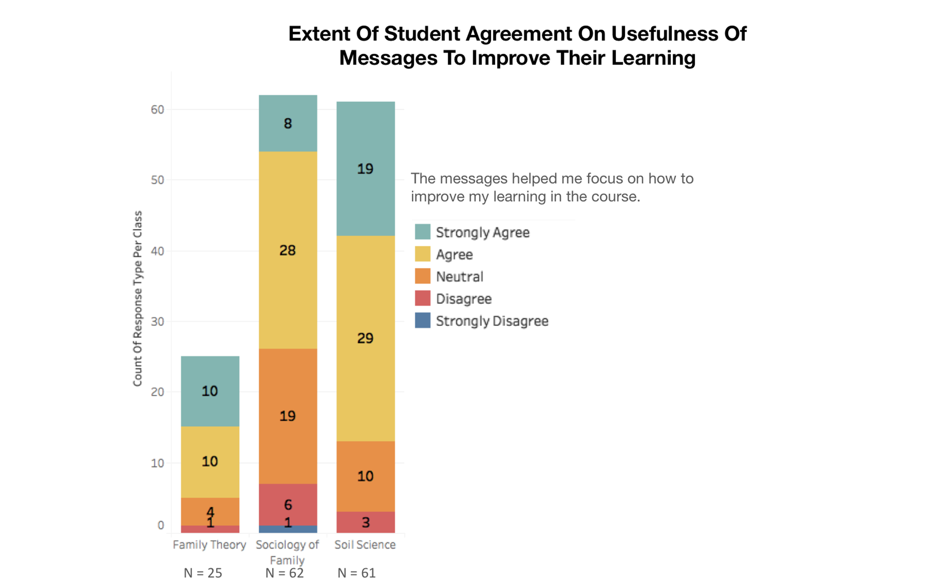
Student Perceptions of Learning Improvement

Slide 28
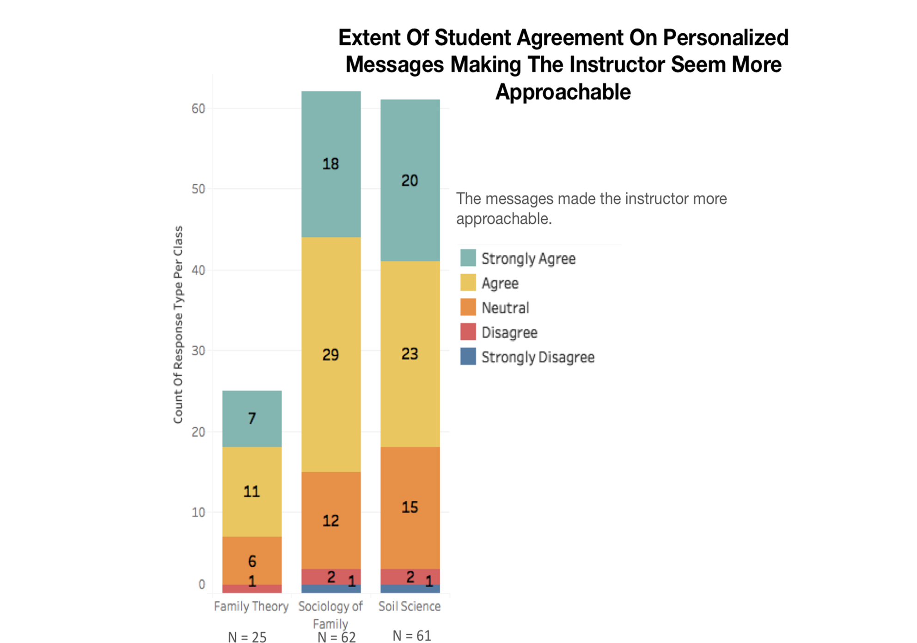
Student Perceptions of Instructor approachability

Slide 29
How to access Ontask
Contact the Learning Technology Hub
Join our TLEF assessing OnTask (term 1 or 2 courses)
Bartolic@mail.ubc.ca

Slide 30
Reminders
Use available resources to save time
Be organized and consistent in course design
Be creative and flexible with class time
Consider group work and peer review
Consider non-exam based assessments
Use TAs/markers strategically
Use rubrics
Provide informal spaces for students to interact
Use personalized feedback

Slide 31
Q&A Discussion
To participate:
Use the built-in chat to share any questions, comments, and resources.
Raise your hand if you would like to speak.
Reminder: This session is being recorded.
Please anonymize any student information in your discussion.
If you have any questions that cannot be anonymized, please email us at arts.helpdesk@ubc.ca and we will follow-up with you.

