Slide 1
The Chinese Language Program's Response Plan to COVID-19: Building an Online Language Learning Community
Hsiang-ning Sunnie Wang
July 20, 2020
Notes:
Before UBC announced all courses were to be moved online, all of our instructors were notified to be prepared for a huge change when we heard many schools in the US closed their campuses, and invited the Arts ISIT to host an online teaching and learning workshop specifically tailored for language instructors.
Since this change involved 1700 students taking Chinese language or literature courses, we moved very fast. In our Chinese language courses, what quickly came to our mind is--
How can we help our instructors who mostly had no online teaching experiences learn to teach online classes in such a short time?
What do we need to do to keep up the good quality of teaching and students’ engagement through effective teaching?
How do we make the whole team work closely with one another to get through this? What can we do to ensure the wellbeing of students, TAs and instructors?

Slide 2
welcome
Arts ISIT is hosting webinars all summer to support your online teaching needs, from designing online courses to creating engaging assessments using UBC-supported technologies. For more information, please see https://isitworkshops.arts.ubc.ca.
Please share any questions using the chat. A Q&A discussion will take place at the end of the session.
This webinar will be recorded and uploaded to the ISIT website. Please be mindful of any private information and anonymize personal details about specific students.
Your cameras and microphones have been disabled to help save on bandwidth.

Slide 3
Presenter INTRODUCTION
Sunnie Wang, Instructor & Program Coordinator of Chinese (ASIA)
Chinese Language Program’s detailed Action Plan for transitioning to remote learning
Technology training for instructors, revising pedagogy, creating a more holistic online language learning community through wellbeing support networks & student care in the curriculum
Learnings & experiences from building online language learning community and technology examples

Slide 4
The Chinese Language Program's Response Plan to COVID-19

Slide 5
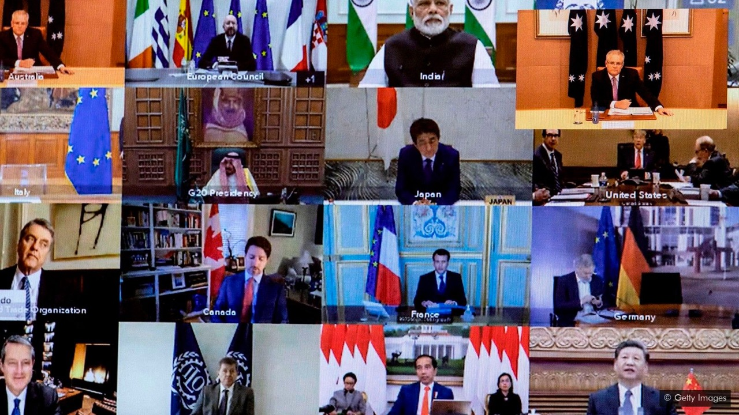

Slide 6
Thank you for coming to today’s webinar
Please tell us:
Who are you?
Which department/program are you associated with?
Why are you attending this webinar?

Slide 7
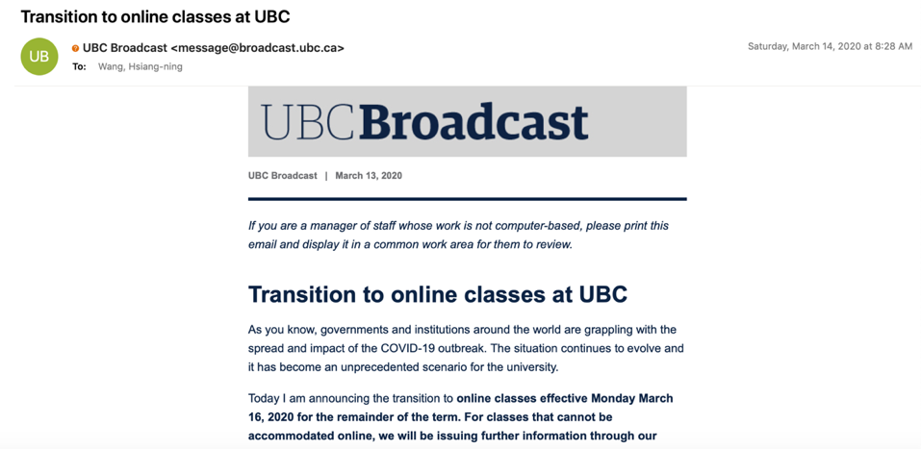
Life Changing Date：Saturday, March 14

Slide 8
When we have to move ALL courses online in mid March…
Students
？
Notes:
Given the situation that most instructors have zero experience teaching online courses, we rapidly started several crucial tasks:
All instructors have been working closely as a strong team and trying their best to provide students with a positive online learning experience. Here is what we have accomplished up to now—

Slide 9
When we have to move ALL courses online in mid March…
How can we make sure everything and everyone is interconnected and not falling apart?

Slide 10
When we have to move ALL courses online in mid March…
Wellbeing of our three key players:
instructors, TAs and students

Slide 11
When we have to move ALL courses online in mid March…
Students
(1) Teaching/ Instructors
Tools
TA support
(3) Online community
(2) Effective Teaching for Learning/
1. Syllabus, Workload, Learning Goals
2. Materials
3. Infrastructure

Slide 12
When we have to move ALL courses online in mid March…
Students
(1) Teaching/ Instructors
Tools
TA support
(3) Online community
(2) Effective Teaching for Learning/
1. Syllabus, Workload, Learning Goals
2. Materials
3. Infrastructure

Slide 13
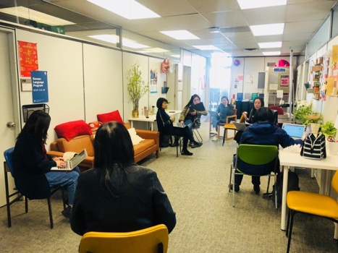
(1) Teaching:
Offer online course training to BOTH instructors and TAs
Arts ISIT Workshop
Online teaching workshop tailored for language instructors
2. Adjust TA’s work and provide instructors extra tech and TA support
Tech mentorship (instructor→ instructor)
TA tech training team (TA→TA)

Slide 15
Instruction website: https://sites.google.com/view/clpotws/home
Other instructions: https://drive.google.com/drive/folders/1UbKlZdb8iXObA33WEV9sz85IOs2CudLN

Slide 16
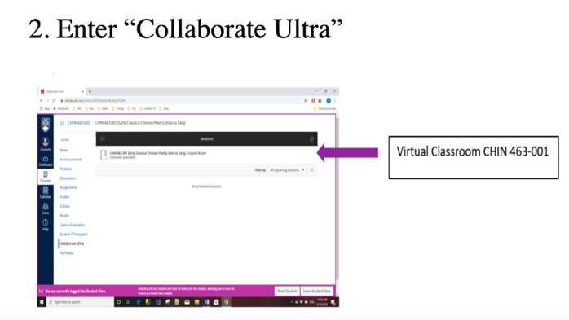
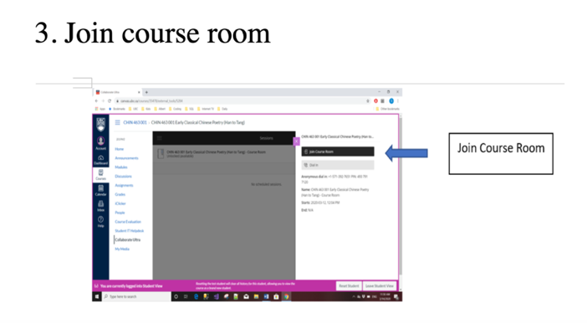

Slide 17
When we have to move ALL courses online in mid March…
Students
(1) Teaching/ Instructors
Tools
TA support
(3) Online community
(2) Effective Teaching for Learning/
1. Syllabus, Workload, Learning Goals
2. Materials
3. Infrastructure

Slide 18
(2) Teaching for Learning:
Revise all syllabi (change & non-change)

Slide 19
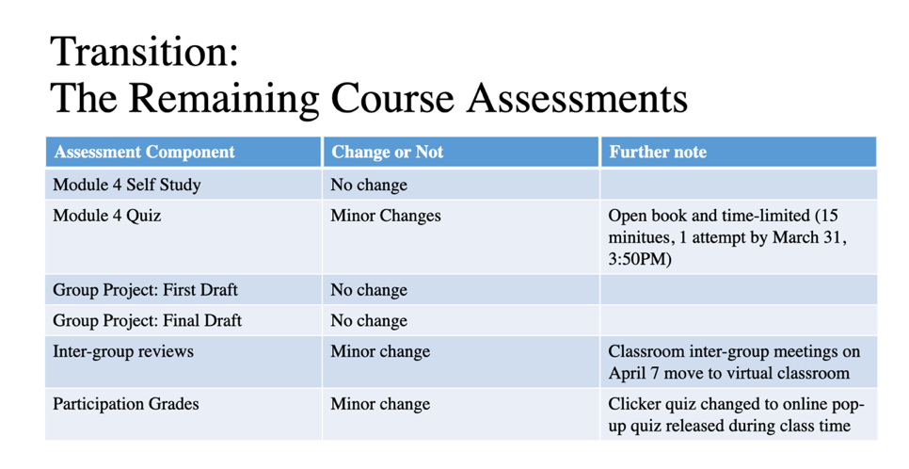

Slide 20
(2) Teaching for Learning:
Revise all syllabi (change & non-change)
Adjust student’s workload & reconsider students’ learning goals
Rethink of curriculum and pedagogy
Offer instructors useful tools, templates & basic materials
Public resources (grammar video)→ flipped course
Step-by-step “Getting Our Class Online” for BOTH teachers & students
4 self-study classes
1 trial online class
Notes:
We adopted the available online open resources for several courses at lower levels to make these course flipped courses in order to keep and even strengthen interactions between instructors and students in online classes without lecturing. The goals of these changes were to maximize total language practice since, for many of our students, class time is the only time and safe space to practice Chinese. Many instructors incorporate the current COVID-19 situation into their in-class discussion or after-class assignments, not only to understand students’ situations and thoughts, but also to build up their sense of being global citizens.

Slide 21
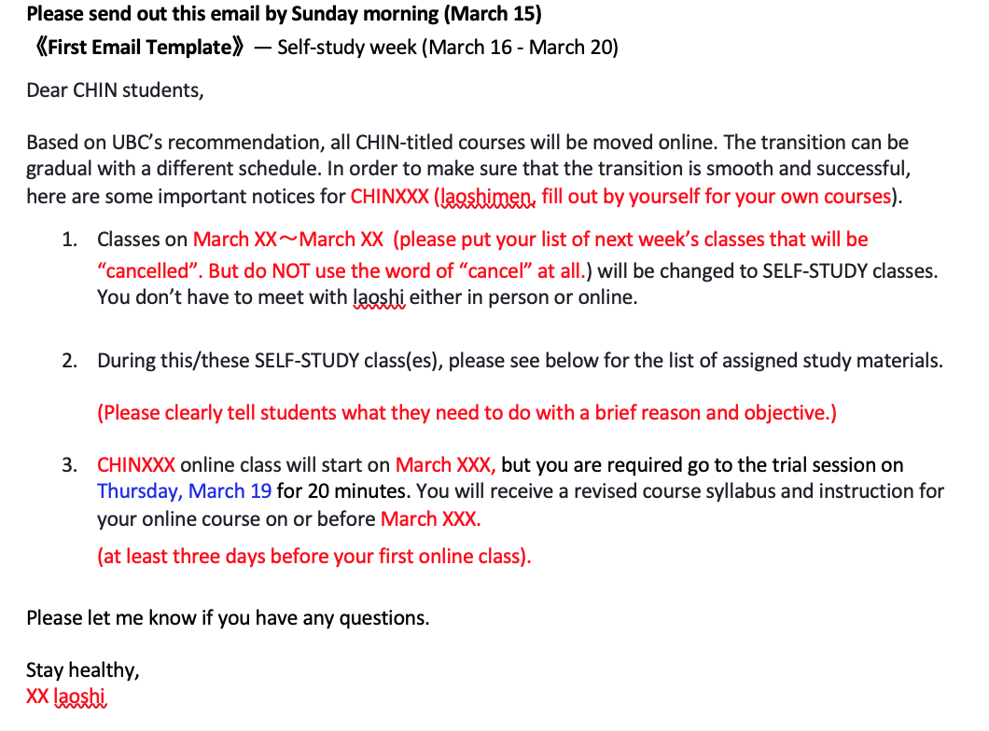
Email template

Slide 22
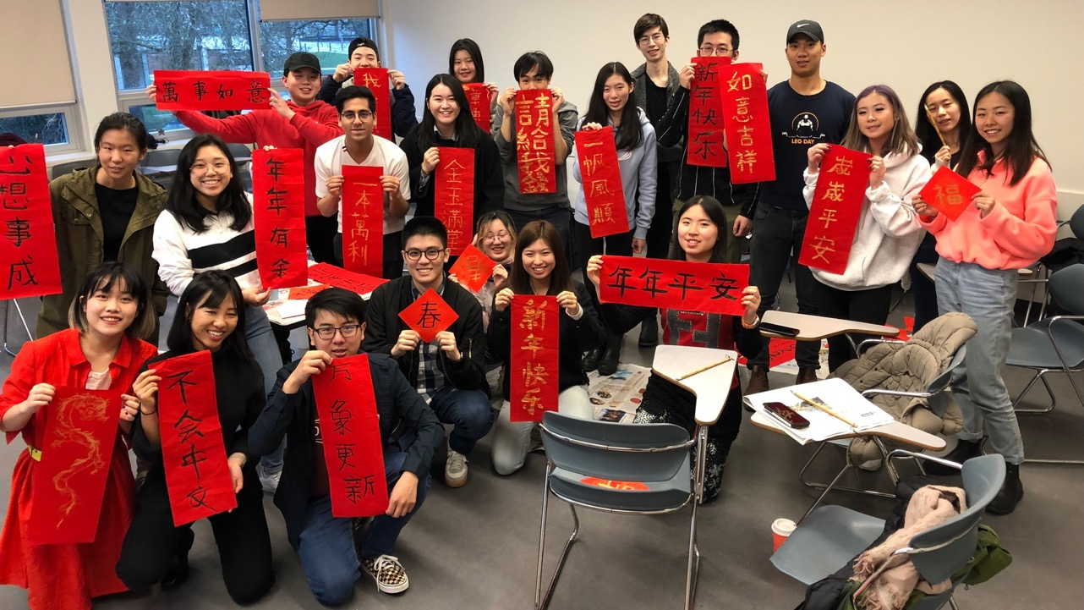
CHIN 143 Getting Our Class Online
Mon. March 23 ～Tues. April 7

Slide 24
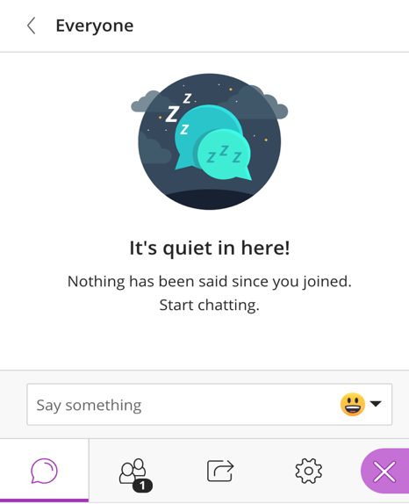
你这几天好吗？
TYPE your answers in the chatting bubble-
你在哪里？
家里
宿舍
其他：___________
type something～
Notes:
Discuss about our wellbeing and support each other。关心学生在哪里？

Slide 25
你这几天好吗？
你这几天好吗？
Raise your hand before you want to talk.
你一个人住吗？
你这几天吃什么？
你好不好(心理、身体健康)？
你的家人好不好？
Notes:
Discuss about our wellbeing and support each other。关心学生在哪里？

Slide 26
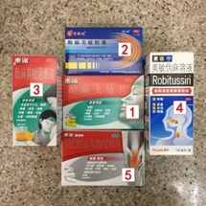
你买了什么？ 你还想买什么？你 买不到(mai3bu2dao4)什么？
TYPE, WRITE or DRAW your answers on the whiteboard
干洗手
gan1xi3shou3
口罩
kou3zhao4
药
yao4
罐头
guan4tou

Slide 27
你买了什么？ 你还想买什么？你 买不到(mai3bu2dao4)什么？
TYPE, WRITE or DRAW your answers on the whiteboard
write
type

Slide 28
我们现在 可以 做什么？不可以 做什么？
出去玩
chu1qu4wan2
洗手
xi3shou3
戴口罩
dai4 kou3zhao4
一边听课
一边找 X 聊天
站 远远的
zhan4 yuan3yuan3 de
运动

Slide 29
Group Discussion
How do you feel about the current situation?
How many times do you check news in a day?
What are you worrying about?
Where is your heart and mind?
How’s your online learning so far?
How can we support each other?

Slide 30
What is (in)appropriate?

Slide 31
Online Course Setting
Where will we meet?
When will we meet?
Virtual Office hours:

Slide 32
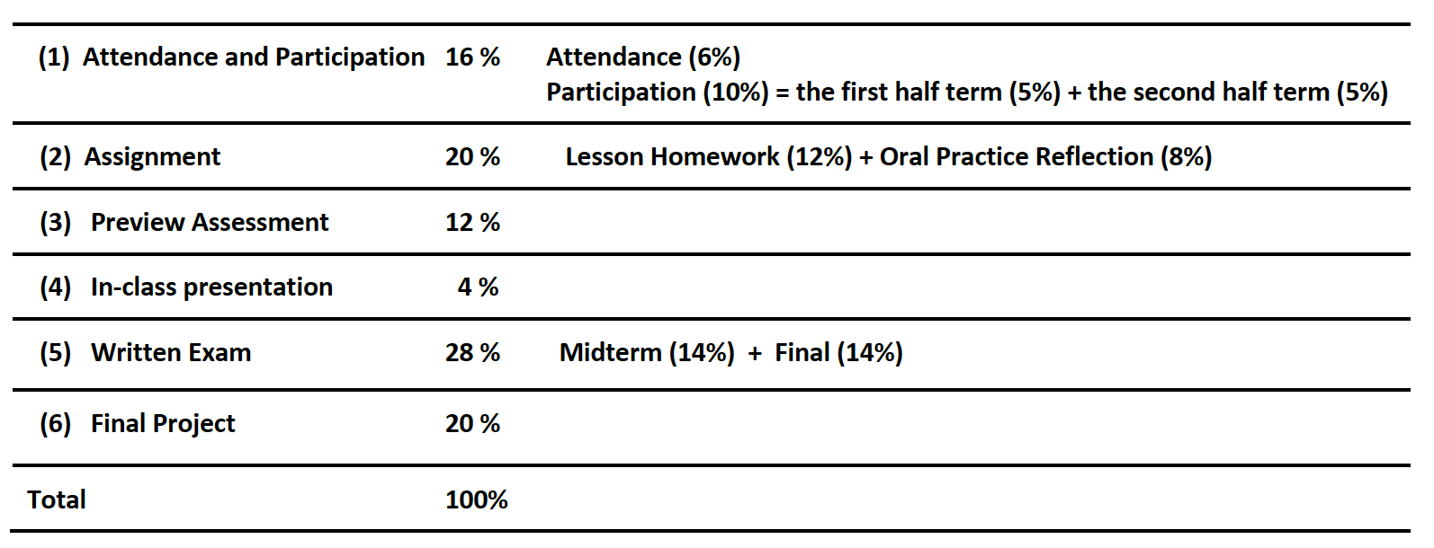
Assessment and Evaluation Nothing is changed!

Slide 33
Necessary Changes
Task | Current Requirement | Updated requirement
Preview Assessment |  | Word recognition (10 words) / on Canvas Reading comprehension / on Canvas
Lesson homework |  | Type your homework only. No need to do revision. Your mark will be given based on the correctness of the only version. Upload your homework (.pdf) to Canvas- Assignments.
Oral practice |  | Write an essay instead (movie reflection for L4).
In-class presentation |  | Online “In-class” presentation Each student will have 5-6 minutes for the presentation (10-12 minutes for 2 students in a pair) followed by a 3-minute Q&A. Presenters can still use PPT slides and are encouraged to come up with creative and effective ways to do your real-time presentation.
Final Project |  | Online documentary festival Please submit your final project work to Canvas-Quiz- Your Final Project Work by Sunday, March 22 @11:59pm. The online peer review will be Monday, March 30～Sunday, April 5, 2020.
Final Exam |  | April 16th (Details will be provided soon.)

Slide 34
How to be successful in the virtual classroom?
Please do you preview work before in after class.
In class, actively inactively participate in group discussions is the KEY.
Keep your eyes, ears, mouth and heart open closed during our online class.
Pay close attention to emails announcements on Canvas for important updates and be aware of the due dates for various assignments.
X
X
X
X
X

Slide 35
What do you need to do this week?
Date | Task
Thursday ~ Friday | Read “movie reflection instruction” Watch a movie from the given list.
Sunday by 11:59pm | 4. Submit your final project work to Canvas-Quizzes

Slide 36
What do you need to do next week?

Slide 37
别忘了—
1. Come in early to chat with your friends like you always did.
2. Check your emails/course announcements
3. Stay in touch with your friends and families.

Slide 38
TYPE, WRITE or DRAW what you want to say to your friends!
On the whiteboard

Slide 39
3Cs 2Hs
Keep cool, calm, and comfortable.
Stay healthy and happy.
Feel free to email me if you have any questions.

Slide 40
When we have to move ALL courses online in mid March…
Students
(1) Teaching/ Instructors
Tools
TA support
(3) Online community
(2) Effective eaching for Learning/
1. Syllabus, Workload, Learning Goals
2. Materials
3. Infrastructure

Slide 41
(3) Community
Remind instructors of caring about students’ and student employees’ wellbeing through email, WeChat, teaching& learning platform
→ Build up a supportive online community in class and beyond

Slide 42
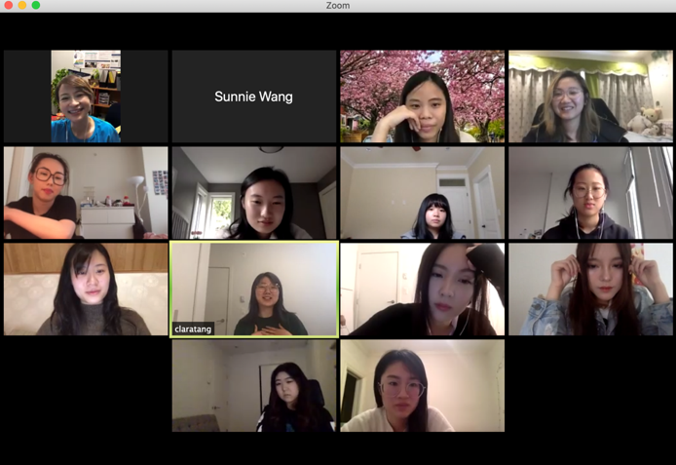
Faculty & TA meetings happy hours

Slide 43
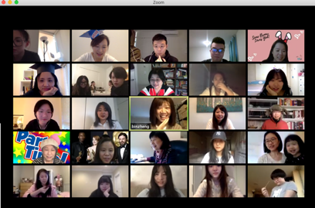
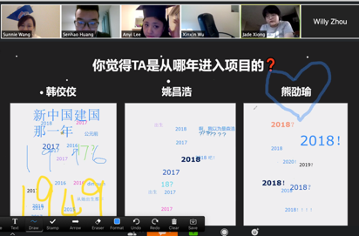
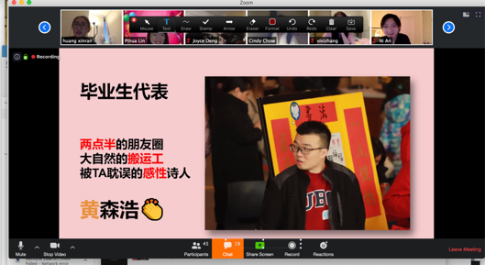
Virtual Graduation Ceremony

Slide 44
Build up a community– mutual support in class

Slide 45
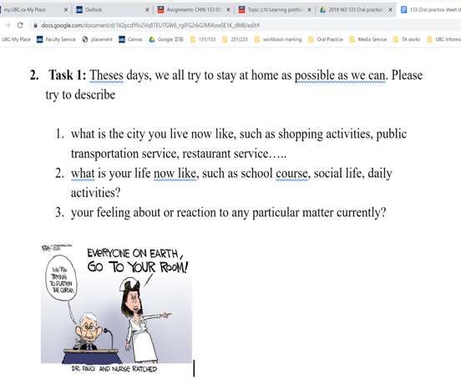

Slide 46
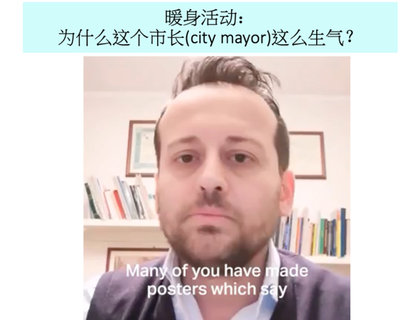
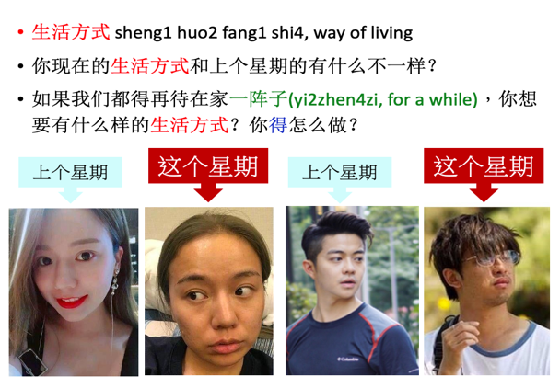
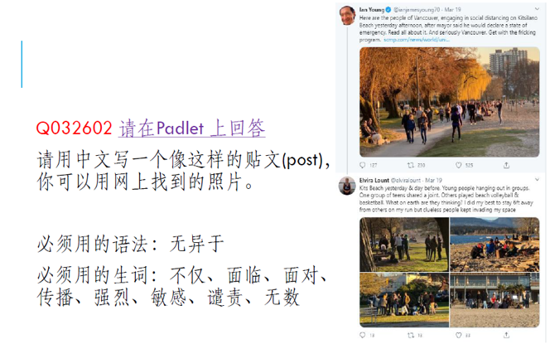
Incorporate COVID-19, teaching & learning

Slide 47
Small authentic task

Slide 48
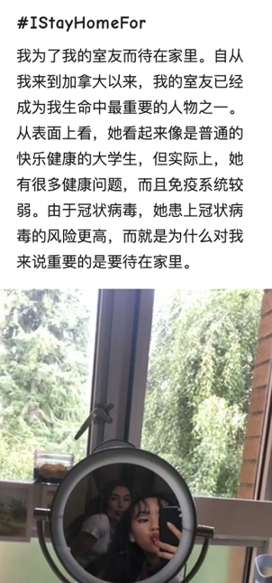
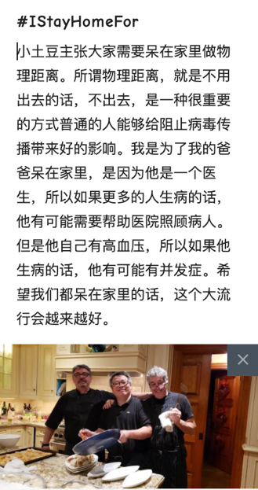

Slide 49
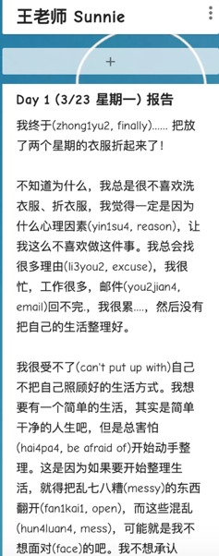
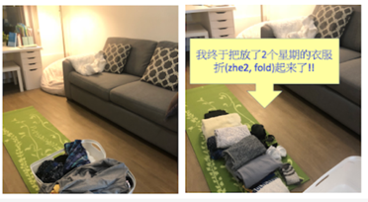
Stay-home e-journal: Keep social distance but be socially close online
Goal：Let's become stronger and resilient! I know some people have already stayed at home for 5 days. Some people lost their motivation. Some people just start a push-up plan. Some people need to take care of their families. Some people love board games! It is great to have someone to talk and have a simple goal in our lives now. Let's support each other to go through hard times. Step: 1. Set up your personal objectives for 14 days. It can be anything that you wanted to do for a long time, but did not have time, energy or determination to do. 例：我想有腹肌 (fu4ji1, 6-pack abs)！🙋🙋‍♂️/ 我想多喝水！ / 我想跟很久没联络(lian2luo4, contact)的朋友联络 2. One TINY step a day. 例：一天运动15分钟 / 一天喝2500c.c.的水 / 一天发一封短信给一个很久没联络的朋友 3. Tell us what you did and how it made you feel TODAY (in Chinese and/or English). 4. Let's celebrate our new routine and achievement TOGETHER! (You can only focus on one aspect and one goal. You don't need to follow laoshi's format, either. Create your own! ^^)

Slide 50
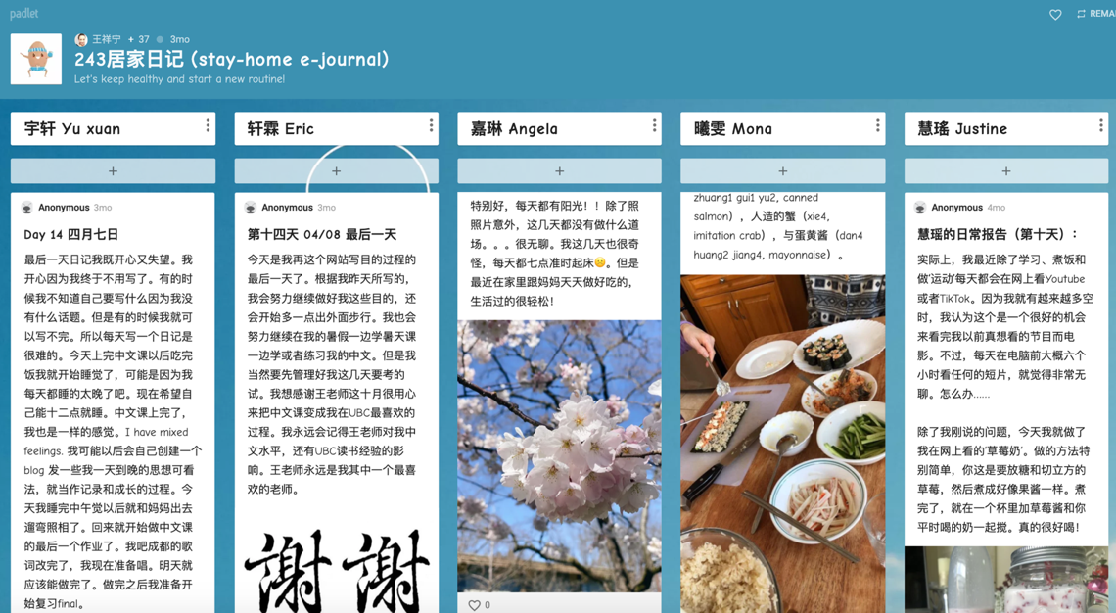

Slide 51
Conversation (interpersonal & presentational modes)

Slide 52
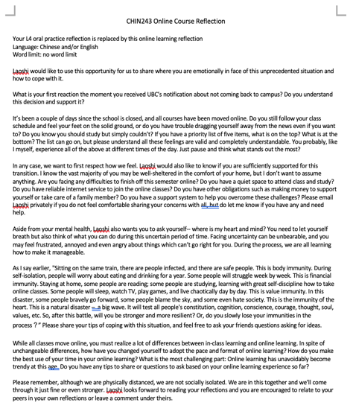
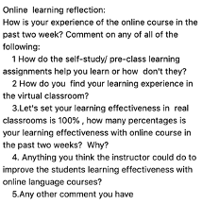
Reflection
Notes:
These tasks focus beyond just simple personal inquiries and the questions that are posted reflect this. These creative tasks which are highly related to their current life and language learning involve what they think about the current government policies in regard to sanitation, global events, as well as how they think society is affected by the current pandemic.

Slide 53
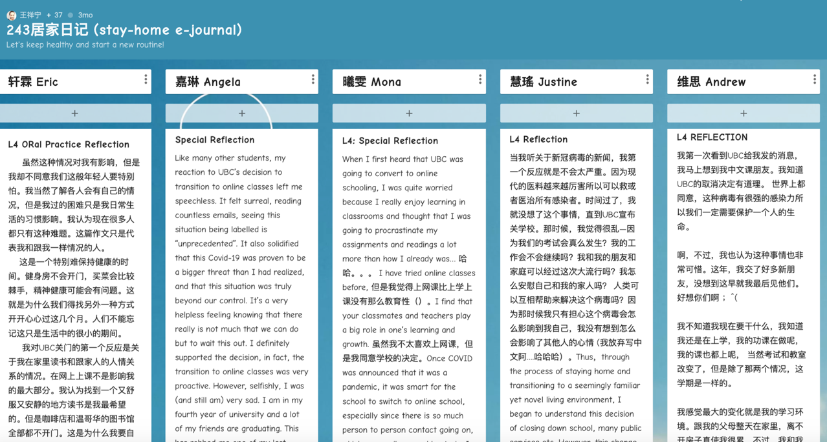

Slide 54
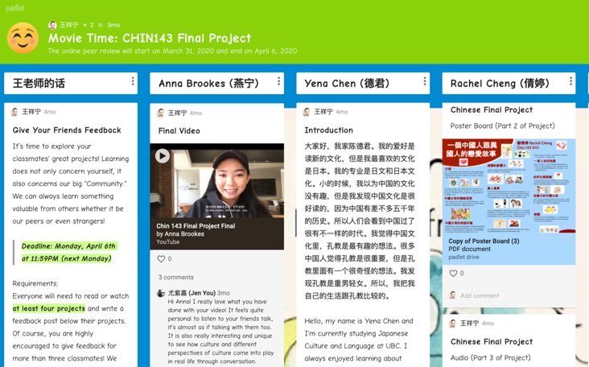
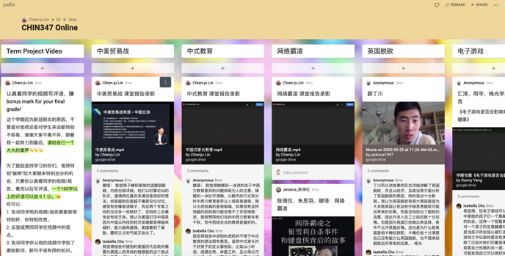
Final Projects

Slide 55
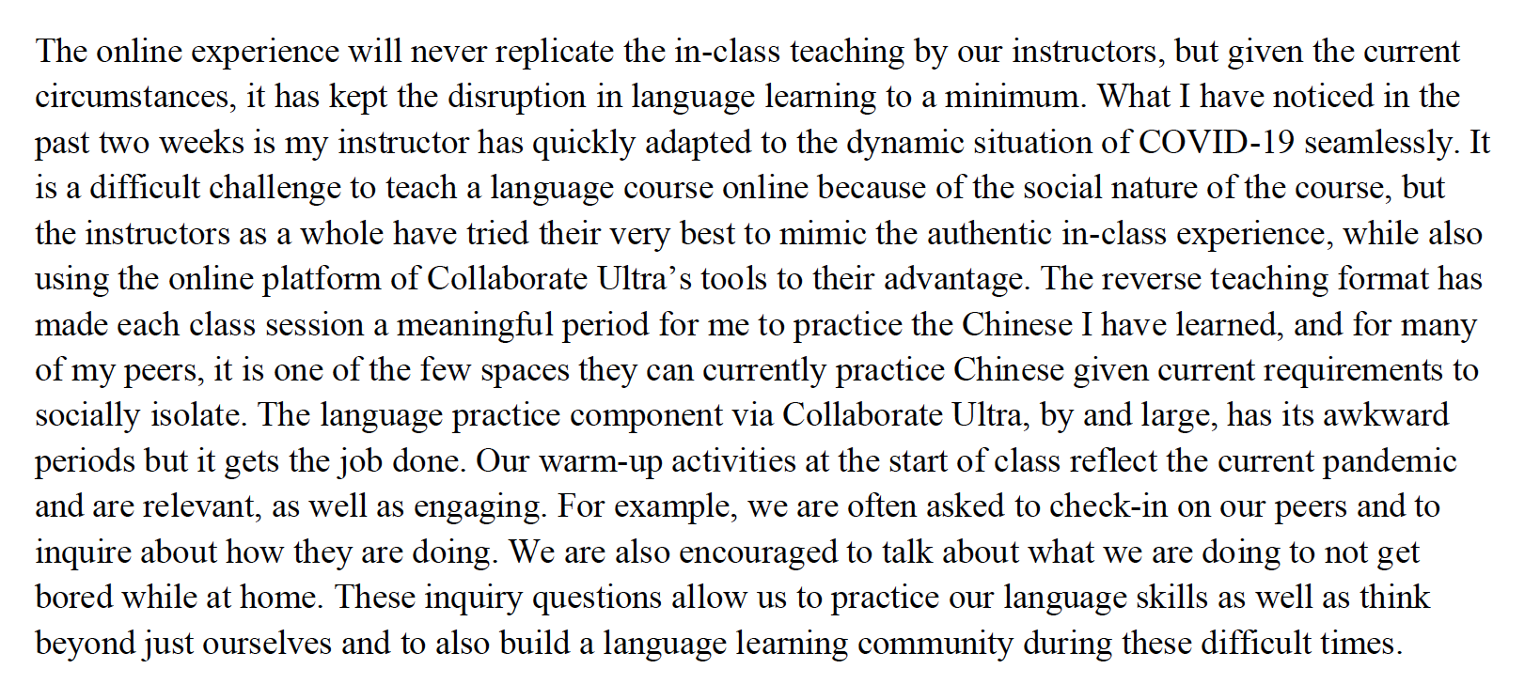
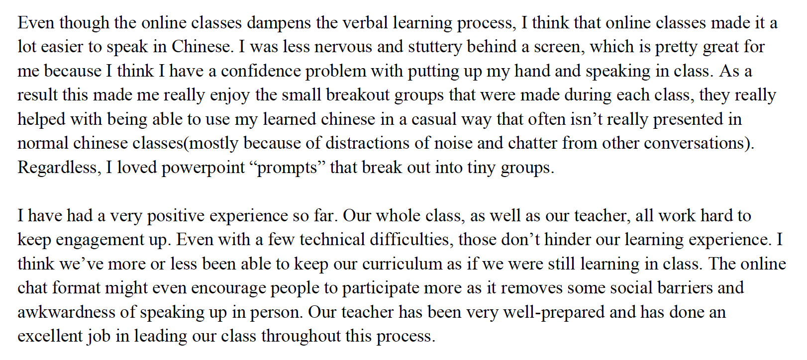
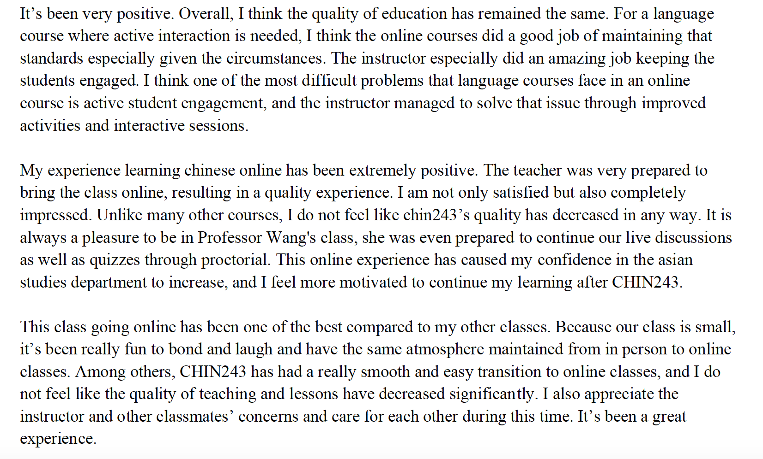
Students’ Feedback

Slide 56
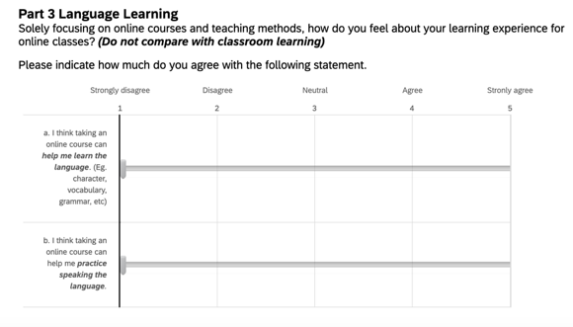
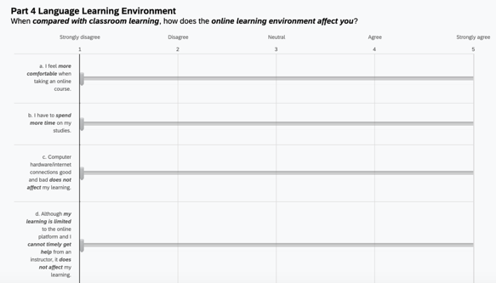
Students’ Feedback
Part 1: student’ background
Part 2: Reflect on Transition to Online Chinese Classes
Part 3: Language Learning
Part 4: Language Learning Environment
Part 5: Classroom Interaction and Engagement
Part 6: Online Learning Experience
Part 7: Overall Comments on Chinese Course Online

Slide 57
Students’ Feedback
319 responses across all 4 levels.
preliminary result：
Smooth transition to online Chinese language courses: mean 4.22
Your instructors have prepared well for online teaching: mean 4.35.
students at higher-level courses: more positive toward online courses or hybrid courses
students at the lower-level courses: prefer in-the-classroom learning.

Slide 58
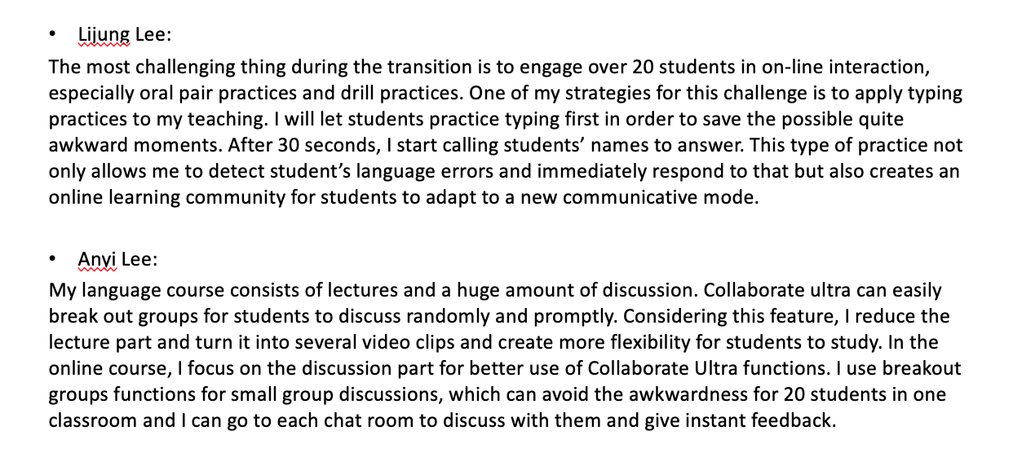
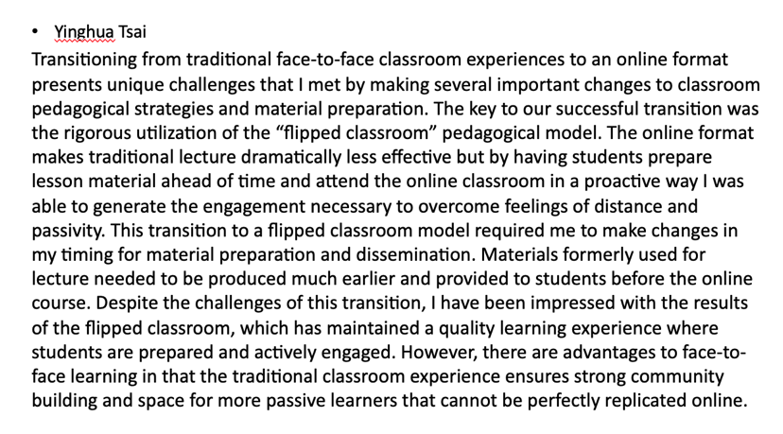
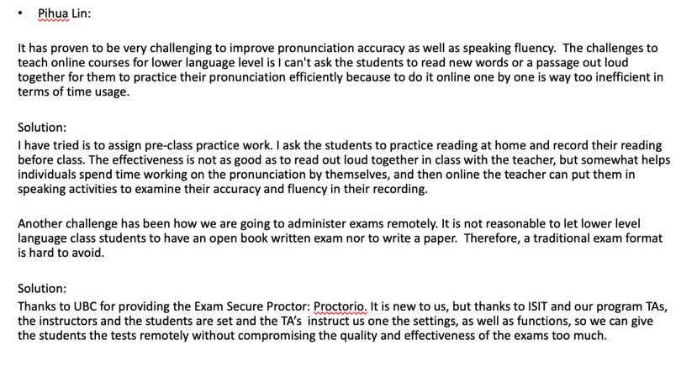
Instructors’ Reflection

Slide 59
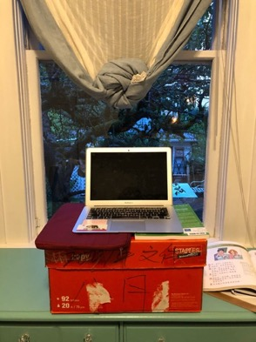
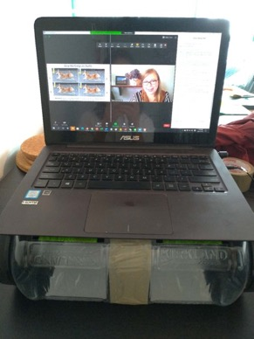
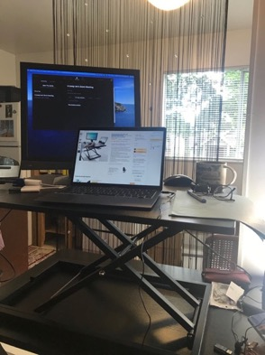
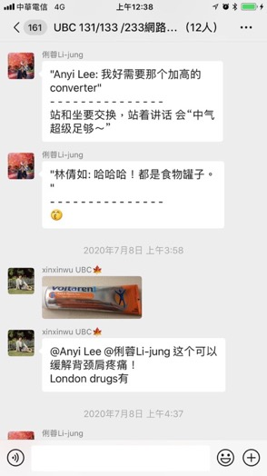
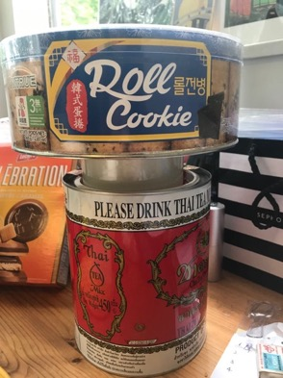
Support Group

Slide 60
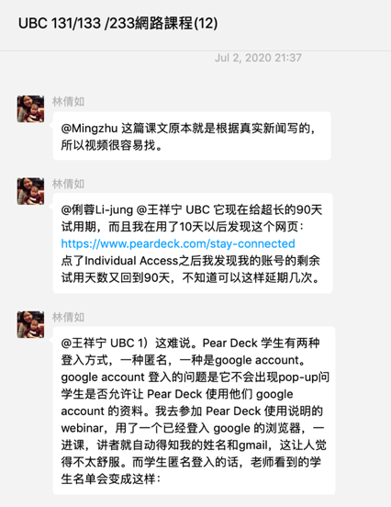
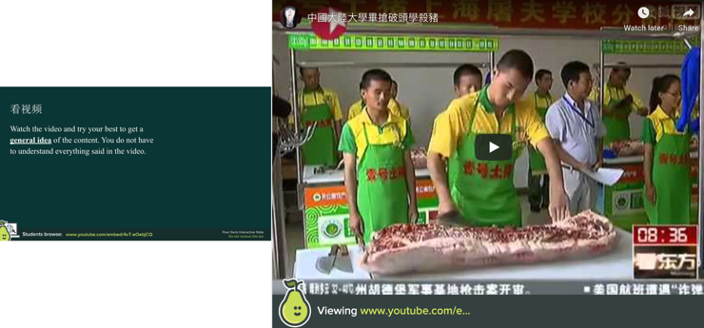
Mutual Learning
https://app.peardeck.com/student/thjshxxwc
Notes:
https://app.peardeck.com/student/thjshxxwc

Slide 61
Summer Courses
Summer 1 & 2:
Online learning community—
30-min virtual oral practice with volunteers
Summer 1: 46; Summer 2:44
Student: Volunteer = 2:1
Summer 2:
Synchronous + asynchronous

Slide 62
Incoming Winter courses
100% Synchronous
Low-level non-heritage courses
Synchronous and asynchronous courses (3:1)
Low-level non-heritage courses
Synchronous and asynchronous courses (2:2)
Heritage courses
Mid-level non-heritage courses
High-level non-heritage courses
Student registration number?

Slide 63
Principles for instructors
What can we do to help students feel that they are on a solid ground？
Let’s learn together. Build up things slowly. Don’t try anything fancy in your first class.
Moderate expectation
Maximize students’ language practice and interactions & minimize changes.
Let students & yourself breath.
→ Change, connection/collaboration, consistency
Notes:
ur principle is to keep things simple and clear, balance changes and unchanges, be consistent but flexible, and keep creating an interactive and communicative learning environment.

Slide 64
A crisis can be an opportunity！
Notes:
A crisis can be an opportunity. This truly is a great experience of collaborative learning for us, and an invaluable opportunity for us to grow a lot professionally. We do see this crisis helped us build up a tight online community by taking proactive actions and made our instructor and TA team even stronger. Our original goal was just to survive until the end of the semester, but we turn out to thrive throughout this challenge.

Slide 65
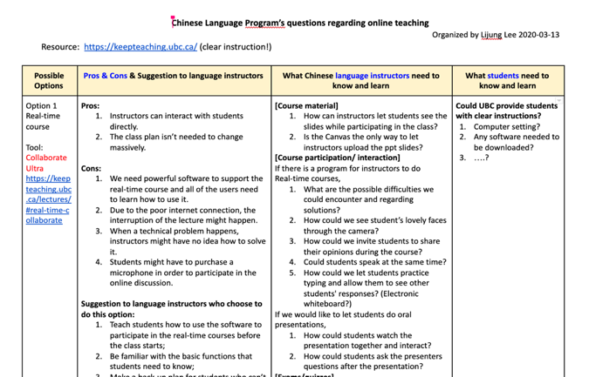
Collaborative Learning for instructors 😊

Slide 66
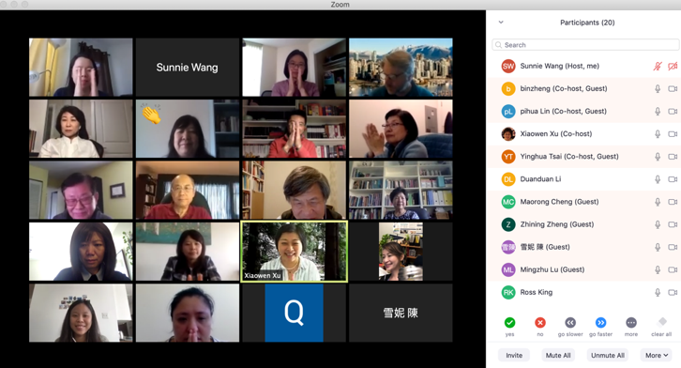
Acknowledgement
Many thanks go to my dearest colleagues—
Qian Wang
Xiaowen Xu
Xueshun Liu
Pihua Lin
Anyi Lee
Lijung Lee
Yinghua Tsai
Chien-ju Lin
Xinxin Wu
Mingzhu Lu
Sheni Chen
Bin Zheng
Zheng Cai

