Slide 1
STUDENT EPORTFOLIOS FOR MEDIA-RICH ASSIGNMENTS & STUDENT SELF-PRESENTATION IN CURRICULAR AND EXTRA-CURRICULAR CONTEXTS
Fred Cutler
Thurs, July 9, 2020

Slide 2
welcome
Arts ISIT is hosting webinars all summer to support your online teaching needs, from designing online courses to creating engaging assessments using UBC-supported technologies. For more information, please see https://isitworkshops.arts.ubc.ca.
Please share any questions using the chat. A Q&A discussion will take place at the end of the session.
This webinar will be recorded and uploaded to the ISIT website. Please be mindful of any private information and anonymize personal details about specific students.
Your cameras and microphones have been disabled to help save on bandwidth.

Slide 3
Presenter INTRODUCTION
Fred Cutler, Associate Professor (POLI)
ePortfolios: online platform that allows students to deliver online projects and curate accomplishments from their entire university experience
Help students produce creative multimedia projects, showcase their work beyond the university, and prepare for the early stages of their careers
How to incorporate portfolio-based assessments into your syllabi and capture curricular, extracurricular, and personal student performance

Slide 4
STUDENT EPORTFOLIOS FOR MEDIA-RICH ASSIGNMENTS & STUDENT SELF-PRESENTATION IN CURRICULAR AND EXTRA-CURRICULAR CONTEXTS

Slide 5
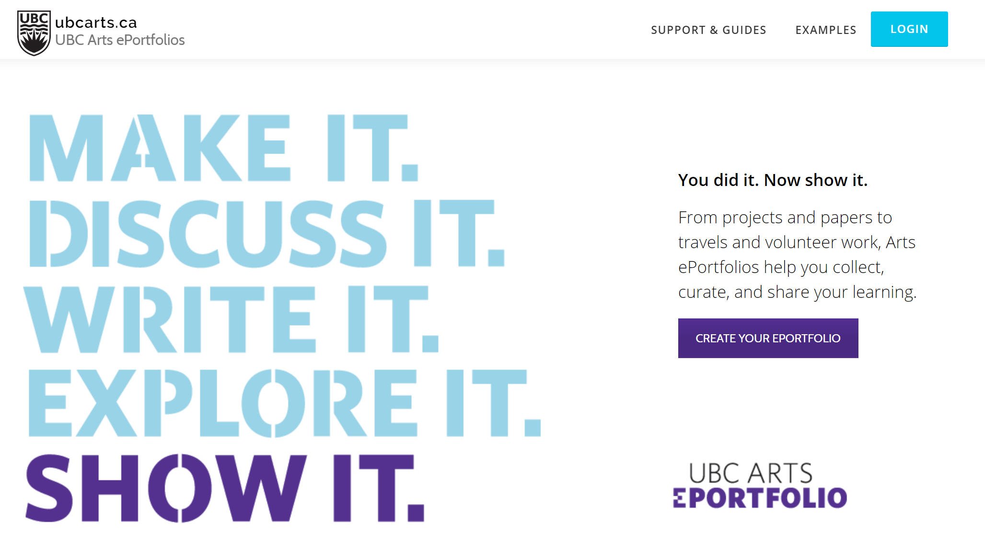
DIGITAL PORTFOLIOS Preserve. REFLECT. CURATE. SHOW. SHARE.
Fred Cutler | POLItical SCIence

Slide 6
What is an e-portfolio / Digital Portfolio?
A website that holds evidence of learning, output, skills

Slide 7
Let me introduce myself
Imagine you’re a Dean of Arts & Science.
You want to hire an innovative Associate Dean for Teaching and Research. You’re looking at academic cv’s and you’re bored.
Then you get one that says the applicant has an online portfolio…
cutler.ubcarts.ca

Slide 8
I’m here because… ubcarts.ca

Slide 9
Agenda / what are they good for?
What I’ll talk about, or: Instructional benefits of ePortfolios
Best medium if you want students practicing and learning: self-presentation, reflection on learning, integrated learning
Multi-media assignment submission using blog post technology
Visibility into and self-consciousness about the production process
Get to know your students and them to know you know them!
Medium for public/social learning and impact

Slide 10
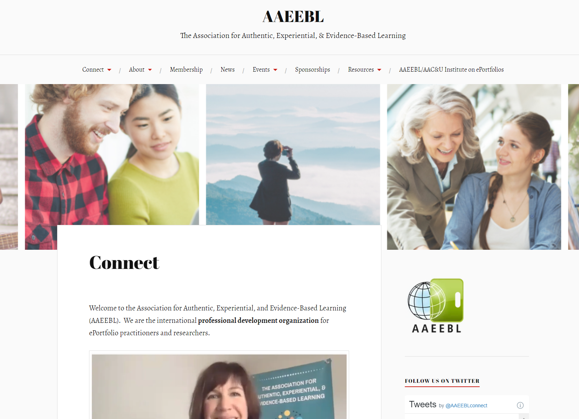
They’re bigger than you might think aaeebl.org

Slide 11
Pedagogy i
See AAEEBL “Field Guide to ePortfolio”

Slide 12
Pedagogy ii
See AAEEBL “Field Guide to ePortfolio”

Slide 13
‘selling’ portfolios to students
For a reflective process of learning and growing
More introspective, less public
As a showcase of work & skills
Showing one’s best work as a finished piece, without process evident
An ePortfolio that works in both ways shows both capabilities and the ability to grow through learning and reflection

Slide 14
‘selling’ portfolios to students (example)
The ePortfolio is an ongoing professionalization opportunity
As a product, you’ll end up with a way to show
What you learned
What you produced
What you can do
What you thought about your experiences and what you think now
How these things fit together and add up to something more
As a process, you’ll gain practice in articulating how your work in this fits with the ‘big picture’ of your cumulative experiences.
You build who you are through the things you’ve done and the connections you make among them.

Slide 15
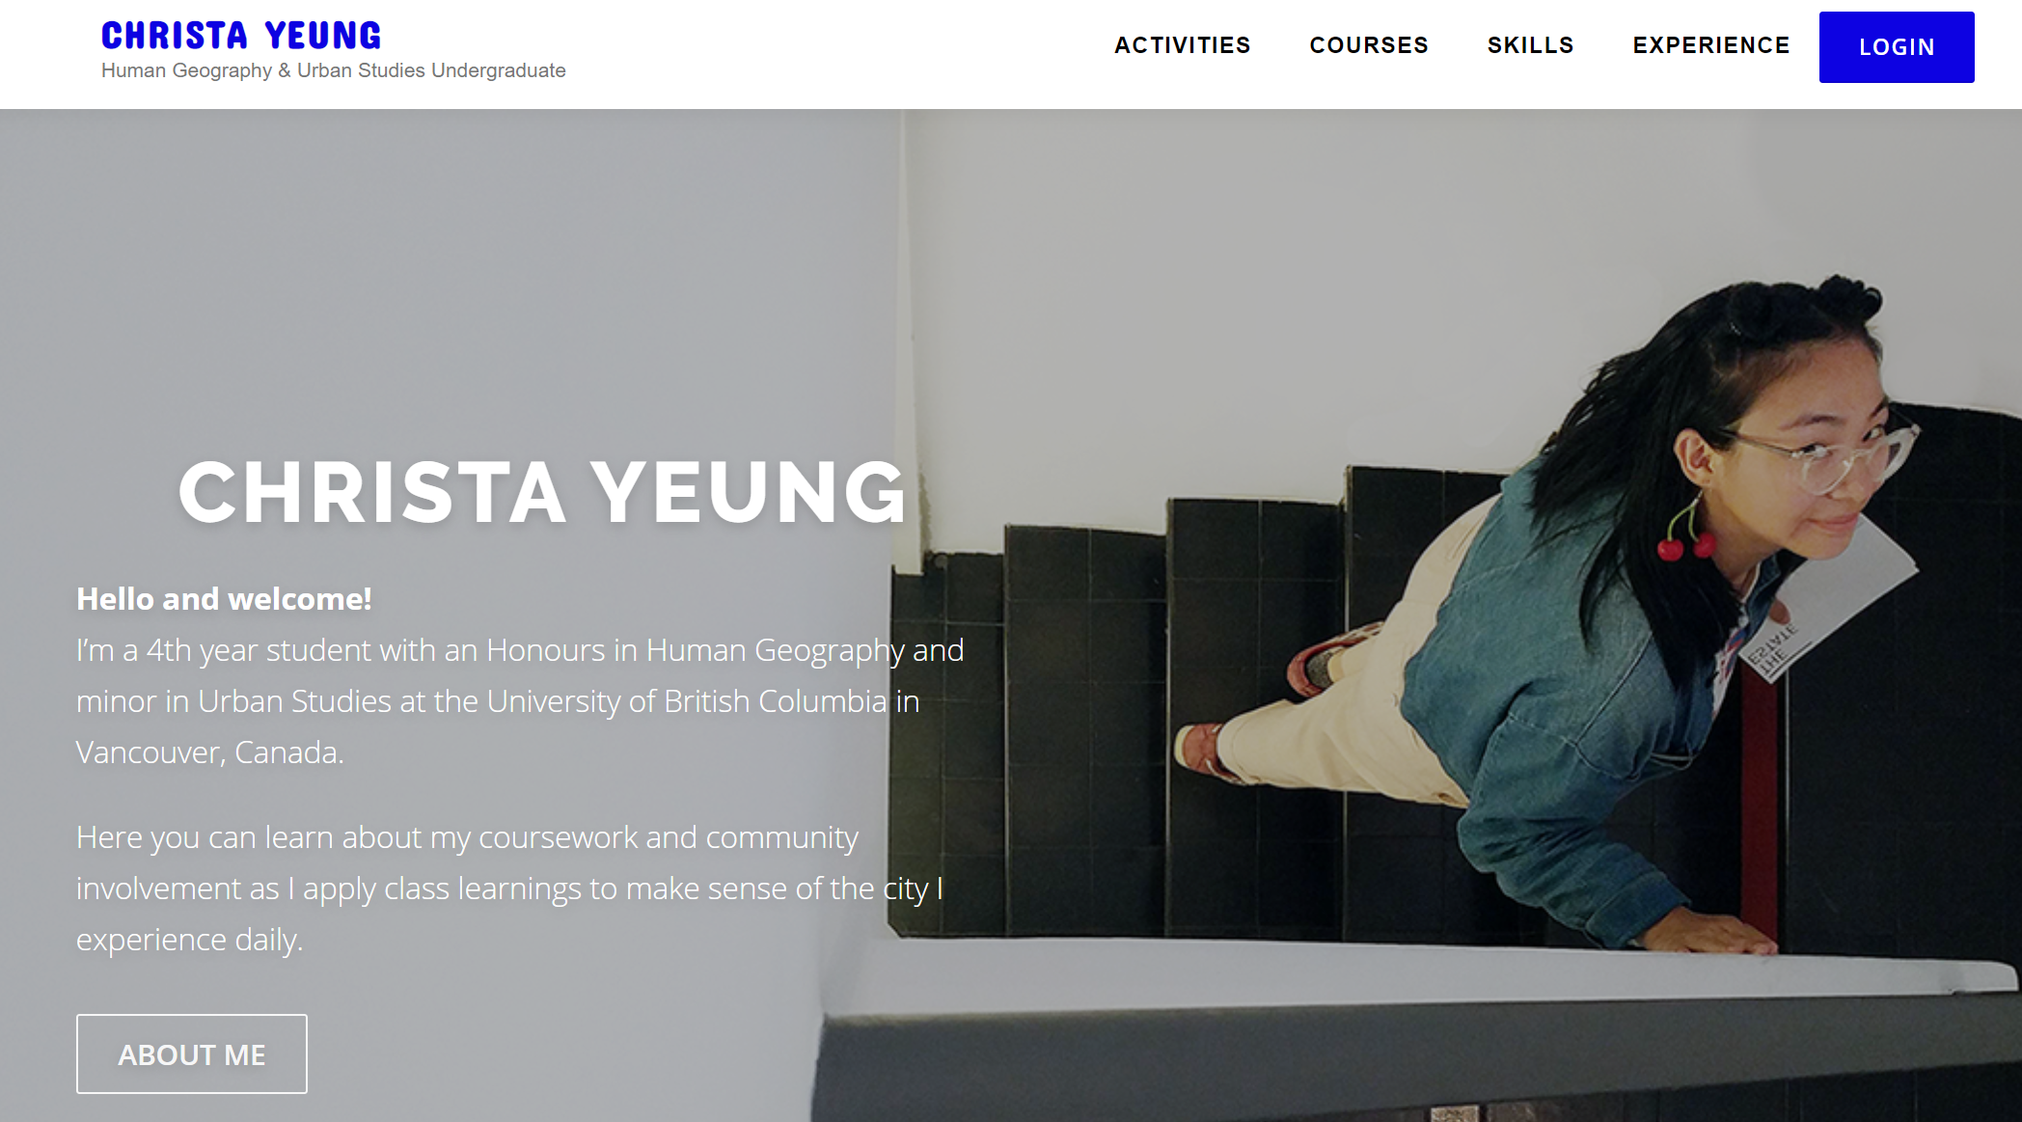
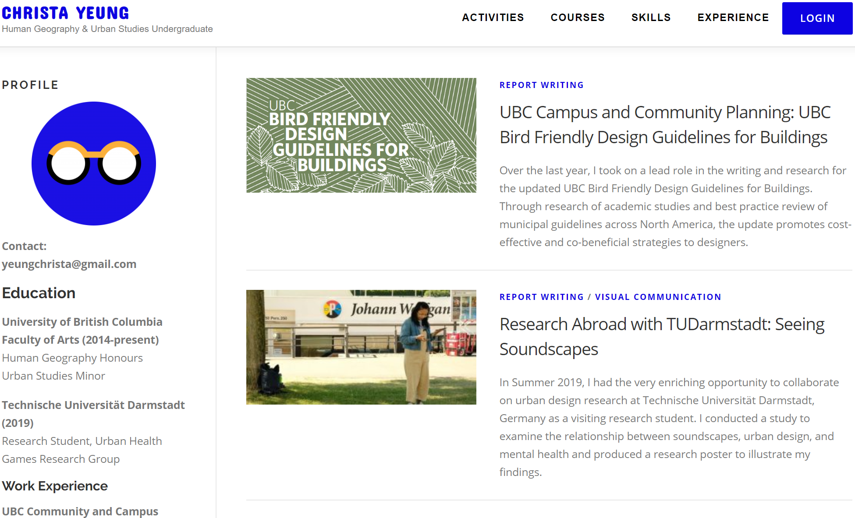
How? UBCARTS.ca
Every Arts student, faculty, staff can get one immediately
Guides made by ISIT and user support available
Simplified Wordpress back end
Language and features built for education and portfolio use

Slide 16
Features of ubcarts.ca
THE DESIGN CHALLENGE…
Some standardization for easy onboarding and support
but,
Some customizability for student ownership and expression

Slide 17
Features of ubcarts.ca
Each post is an “Activity” with a “Significance” box for reflection
Automatic site creation with CWL
Tags: Skills (student defined), Courses (imported from SIS)
Collections: Assemble multiple activities & contextualize them
e.g. Trip to Japan in a Languages collection, Travel collection, and East Asian Politics collection
Simple editor with media storage and embed in Activities
Can be submitted to Canvas as a URL assignment type and they appear in SpeedGrader

Slide 18
Features of ubcarts.ca
THE DESIGN CHALLENGE…
Some standardization for easy onboarding and support
but
Some customizability for student ownership and expression

Slide 19
Portfolio Assignment option I
Get to know your students. Get them going with ePortfolio.
Week 1 or even before the first meeting
3 entries. Description, media object, learning reflection.
One personal (travel, job, volunteer, artistic, spiritual)
One academic (a project or field experience or research)
One about something the subject of the course
Example: https://aniquebaillon.ubcarts.ca/skills/ (next slide)
Assessment: Pass/Fail
Feedback: Show that you’ve read them. Give suggestion for focus of engagement or research in the course.

Slide 20
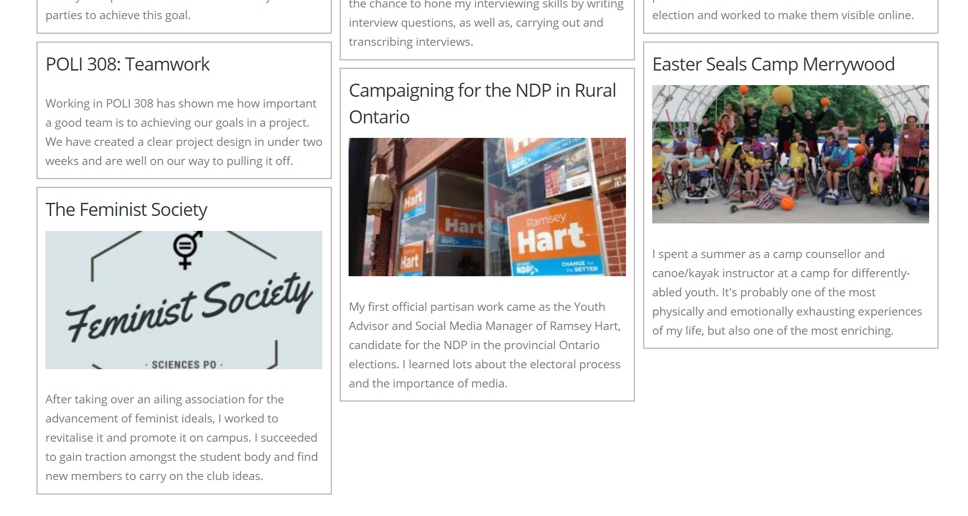
Get to know studentS example

Slide 21
Portfolio Assignment option 2
Skills: Reflection, Writing for non-academic audience, Planning
Week 3 or 4?
2 related entries. Description, media objects, learning reflection.
One to take an essay or project from a previous course, present it forcefully, concisely, and reflect on the learning both at the time and now revisiting it.
Record a 3 minute video of reflection, upload to CLAS/YouTube, embed
One as a seed for a larger project in the course. Speculative presentation of what interests you about the course material, what you’d like to dig deeper into, and what that connects to you in your life and your future academic and career or service plans.
Example: https://christayeung.ubcarts.ca/activities/research-abroad-with-tudarmstadt-seeing-soundscapes/
Assessment: Graded, fairly low stakes
Feedback: Focus on the reflective exercise. Show that you can mark a process as much as a product. Hone the student’s interest toward engagement or research in the course.

Slide 22
Portfolio Assignment option 3
Digital Story
Mid-course
One or multiple linked entries. (Choose your own adventure format?)
Written to tell a story, from a given perspective
Needs contextualization if it remains public
Images, Video, Audio (podcast-y), Maps, Infographics, Interactive calculators
Assessment: Graded, medium stakes
Feedback: Rubric includes creativity, analysis, reflection, relationship to course material and learning objectives.

Slide 23
Portfolio Assignment option 4
Major research project for public consumption
Week 9 or 10?
One long entry, but communicated in modular fashion with mini TOC, embedded objects, hyperlinks, etc.
More like a typical reseach paper, but…
Focus on clarity of writing for public consumption
More imagination around presentation modailities
Assessment: Graded, peer-reviewed?
Feedback: More typical, but with emphasis on the integration of analysis and presentation. Reward creativity.

Slide 24
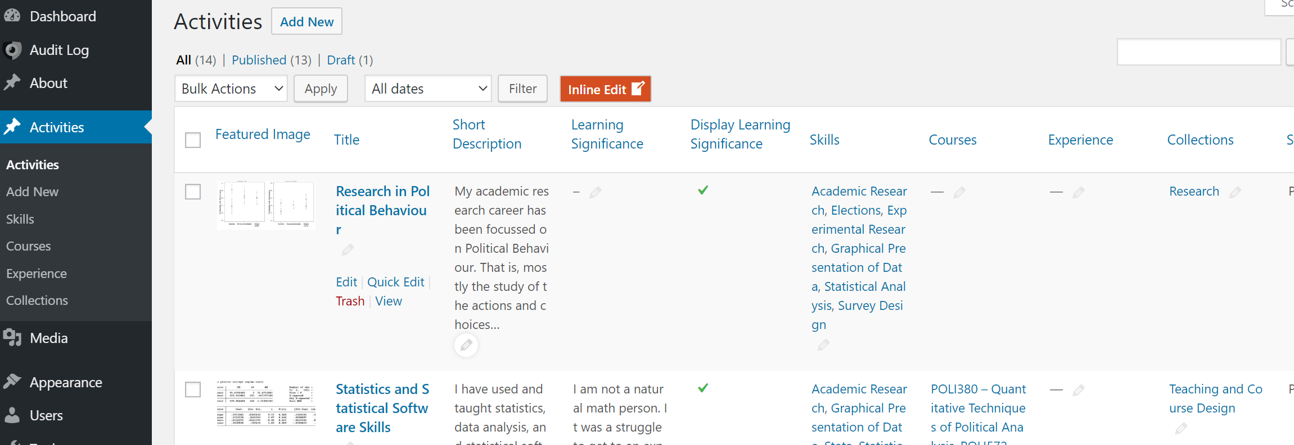
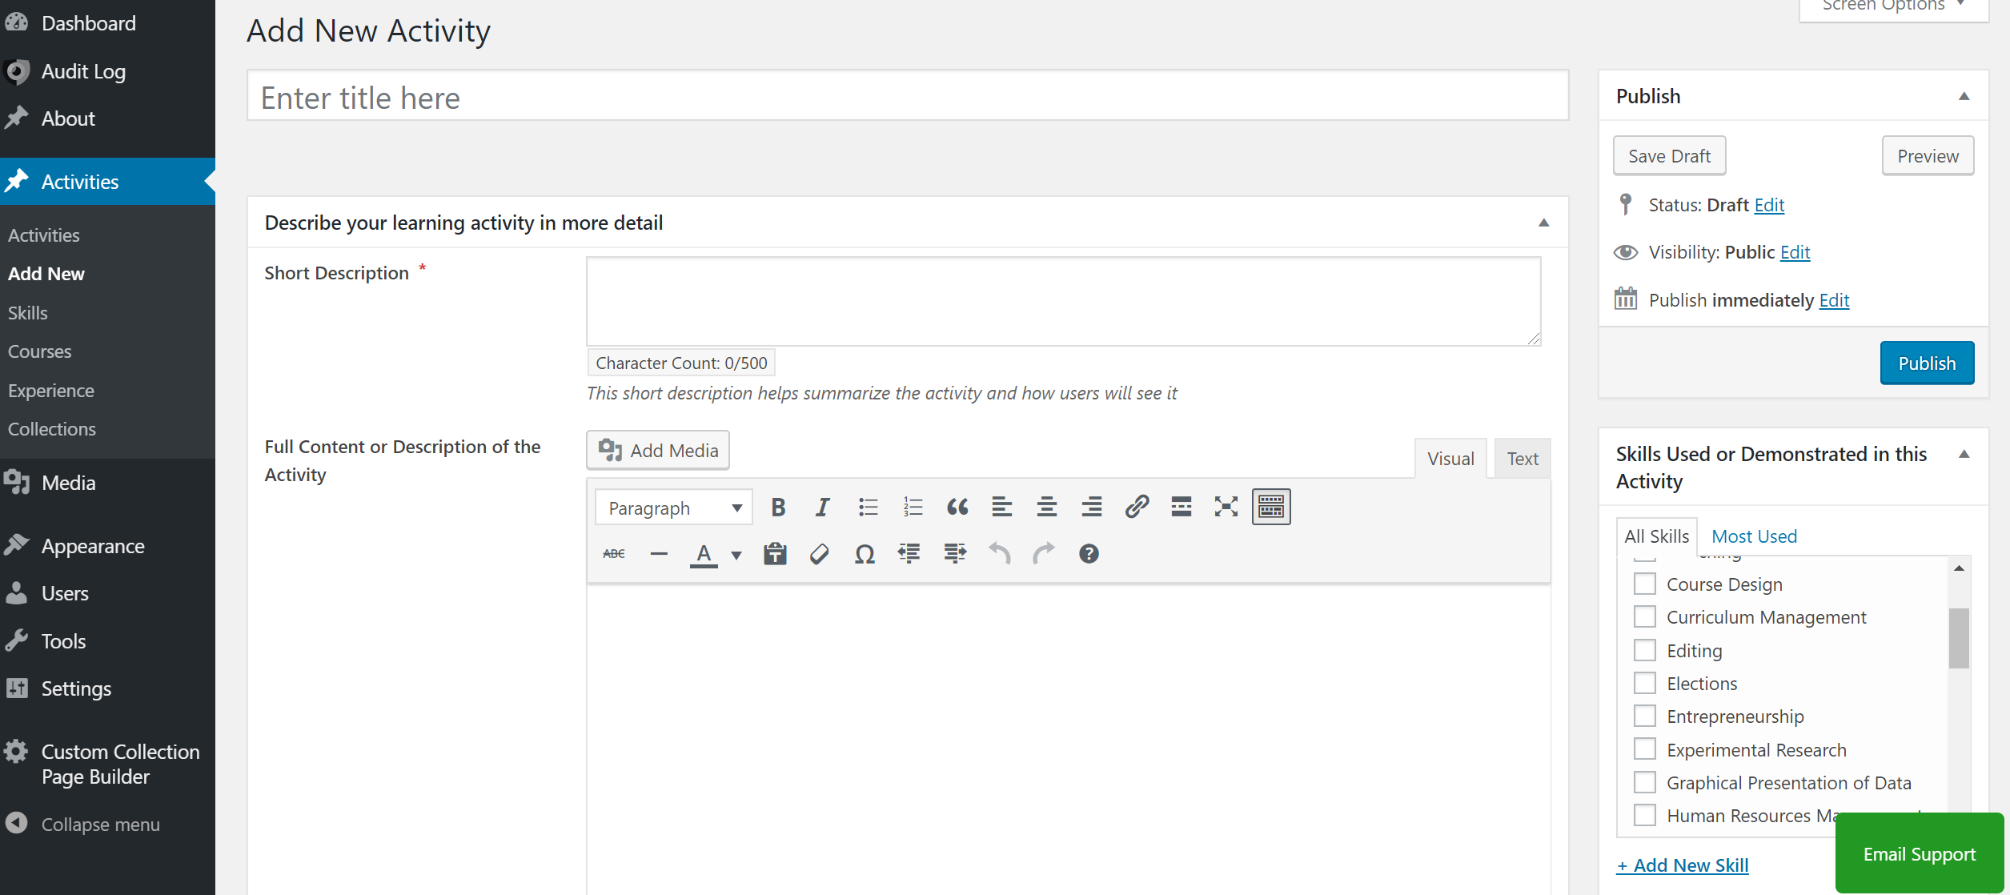
The back end

Slide 25
QUESTIONS? ASSIGNMENT IDEAS? FEATURE SUGGESTIONS?

Slide 26
Q&A and Discussion
To participate:
Use the built-in chat to share any questions, comments, and resources.
Reminder: This session is being recorded.
Please anonymize any student information in your discussion.
If you have any questions that cannot be anonymized, please email us at arts.helpdesk@ubc.ca and we will follow-up with you.

