Slide 1
Enhancing Classroom Interactions with Top Hat: Synchronous Assessments & Discussions
Joy Dixon & Grace Truong
July 14, 2020

Slide 2
welcome
Arts ISIT is hosting webinars all summer to support your online teaching needs, from designing online courses to creating engaging assessments using UBC-supported technologies. For more information, please see https://isitworkshops.arts.ubc.ca.
Please share any questions using the chat. A Q&A discussion will take place at the end of the session.
This webinar will be recorded and uploaded to the ISIT website. Please be mindful of any private information and anonymize personal details about specific students.
Your cameras and microphones have been disabled to help save on bandwidth.

Slide 3
Presenter INTRODUCTION
Presenters:
Joy Dixon, Associate Professor (HIST)
Grace Truong, Lecturer (PSYC)
Topic:
Top Hat, a classroom response system for quick assessments, spot-checking student understanding, synchronous online discussions
Mostly used for synchronous interaction, but all can be adapted into asynchronous forms
Experiences & recommendations for using Top Hat in virtual classroom from both beginning and more experienced users

Slide 4
Grace truong
Lecturer, psychology

Slide 5
What I used before and why
i>clicker (with lecture hall base), iClicker cloud
Used in all my classes (Intro Psych, Research Methods, Statistics, Cognitive Processes)
Purpose: Real-time comprehension checking, stimulate discussions, review previous material, student engagement
Assessment: Participation (but not accuracy) was worth 3% of overall grade
Frequency: 3-8 questions per lecture, depending on topic
Style: Only multiple choice questions (b/c physical remotes only do MC)

Slide 6
Why I tried Top Hat during Summer 2020
Free for students and faculty in Arts
Clicker cloud (REEF) required paid student subscription
Ability to ask all of the same questions as before
Desire to maintain participatory component without too many burdens on students
Financial burden, bandwidth burden, learning-new-tech burden (just another internet tab)

Slide 7
Setting up Top Hat
Summer 2020 course: PSYC 218 (Analysis of Behavioral Data)
Had a Top Hat Demo with Arts ISIT
Copied/pasted questions from previous iteration of course and added a few more
Minor hiccup: Course/join code already existed, required to specify Canadian Top Hat website (default is American) – easily resolved by Top Hat IT person

Slide 8
Setting up Top Hat
Created make-up assignment for students who could not attend class synchronously (and therefore answers questions in real time)
“Create 3 MC questions parallel to the Top Hat ones from class”
One make-up assignment = one day of participation
Due by the start of the next class
Marked pass/fail
Offered to everyone, regardless of reason

Slide 9
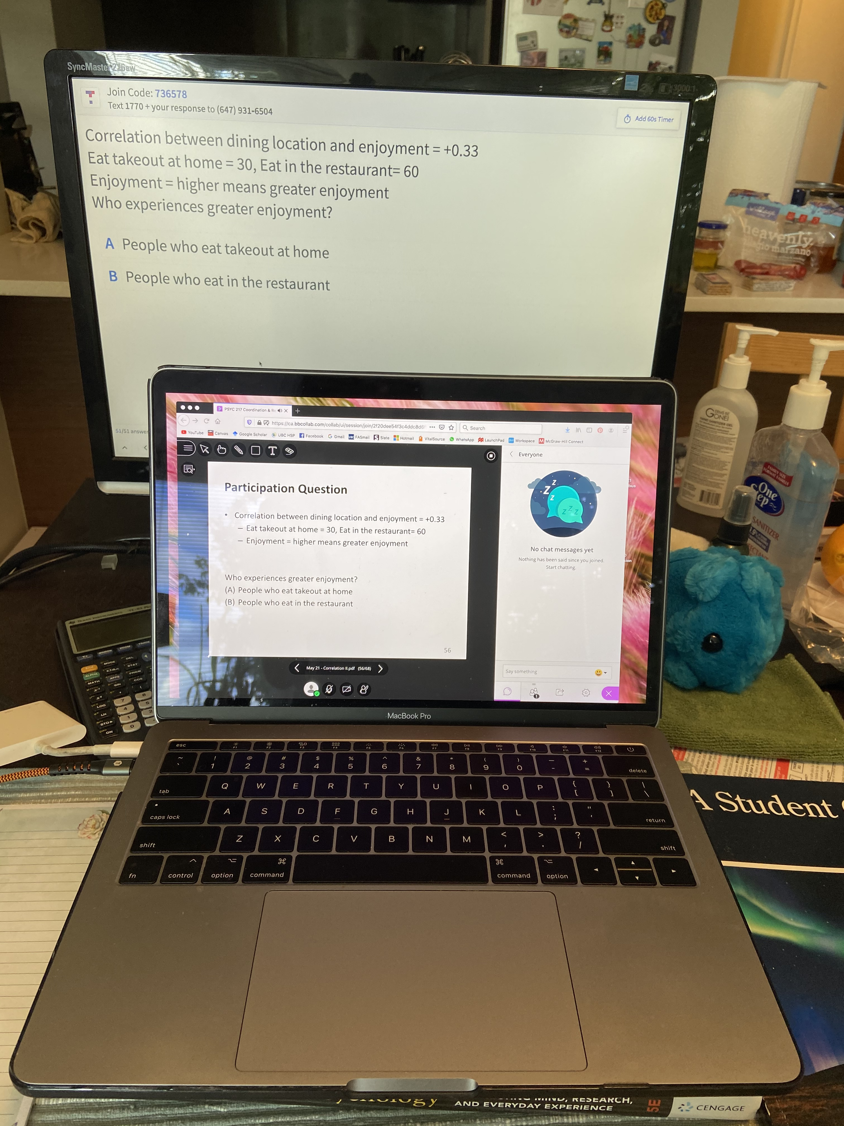
Physical Set-up during lecture
Screen #1: CU
Screen #2: Top Hat
Able to monitor CU chat
and Top Hat response
rate (and responses) at
the same time
You can also present your slides from within Top Hat
Notes:
Presented slides in CU, was able to monitor both without messy switching

Slide 10
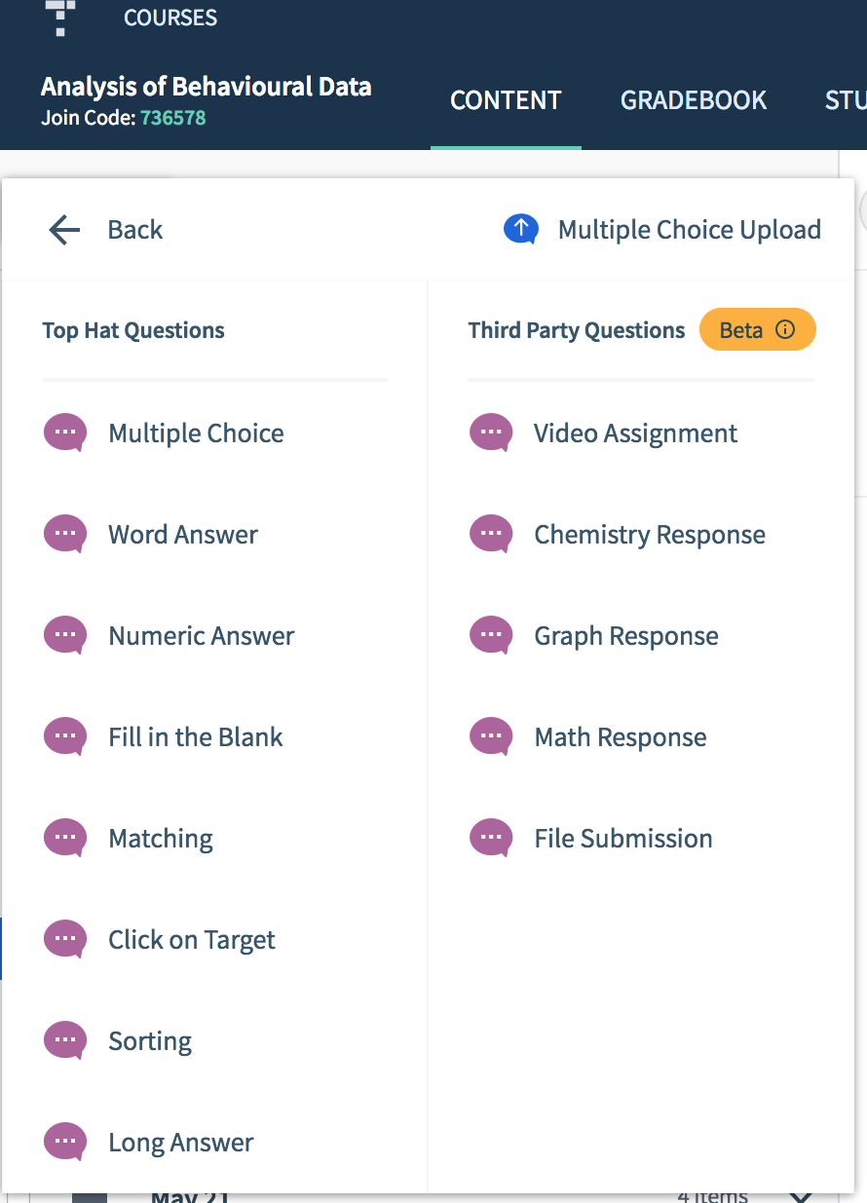
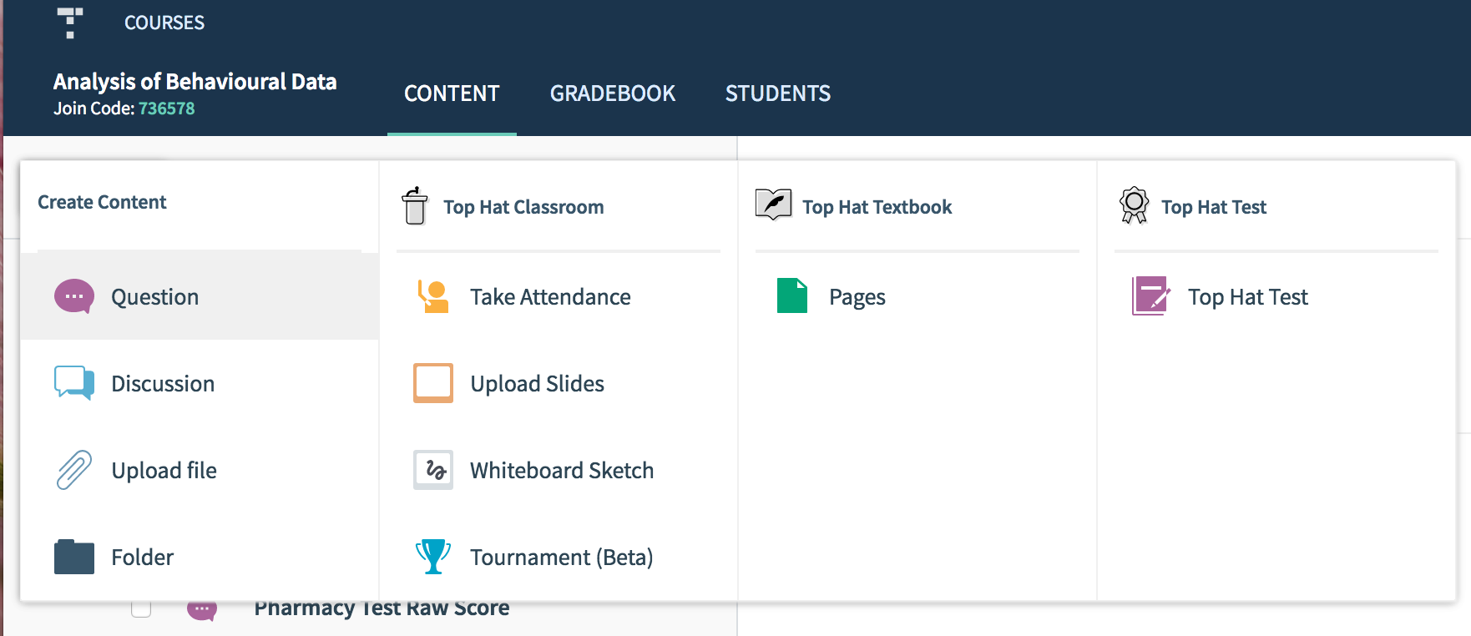
Questions in Top Hat

Slide 11
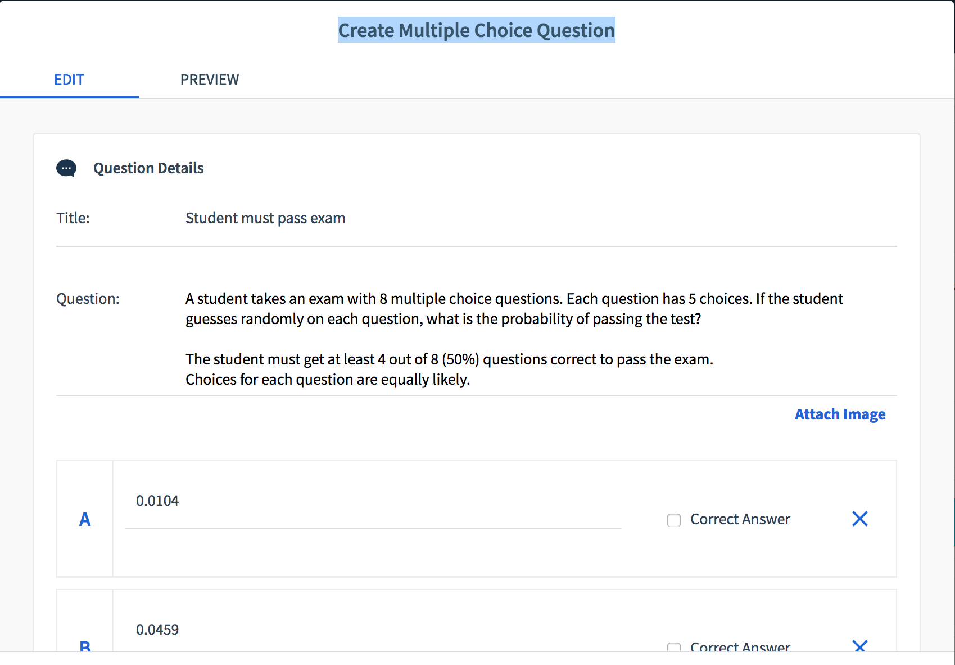
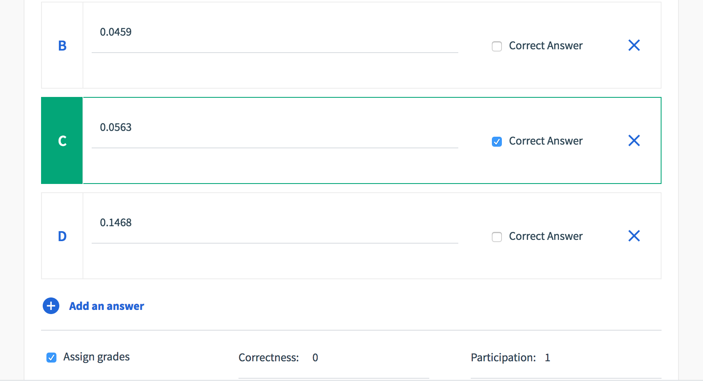

Slide 12
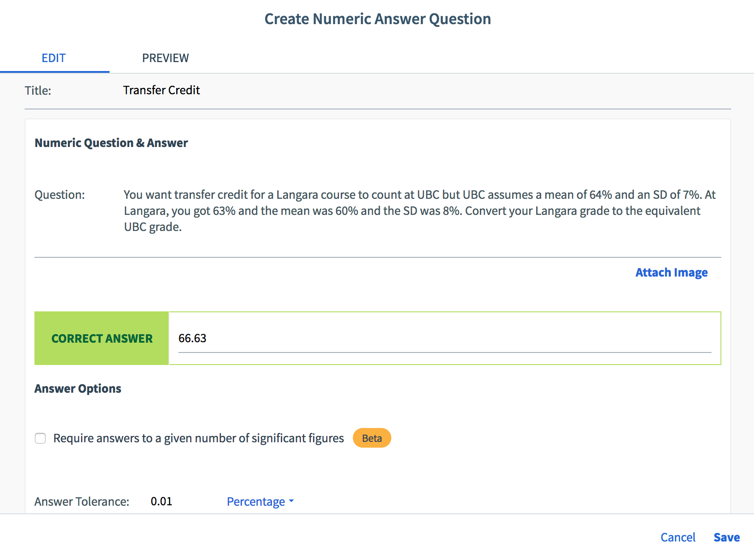
Numeric Answer
Could not ask numeric answers before because remote constrained question type to MC

Slide 13
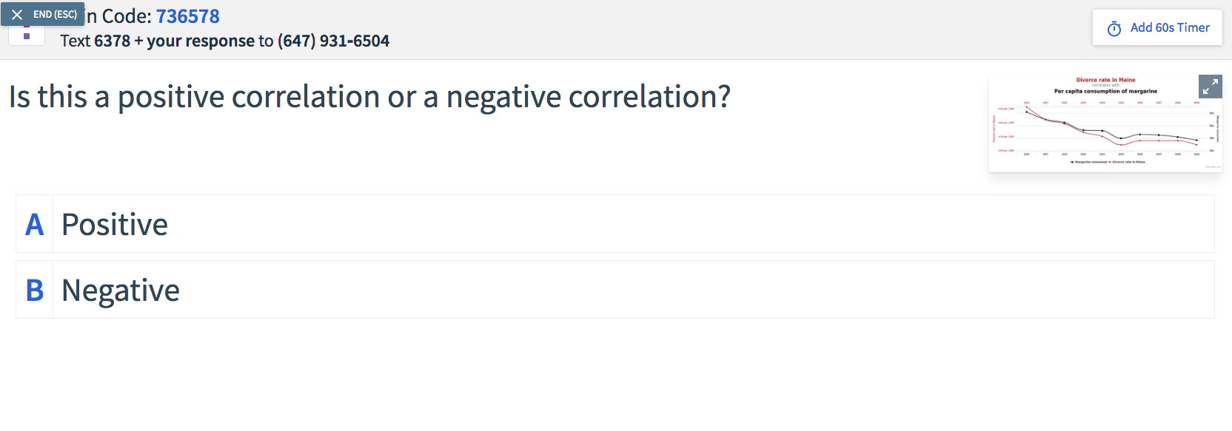
Ability to add images

Slide 14
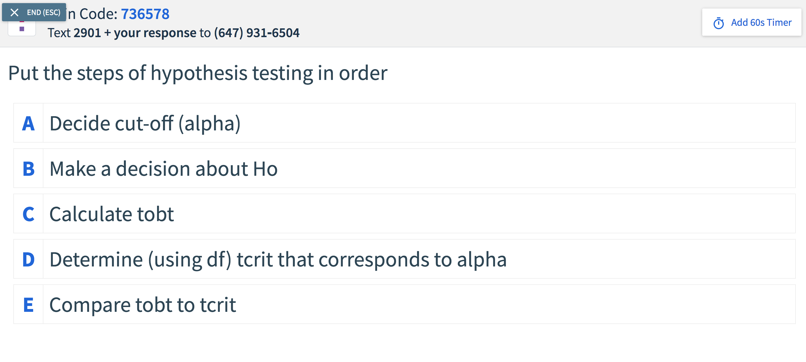
Sorting Question

Slide 15
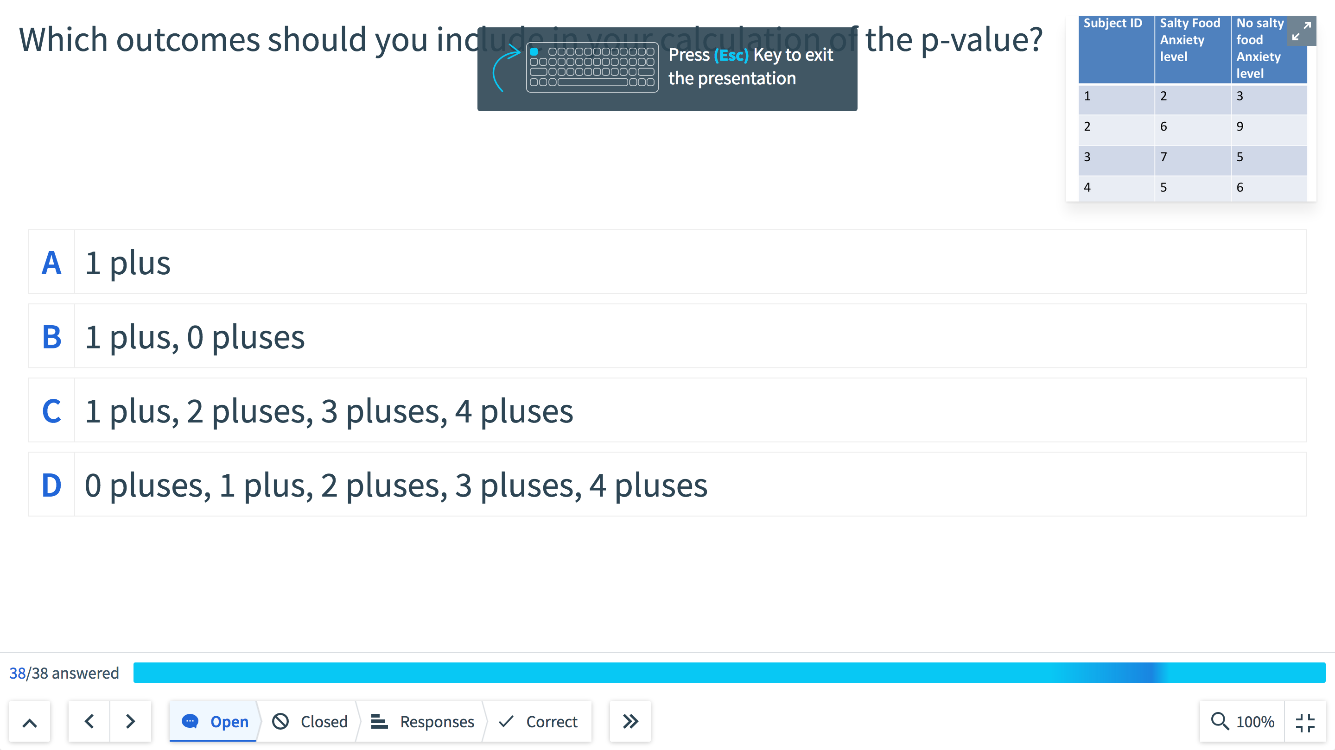
What the instructor sees during question

Slide 16
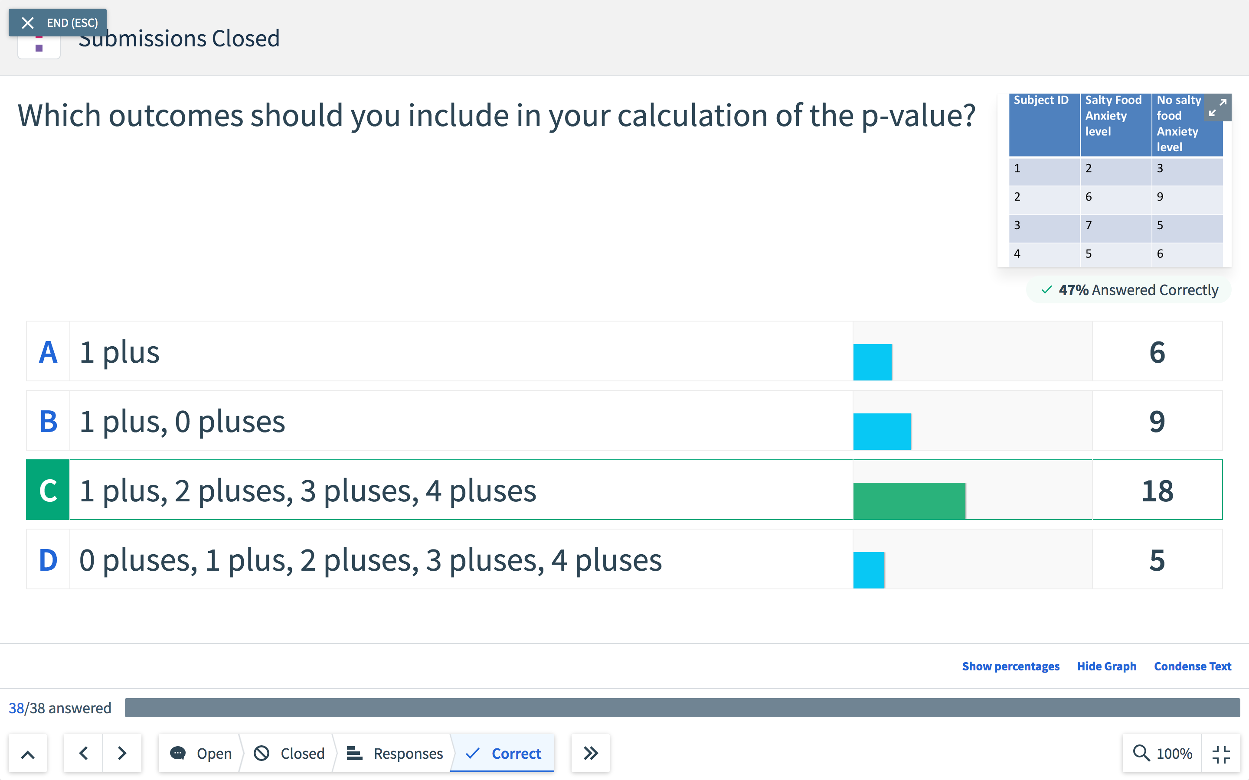
What the instructor sees after question

Slide 17
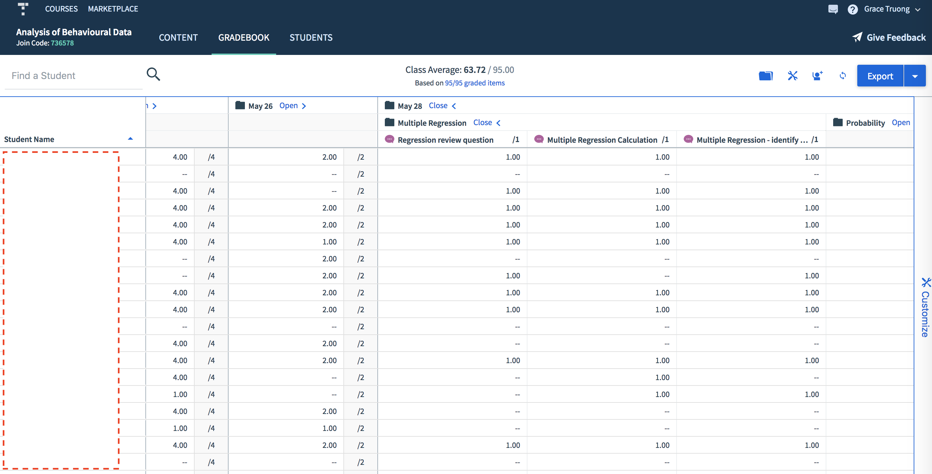
Gradebook

Slide 18
Overall impressions
It is instructor-friendly: Creator interface is straightforward
It is student-friendly
Only student issue was they mistakenly went to American Top Hat website
Students can check their participation marks any time they want
Preserves the participatory component of class

Slide 19
Reflections, future use, & Advice
50-65% of the class participated regularly in Top Hat questions
No student complaints about usage
Will use Top Hat again in Fall 2020 for Research Methods class
Contemplating using make-up assignment again – only ~10% of students regularly completed them (mostly students in Asia), not sure proportion of asynchronous students in the fall
Advice: Repeat slide info (and images) in Top Hat question

Slide 20
Joy Dixon
Associate professor, history

Slide 21
Top Hat Pro
https://tophat.com/teaching-resources/webinars-and-videos/active-learning-anywhere-introducing-top-hat-pro/
See the free webinar linked above on the changes to Top Hat introduced this summer:
“These new features will help you deliver engaging and accessible courses, whether teaching online, in-person, or a combination of the two. Learn how we’ve integrated video streaming, recording and transcription into our active learning platform to support synchronous and asynchronous learning. You’ll also see our new automatic attendance solution as well new features to personalize and securely administer remote assessments and more.”

Slide 22
Flexibility of Presentation Format
Run slides and Top Hat in separate windows
Use floating Presentation Tool over Keynote or Powerpoint
Upload slides (Powerpoint or PDFs – Keynote not currently supported) to the Top Hat platform and run slides and questions from there (you can also set it so that students can download the presentation directly from the Top Hat site)
Use “Pages” function on Top Hat website in place of slides (Pages can also be used to upload Word documents, image files, or PDFs)

Slide 23
Flexibility in Structuring Questions
Make questions time limited (e.g. while lecturing) or leave them open for a-synchronous completion by students
Questions can be fully anonymous, names visible to all, or names only visible to instructor
You get to choose mix of correctness and participation points for each question
Choose Review (ungraded) or Homework (graded)
Assign material or questions to all students or to individual students or groups
Set time/date limits on when they can access the material or particular questions

Slide 24
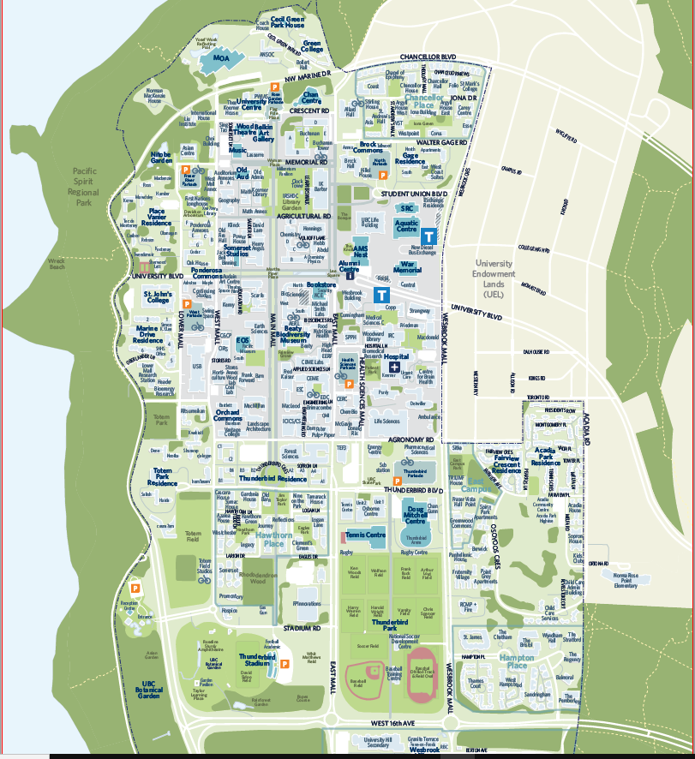
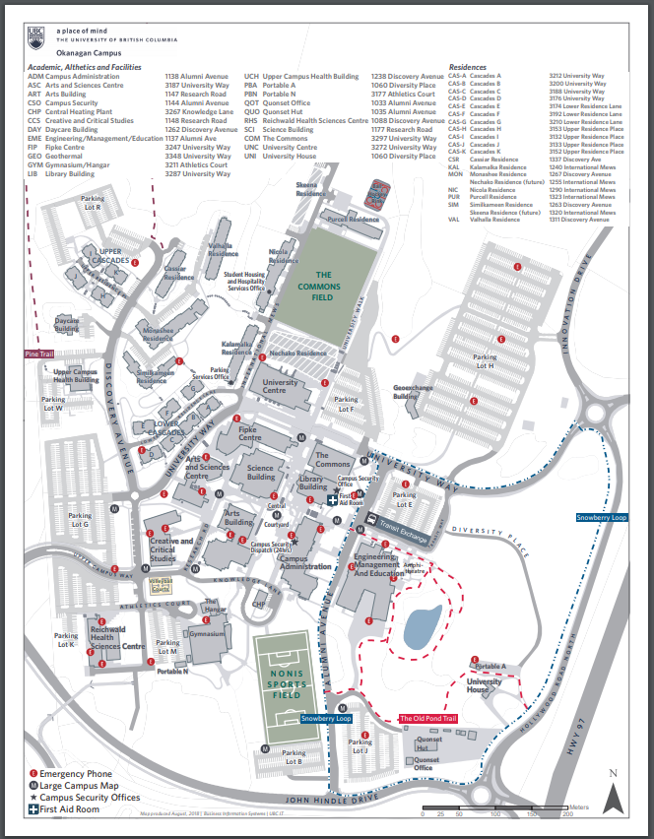
Target Questions: Where do you work?

Slide 25
From the SRS Working Group Demo

Slide 26
Virtual Discussions
“When laptop-ban arguments are broken down, what you find is mistrust of students and a sense of insecurity on the part of professors. And the studies that support the bans are shaky at best. Worst of all, laptop bans harm—really harm—disabled students, who make up a large part of the U.S. student population. Mistrust of students and shaky studies are not a good enough reason to hurt disabled students.”
Katie Rose Guest Pryal and Jordynn Jack, “When you talk about banning laptops, you throw disabled students under the bus,” HUFFPOST, 11/27/2017.
https://www.huffpost.com/entry/when-you-talk-about-banning-laptops-you-throw-disabled_b_5a1ccb4ee4b07bcab2c6997d

Slide 27
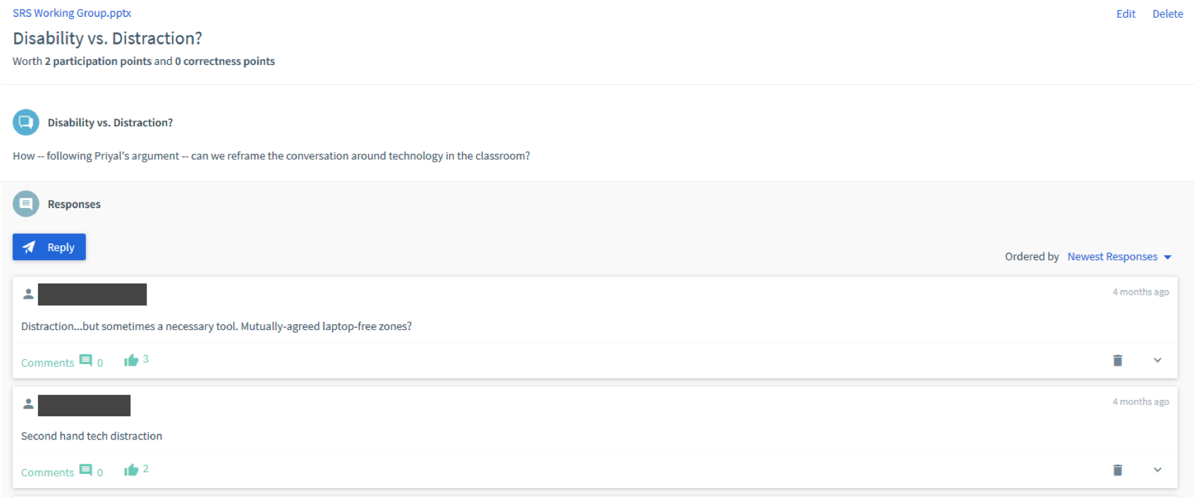
From the SRS Working Group Demo

Slide 28
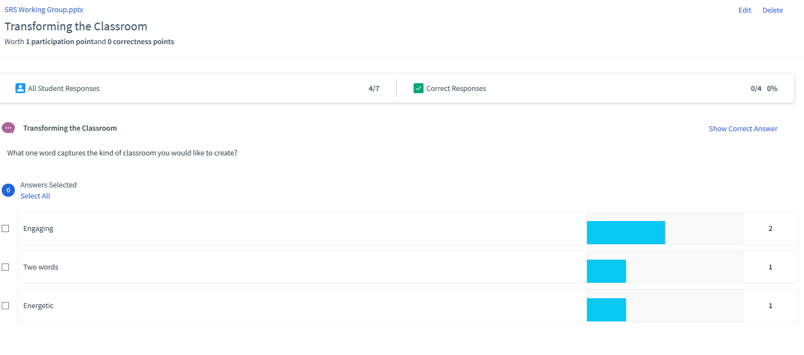
Display the answers as a word cloud,
graph, or in percentages

Slide 29
Other Features
Sorting questions (e.g., create a ranked list, put in chronological order…)
Numeric questions (can set a tolerance range for “correctness” – say within 10% is close enough to earn points)
Multiple choice
Matching questions (match the items in column A with items in column B)
Fill in the blank questions
“Tournament” (Beta)
Long answer questions (new)
Taking attendance (with or without geo-location)
Whiteboard sketch
Embed a link to an online video or website

Slide 30
Q&A Discussion
To participate:
Use the built-in chat to share any questions, comments, and resources.
Reminder: This session is being recorded.
Please anonymize any student information in your discussion.
If you have any questions that cannot be anonymized, please email us at arts.helpdesk@ubc.ca and we will follow-up with you.

