Slide 1
What we’ve learned from moving to online language instruction
A Panel Presentation
Thursday, June 4th, 2020

Slide 2
welcome
Introduction
Panelist presentations
Q&A discussion

Slide 3
INTRODUCTION
This is the kick-off panel for a month of online language teaching webinars. Details to come on https://isitworkshops.arts.ubc.ca.
This session will be recorded and uploaded to the ISIT website.
Please share any questions on https://app.sli.do/event/ieuoh9nr and vote on the ones you want answered during the Q&A. Use “@All” or “@Name” to indicate who your question is for.
During the Q&A discussion, please be mindful of any private information and anonymize personal details about specific students.
Your video streams and audio have been disabled to help with bandwidth.

Slide 4
presenters
“Pedagogical Considerations” by Luisa Canuto (FHIS)
“Design Considerations” by Qian Wang (ASIA)
“Selecting the Tools for Your Online Course” by Florian Gassner (CENES)
“Facilitating Virtual Interactions” by Brianne Orr-Álvarez (FHIS)

Slide 5
Pedagogical Considerations
Luisa Canuto

Slide 6
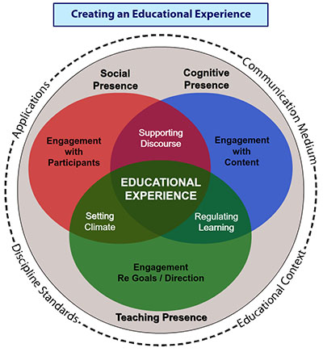
Community of Inquiry
Garrison, D. R., Anderson, T., & Archer, W. (2000). Critical inquiry in a text-based environment: Computer conferencing in higher educationmodel.

Slide 7
Cognitive Presence
Ability of learners to construct and confirm meaning through sustained reflection and discourse.
Establish clear, measurable learning objectives
Develop relevant, challenging, engaging learning activities
Utilize team-based learning to build collaborative knowledge and solve in-depth problems.

Slide 8
Cognitive Presence
Is my course syllabus clearly communicating measurable course learning goals?
Which online tools or strategies can I use to support reflection and interaction/collaboration?
What kind of learning activities can I use to help students remember, understand, apply, analyze, create knowledge? (i.e. Bloom Digital Taxonomy)
Common Sense Education. (2016, July 12). What is Bloom’s digital taxonomy? [Video]. YouTube. https://www.youtube.com/watch?v=fqgTBwElPzU

Slide 9
Social Presence
Ability of students and instructors to identify with the community, project themselves socially and emotionally through an online medium.
Personalize introductions and announcements
Include multiple formative assessments
Provide a mix of individual and group projects
Create engaging discussion forums

Slide 10
Social Presence
What personal information can I share with my students and encourage them to share as they introduce themselves?
What kind of assessment strategies can I include in my courses [synch/asynch, individual/group]?
What are the elements of an effective and engaging discussion forums?

Slide 11
Teaching Presence
“Design, facilitation, and direction of cognitive and social processes to realize educationally worthwhile learning outcomes.”
Set and communicate clear expectations for students. (ie. Course structure, Class meetings, Communication, Grading, Student workload, Feedback, etc.)
Be visibly (and often) present in the course and anticipate questions on activities and assignments.
Coach, guide learners and facilitate collaboration

Slide 12
Teaching Presence
What is my plan to communicate with students (i.e. welcome message, module overviews, task/deadline reminders, assignment) and help them stay on task?
What type and frequency of feedback will I need to provide (ie. formative, summative, timely)?
What type(s) of resources best support diverse learners (i.e. Principles of Universal Design for Learning)?
http://ctl.wiley.com/course-expectations-why-you-need-them-and-how-to-communicate-them/

Slide 13
design considerations
Qian Wang

Slide 14
Design Consideration
Level of language Class
Type of Language Class (spoken/listening, written/reading, topic-oriented, or comprehensive)
Class Type (Intensive, 2/3 times a week, etc.)
Content (Grammar, Vocabulary, Passage, Practice, Assessment)
Student composition
New and/or continuing students (freshman vs. graduating)
Language background (heritage vs. non-heritage)
Interaction Type
student-student,
student-teacher,
student-TA
Portion of Asynchronous and Synchronous components

Slide 15
selecting the tools for your
online course
Florian gassner

Slide 16
Digital Tools and Analogue Experiences

Slide 17
Creating your classroom

Slide 18
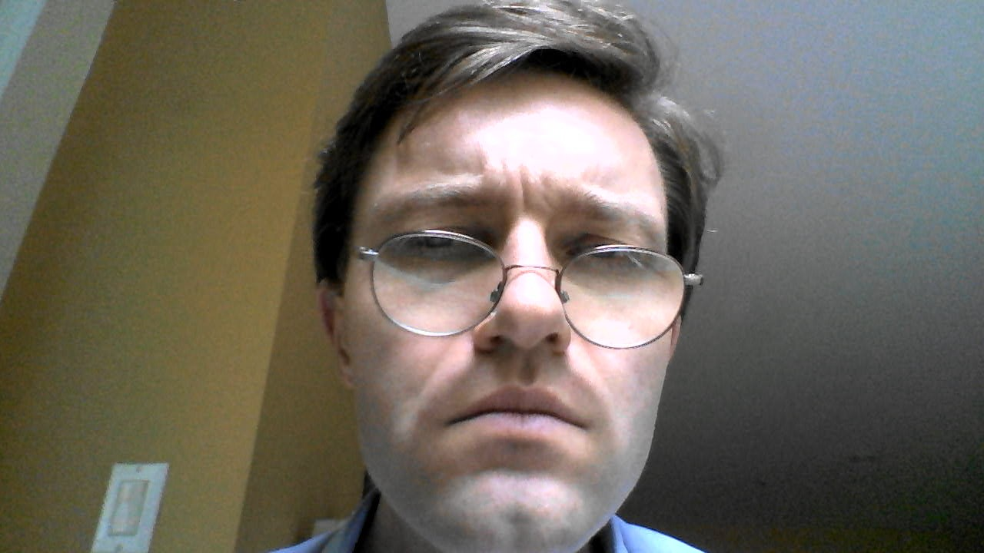
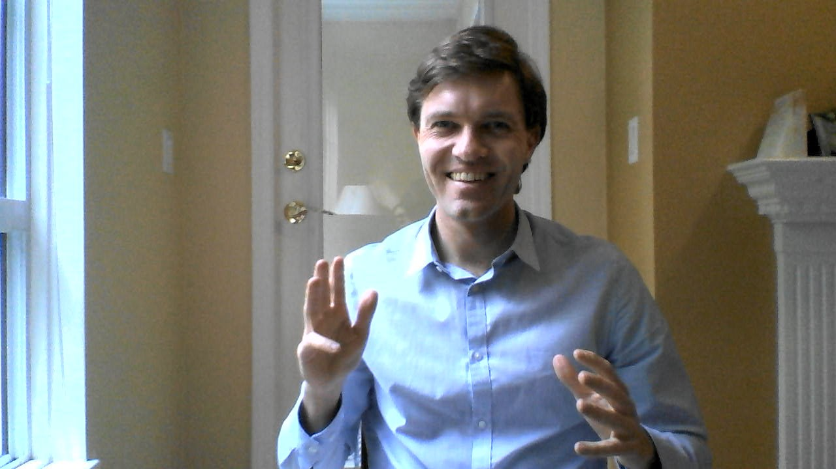
Hi – I’Ll be your instructor in LANG 100!

Slide 19
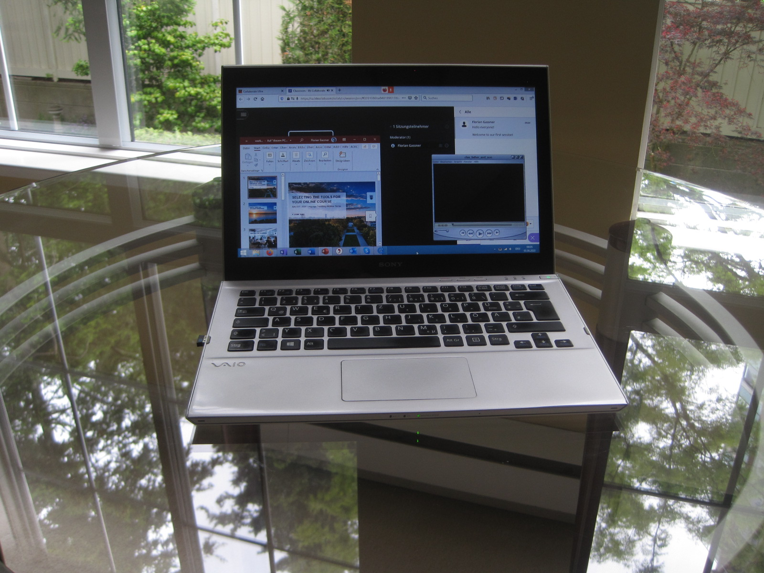
Setting yourself up for failure

Slide 20
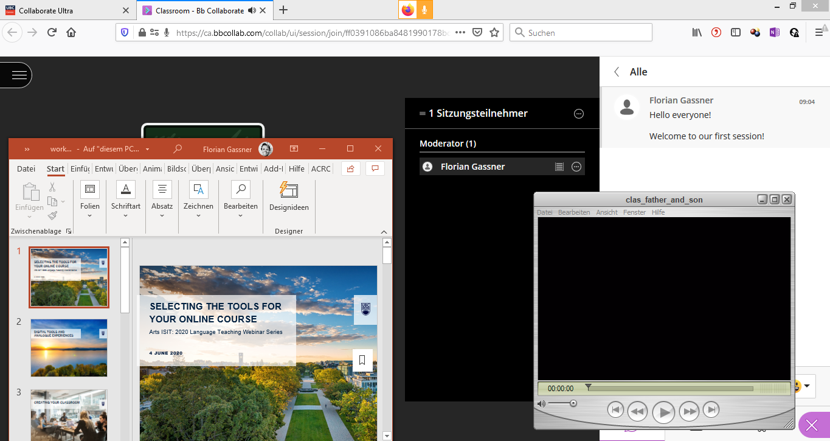
Your Desktop in failure mode
Collaborate Ultra Window
Presentation
Participant List
Chat
Video for Class Exercise

Slide 21
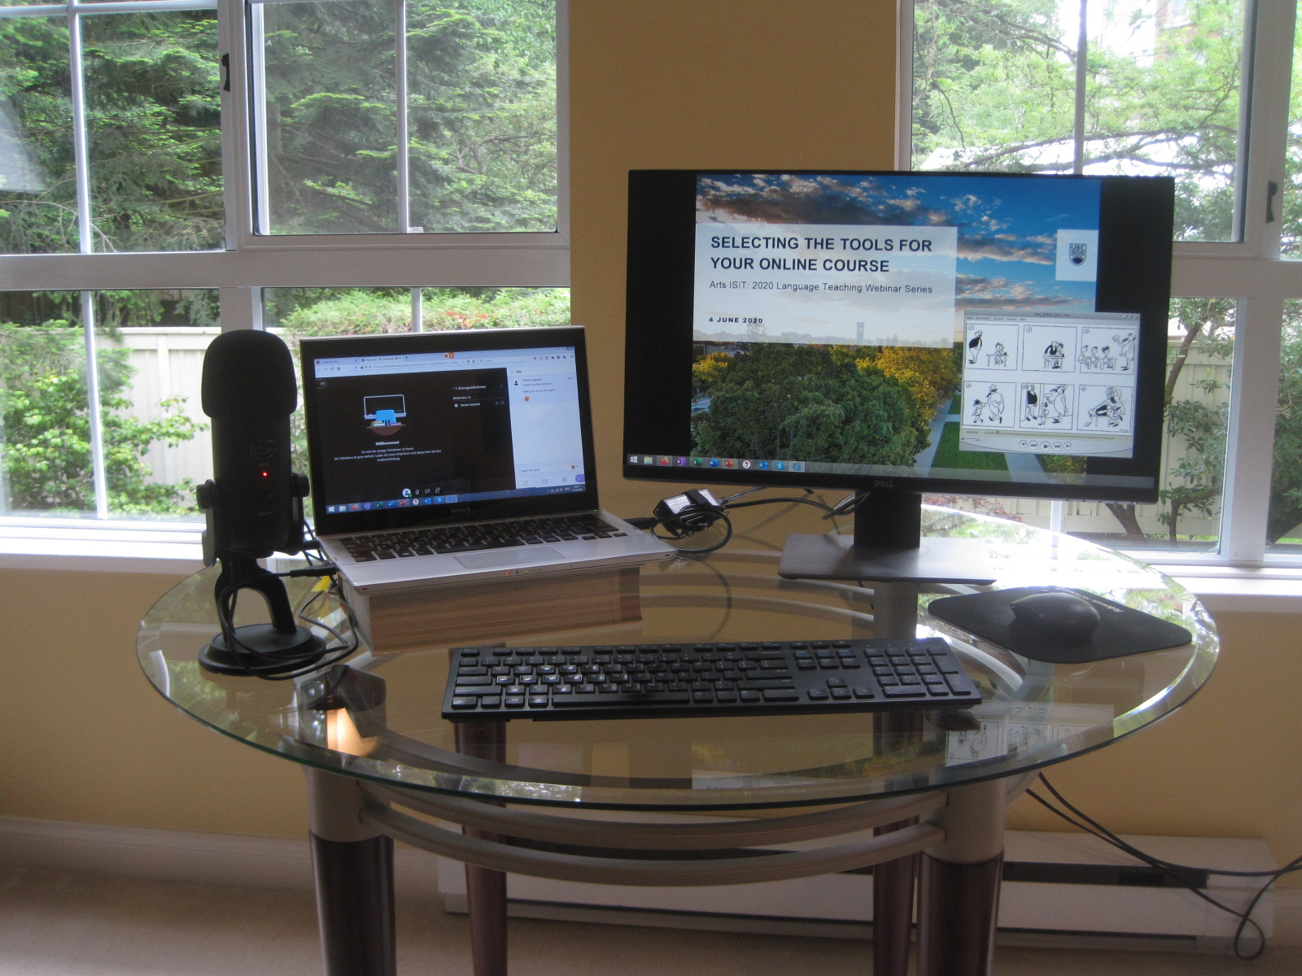
Taking control of your desktop

Slide 22
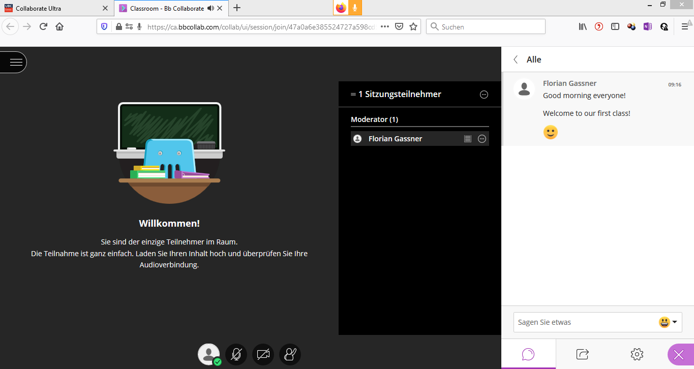
your desktop under control
My Screen
Shared Screen

Slide 23
manageable investments

Slide 24
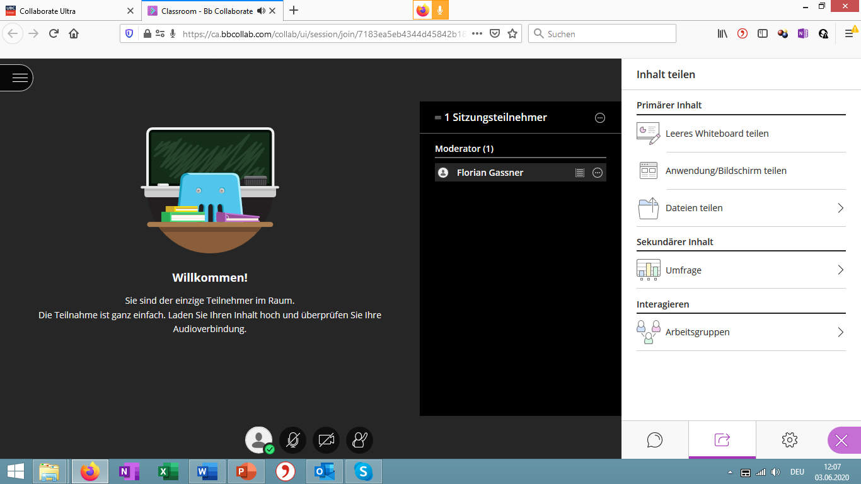
creating a social space

Slide 25
building your
course material

Slide 26
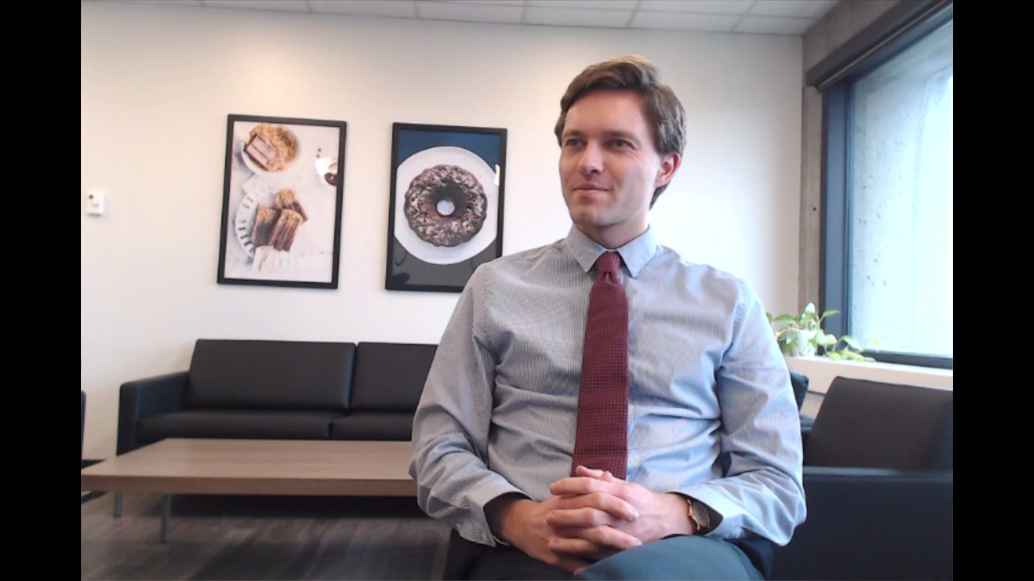
Breakfast

Slide 27
Father and son

Slide 28
Storytime Tutorial
http://languageteachingtools.sites.olt.ubc.ca/clas

Slide 29
Facilitating virtual interactions
Brianne orr-Álvarez

Slide 30
Facilitating Virtual Interactions Between students, Instructors, and Language Content
The focus of this segment:
Guiding principles for tool selection.
Effective tools and their advantages and limitations.
Tools for consideration for future virtual interactions and language content.
Guiding Principles
FIPPA Compliant
Flexible and adaptable to various collaborations and courses
Mobile friendly (when possible)
CWL restricted
Effective Tools
Canvas
Canvas integrated tools
MRBS
Tools for future virtual interactions
UBC Blogs
MatterMost
Brianne Orr-Álvarez June 2020

Slide 31
Q&A Discussion
To participate:
Go to https://app.sli.do/event/ieuoh9nr and submit your questions or vote on existing ones.
Use the built-in chat if you would like to share comments or resources.
Reminder: This session is being recorded.
Please anonymize any student information in your discussion.
If you have any questions that cannot be anonymized, please email us at arts.helpdesk@ubc.ca and we will follow-up with you.

