Slide 1
Simple engagement options for language teaching
A Panel Presentation
Tues, June 16, 2020

Slide 2
welcome
This webinar is part of a special series on online language teaching happening this month. For more sessions, please see https://isitworkshops.arts.ubc.ca.
This session will be recorded and uploaded to the ISIT website.
During the Q&A discussion, please be mindful of any private information and anonymize personal details about specific students.
Your cameras and microphones have been disabled to help save on bandwidth.

Slide 3
Session introduction
Introduction
Speaker presentation
Q&A discussion

Slide 4
Presenter INTRODUCTION
Luisa Canuto, Instructor & Program Director of Italian (FHIS)
Mixing Assessment Techniques: Focusing on Writing Skills, from asynchronous to synchronous and from individual to group work
Florian Gassner, Senior Instructor & Undergraduate Advisor of German (CENES)
Community and Collaboration in Language Teaching
Brianne Orr-Álvarez, Instructor & Program Director of Spanish, Director of FHIS Learning Centre (FHIS)
Extra-curricular support for fostering online language communities

Slide 5
Q&A Discussion
To participate:
Use the built-in chat if you would like to share comments or resources.
Reminder: This session is being recorded.
Please anonymize any student information in your discussion.
If you have any questions that cannot be anonymized, please email us at arts.helpdesk@ubc.ca and we will follow-up with you.

Slide 6
Mixing Assessment Techniques
Luisa Canuto

Slide 7
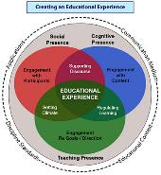
My Reflections as I Revise everything …
Draw from our individual and collective experience
Refer back to the many (successful) learning activities already used
Focus on available/supported educational tools (to limit possible issues)
Keep Guiding Principles in mind

Slide 8
Guiding Principles
Cognitive Presence [Engaging with the Content]
[Utilize team-based learning to build collaborative knowledge]
Social Presence [Engaging with Participants]
[Provide a mix of Individual and Group Projects]
Teaching Presence [Engaging with Goals]
[Coach, guide learners and facilitate collaboration]

Slide 9
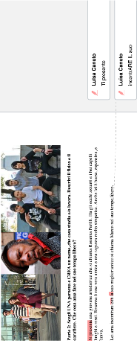
(1a) Individual, asynchronous, low-stakes, formative (ITAL101)
Prova Scrittura 3/5
80-100 words
1% overall grade
L. Objectives
Describe and write about people’s appearance
Use adjectives and agreement

Slide 10
(1b) Individual, synchronous, higher-stakes, summative (ITAL101)
Scrittura 3 /5
110-130 words
3% overall grade
L. Objectives
Describe and write about people’s appearance
Use adjectives and agreement

Slide 11
5% overall grade
L. Objectives
Describe and write about people’s appearance
Use adjectives and agreement

Slide 13
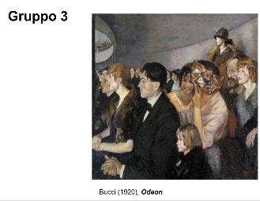

Slide 14
(2a) Individual, (a)synchronous, low-stakes, formative (ITAL101)
Participation Grade
L. Objectives
Describe and write about people’s appearance (Use adjectives and agreement)
Developing intercultural awareness
[Have fun!]

Slide 15
(2b) Collaborative, synchronous, low-stakes, formative (ITAL101)
L. Objectives
Identify and Use adjectives
Develop awareness of Italian music and culture
[Have fun!]
Lavoro di Gruppo 2:
Leggete (Read) il testo della canzone
Identificate (Identify) e highlight TUTTI gli aggettivi
Scrivete (Write) la traduzione di ogni aggettivo in gruppo
in 3 o 4 minuti (EVERYBODY contributes, ONE person per group writes all words in ONE comment)
Cambiate (Change) tutti gli aggettivi con i loro opposti (opposite!) per UN paragrafo (next page)

Slide 16
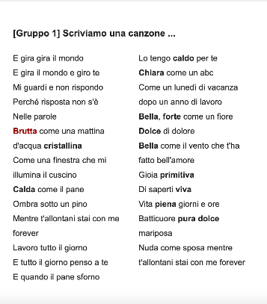
(2b) Collaborative, synchronous, low-stakes, formative (ITAL101)

Slide 17
(3a) Individual, (a)synchronous, (higher)-stakes, formative (ITAL301)
L. Objectives
Develop awareness on aspects of Italian contemporary society
Contribute your knowledge on Italian culture
+ 5 comprehension questions on a Canvas Quiz

Slide 18
(3a) Individual, asynchronous, (higher)-stakes, formative (ITAL301)
Reading + Comprehension Questions on Canvas
Nel 2018 si stima che il numero complessivo di viaggi con pernottamento effettuati dai residenti in Italia sia pari a 78 milioni e 940 mila, valore in notevole crescita rispetto al 2017 (+19,5%) che rafforza la tendenza positiva registrata a partire dal 2016.
L’aumento del numero è associato a una lieve diminuzione della durata media dei viaggi, che si attesta a 5,5 notti (5,7 per vacanza e 4,1 per lavoro), per un totale di 432 milioni di pernottamenti (+13,5%).
Nel 2018, aumentano le vacanze lunghe (oltre quattro notti), con un trend positivo per il terzo anno consecutivo (+12,7%), quelle brevi (+19,6% rispetto al 2017) e i viaggi di lavoro (+57,7%).
Il 79,3% dei viaggi ha come destinazione principale località nazionali (+16,7%), il restante 20,7% è diretto soprattutto nei Paesi dell’Unione europea e registra una notevole crescita sull’anno precedente (+31,4%).
Le mete principali in Italia sono la Puglia (13,1%) e l’Emilia-Romagna (9,9%) per le vacanze lunghe estive e il Trentino-Alto Adige (31,0%) per quelle invernali. In autunno al primo posto si posiziona la Lombardia (14,2%) e in primavera la Toscana (14,1%), principale destinazione delle vacanze brevi dell’anno (16,4%).
La Francia è la destinazione preferita per le vacanze brevi all’estero (17,6%), la Spagna per quelle lunghe (12,6%) e per i viaggi di affari (12,4%).
Tra i viaggi con mete extra-europee, gli Stati Uniti sono la destinazione preferita sia per le vacanze lunghe (2,4%) sia per i viaggi di lavoro (3,9%).

Slide 20
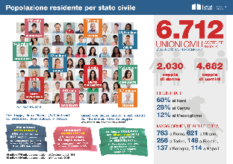
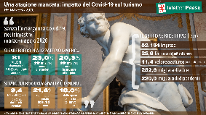
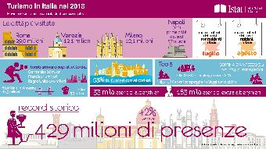
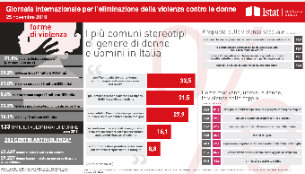
Gruppo 1
Gruppo 6
Gruppo 4
Gruppo 5
Gruppo 2
Gruppo 3

Slide 21
Community and Collaboration in Language Teaching
Florian Gassner

Slide 22
Extra-curricular support for fostering online language communities
Brianne orr-Álvarez

Slide 23
Extra-curricular support for fostering online language communities
THE FOCUS OF THIS SEGMENT
DEFINITION AND BENEFITS
GUIDING PRINCIPLES
USEFUL TOOLS

Slide 24
Extra-curricular support for fostering online language communities
This Photo by Unknown Author is licensed under CC BY
This Photo by Unknown Author is licensed under CC BY-SA-NC
DEFINITION
Extracurricular support could be categorized as anything that supplements the practices and expectations of the regular curriculum for any given course or program.
These types of activities are typically student or instructor-driven, and are not typically regulated by grades, compulsory participation, and other formal aspects of the curriculum
BENEFITS
The focus on community-building typically has a positive impact on students’ course-work, motivation, and capacity to use the language in every-day situations (social, professional)
Participation is voluntary, which improves attitudes and students frame their own expectations for the experience and drive interactions with their interests

Slide 25
Guiding Principles for Effective Tool Selection
Guiding Principles
Privacy
Flexible adaptable, intuitive
Opportunity for growth (for students, tool-wise)
Readily facilitate peer-peer interaction
Notes:
Stick with what students are comfortable with
Protect students’ privacy (FIPPA compliant, CWL restricted)
Choose tools that readily facilitate peer-peer interaction, and are intuitive, flexible, and adaptable to varying student schedules and needs
Mobile friendly (when possible)
Offer related resources and opportunities for extension/expansion, and growth across courses and programs
lease click “Register Now” to register for this event. This event will hosted online on Zoom.
Developing and fostering an online community in your course can increase student engagement and motivate students. In this session we explore practical design and teaching approaches to building a Community of Inquiry (CoI). The CoI is a framework that focuses on facilitating meaningful learning experiences through three presences: cognitive, social, and teaching. Join us as we explore practical instructional strategies based in these 3 presences.
Learning Objectives:
Explain the idea behind a Community of Inquiry
Explain each of the three presence necessary for a successful Community of Inquiry
Select CoI instructional strategies to enhance social, cognitive and teaching presence in your online course
Warm-up and polls (Qian)
– post March 15.
We’re going to start our discussion today by learning a little bit more about how you typically approach assessment in language contexts and what (if anything) you may have changed after March 18, when we all moved courses online.
To do this, please participate in the chat or polls as they come!
Qian’s suggestions on warm-up questions based on Bri’s outline:
Warm-up questions:
1. Q: What are some ways in which you typically assess student learning in face-to-face language learning classrooms?
(Format: participate input? or poll to avoid time for typing and also to direct discussion, waiting period, ease ppl in., invite conversation.)
a.quiz/high-stake exam
b. group project
c. writing/reading assignment,
d. weekly homework
e. oral exams
2. What changes did you make to assessment after we transitioned to online teaching?
a. Moved quiz/exam/submission to online
b. Redistributed percentage of different assessments
c. Increased the frequencies of assessment tasks
d. Changed some summative assessments to formative
e. Designed new assessment tasks
(Format = poll, and chat. Direct ppl to changes that can be made. Disencourage option a., simply moving everything online. Brainstorm the different ways of making changes in assessment that can be made.)
3. What is your biggest concern in keeping integrity in language assessment after we transitioned to online teaching?
a. to prevent cheating in quiz/exam
b. to prevent plagiarism in writing
c. to ensure that learning objectives are achieved
d. to collect/show evidence of student learning
e. other
(Format = poll, and chat. Go over each choice to arrive at these conclusions.
a. & b. are preventive measures.
c. & d. are learning based concerns.
to achieve a and b we will need technology.
to achieve c. and d.
not recommended to pursue super fancy technologies. Pick a couple and use them to your advantages. Spend less time in finding out different tools but spend more time in using the technologies/tools that you are familiar with to meet the needs.
b. academic integrity can be achieved in different ways. E.g. don’t test translation, add one-on-one check-in points, which is easier than in a classroom setting)
c. you can change learning objectives, maybe you SHOULD! emphasize learning ability, identifying learning materials/tools for oneself, reflecting on one’s learning/progression, finding out advantages and disadvantages of one’s own learning.
Conclusion: shift your work to help them discover HOW to learn language better instead of simply focusing on acquired vocabulary and patterns.

Slide 26
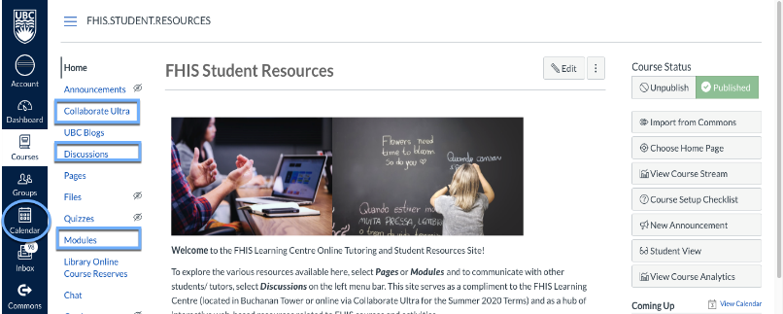
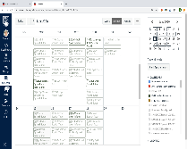
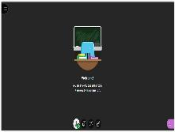
Tools to Support Extracurricular Language Support
CANVAS
SCHEDULE
INTERACT
ENGAGE AND EXPEND
Discussions
Modules
Pages
Library
More!

Slide 27
Are you interested in learning more?
JUNE 25 WEBINAR: Extracurricular Language Support, Scheduling, and Best Practices Time: 1:00pm – 2:00pm
Live, conversational practice is a key aspect of language learning that is hard to replicate in an online classroom with limited hours. Building virtual opportunities for extracurricular support is critical for maintaining an engaging language learning experience for students. In this session, Brianne Orr-Álvarez (Instructor and Program Director of Spanish, FHIS) will discuss the framework, practices, and skill-focus for extracurricular language support, using the FHIS Learning Centre and the related language tables as an example.

