Slide 1
Online Canvas Discussions in Large-Sized Language Content Courses: Perils and Opportunities
Xiaowen Xu
Mon, June 22, 2020

Slide 2
welcome
This webinar is part of a special series on online language teaching happening this month. For more sessions, please see https://isitworkshops.arts.ubc.ca.
This session will be recorded and uploaded to the ISIT website.
Questions will be taken at the end of the session. During the Q&A, please be mindful of any private information and anonymize personal details about specific students.
Your cameras and microphones have been disabled to help save on bandwidth.

Slide 3
Session introduction
Introduction
Speaker presentation
Q&A discussion

Slide 4
Presenter INTRODUCTION
Xiaowen Xu, Instructor of Chinese (ASIA)
Participation before, within, and after class to help students reach their learning objectives using Canvas discussion boards & Collaborate Ultra breakout rooms
Connecting collaborative activities to course materials

Slide 5
Online Canvas Discussions in Large-Sized Language Content Courses
Xiaowen xu

Slide 6
Goals to reach today
Contextualize online discussions in a content course in a language program
Identify perils in engaging online discussions in a content course in a language program
Propose to take action: make opportunities out of perils in connecting online discussions to the course contents, pedagogical practice and learning assessments

Slide 7
Outline
Contextualize Online Discussion
Conceptual Framework
Perils vs. Opportunities
Tentative Solutions
Impact and Limitations
Cited References

Slide 8
Contextualize Online discussion
While I speak, please type how you would contextualize your own course
Course:
A Content Course in the field of Chinese Literature in CHIN Program
Cap:
60/class
Summer session
3hrs/session; 2 sessions/week
Online (Synchronous and Asynchronous)

Slide 9
Contextualize Online discussion
Learning objectives:
Read…required texts with increased critical distance
Know the literature and cultural traditions expressed in the … texts….
Critically discuss and write about the literary aspects of the … texts
Develop original arguments on the … texts in an academic project
Learning Activities:
Students’ participation in (synchronous) class meetings
Students’ pre-session reading of the … texts (asynchronous)
Students’ individual assignments and peer-reviews in final project (asynchronous)
ONLINE DISCUSSIONS:
Discussion Board, Virtual Classroom, Announcements, Self-study online assessments, Canvas Peer Feedback, RichReview Feedback, Virtual Office Hour Consultation, etc.

Slide 10
Contextualize Online discussion
Site | Used to Be | NOW
Canvas | supplementary | major venue for T/L
Online Discussion Board | additional | Supplementary for L
Ultra Collaborate | optional meeting place for virtual office consultation | virtual classroom Instructor’s office (T/L)

Slide 11
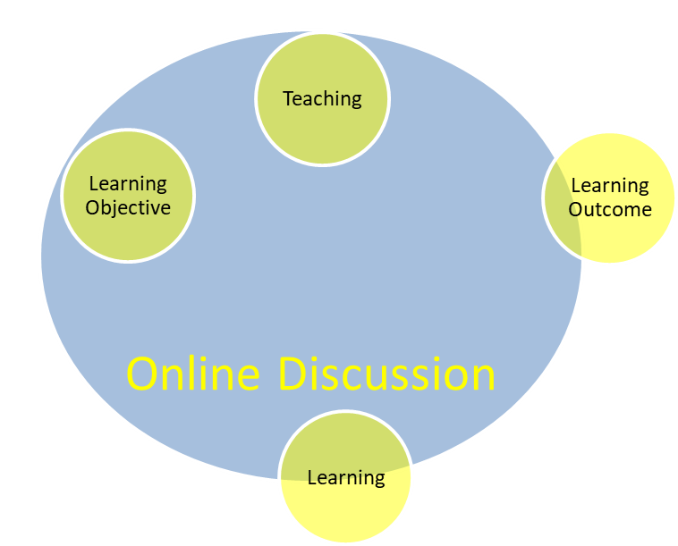
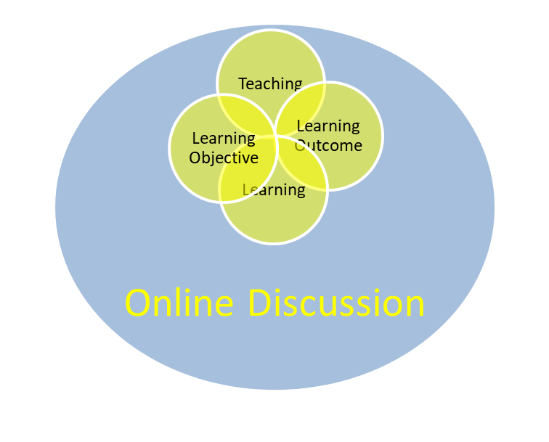
Conceptual Framework

Slide 12
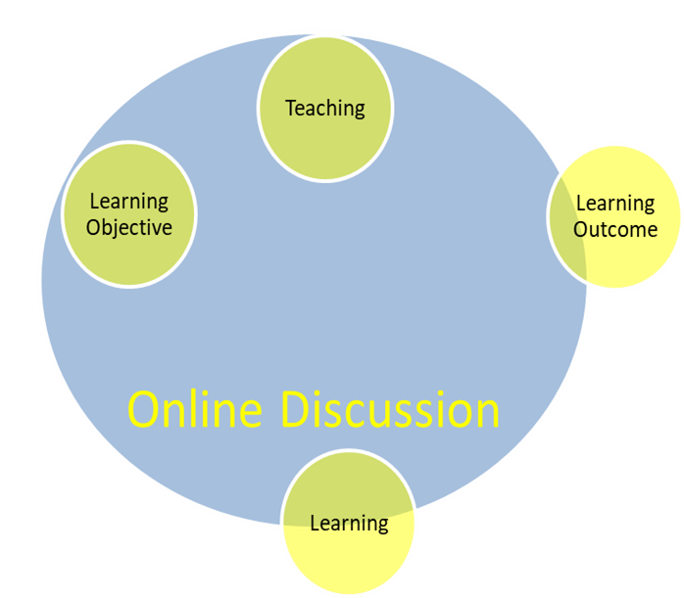
Perils vs. Opportunities
Perils (Please share with us your views)
T/L estranged by
Temporal difference
Spatial distance
Discussion Board | T in Collaborate Ultra | L in Collaborate Ultra
T: start a thread | Face in virtual presence | Screen with a variety of distractions
L: sparse replies | Monologue on content | Monotonous silence
 | Instruction on skills-improvement | Confused, lost, yet reluctant to ask for help
 | Targeting the learning objective | Barely following the course pace
 | Active but futile efforts | Passive but helpless

Slide 13
Perils vs. Opportunities
Behind the Perils: (what caused the perils?)
Traditional mindset of T/L positions
Habitual practice of on-site communication with students
Immediacy of feedback from the instructor
Availability of the instructor to remind students of course progress by regular meetings
The gap/trap (what estranged T and L in the online discussion?)
Teaching Paradigm vs. Learning Paradigm (Barr and Tagg, 1995)
Asynchronous students’ response to a call from the instructor
The instructor is losing touch of individual students’ progress chart
Time and space block the gentle reminders from the instructor

Slide 14
Perils vs. Opportunities
Opportunities: (Let’s brainstorm)
“Climb every mountain / Ford every stream”
Teaching Paradigm vs. Learning Paradigm (Barr and Tagg, 1995)
Flipped roles in the T/L experience
Engage students early before the lecture
Reward their learning with consistent threads
Asynchronous students’ response to a call from the instructor
Use online board to talk to all
Use synchronous teaching to build the learning community
Form patterned communication frequency in asynchronous learning activity
The instructor is losing touch of individual students’ progress chart
Help students build time-management skills via Canvas
Students take the initiative of managing their learning progress
Instructor set up modular pace
Encourage peer-review and online discussion to build up learning community from the students’ end
Time and space block the gentle reminders from the instructor
Climb the mountain of time with steadiness
Ford the stream of space with care

Slide 15
Tentative Solutions
How do we climb these mountains and ford these streams?
Discussion Board | T in Collaborate Ultra | L in Collaborate Ultra
T: start a thread | Face in virtual presence | Screen with a variety of distractions
L: sparse replies | Monologue on content | Monotonous silence
 | Instruction on skills-improvement | Confused, lost, yet reluctant to ask for help
 | Targeting the learning objective | Barely following the course pace
 | Active but futile efforts | Passive but helpless

Slide 16
Tentative Solutions
Discussion Board | T in Collaborate Ultra | L in Collaborate Ultra
Design questions relevant to the next lecture | Stare/glare/smile at your camera from time to time | Focus on the teacher, but with challenging questions in mind (synchronous/asynchronous)
Link the discussion to the participation | shorten your lecture with questions related to the previous discussion board | Solo to respond the instructor’s question, group discussion to communicate with peer students, group report to share with the class
Q & A forum initiated by students | Online instruction sheets and clear rubrics demonstration in lectures (preferably by examples) | Categorize questions in line with rubrics Review peer students’ assignments as in a teacher’s position
 | Targeting the learning objective Set a modular pace for the course | Targeting the learning objective Setting up one’s own learning clock
 | Leading but not monitoring | Co-managing the learning Self-check and group work

Slide 17
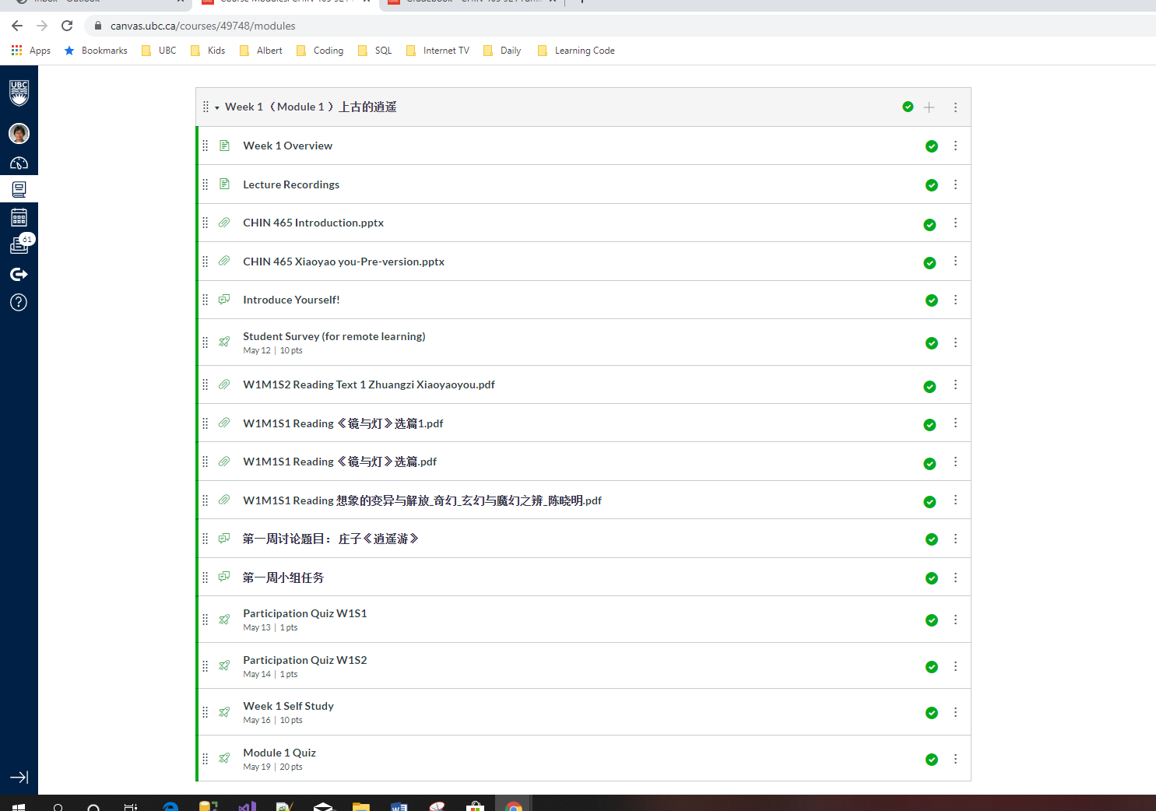
Tentative Solutions and results

Slide 18
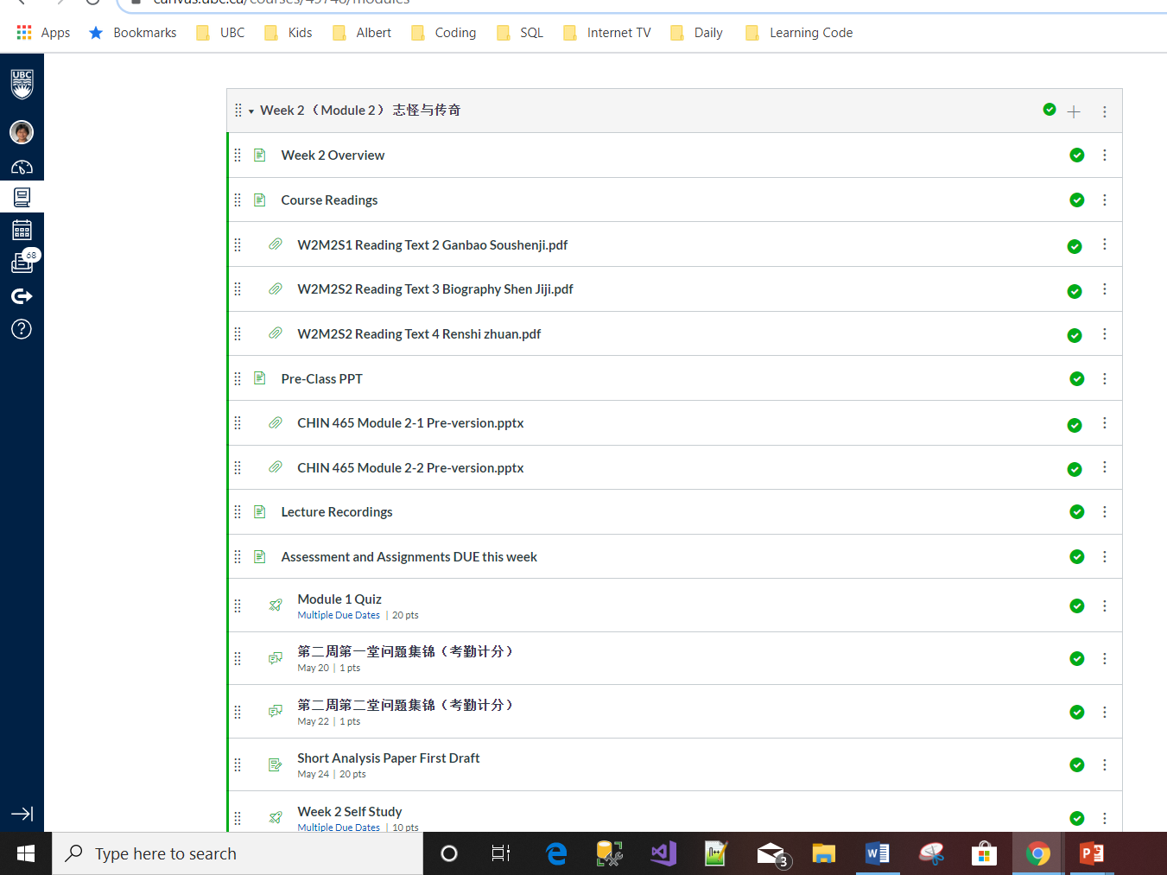
Tentative Solutions and results

Slide 19
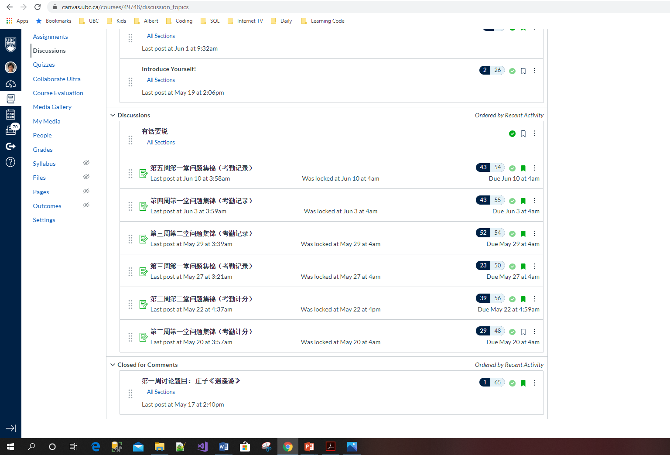
Tentative Solutions and results

Slide 20
Tentative Solutions and results
Analysis of the online discussion board:
(the total enrollment after drop deadline is 57)
Wk | T’s thread | L’s reply | Peers’ responses
1 | 1 | 65 | 1
1+ | 1 | 48 | 29
2 | 1 | 56 | 39
3 | 1 | 50 | 23 (Final project starts this week)
4 | 1 | 54 | 52
5 | 1 | 55 | 43
6 | 1 | 54 | 43

Slide 21
Impacts and limitations
Impacts:
Engaged students’ attention to the texts
Initiated students’ research questions on those texts
Inspired students’ peer-discussion before meeting the instructor
Students paying more attention to the instructor’s lecture, synchronously or asynchronously
Group discussions are more guided by the questions, not the instructor
The instructor provided a model of academic communication
Students achieved better learning outcomes

Slide 22
Impacts and limitations
Limitations
Not all students are engaged equally
Small groups (4-10) are less popular and productive than larger ones (10-20)
A couple of “free-riders” in group discussion
Peer reviews are limited to 2-3 students
Instructor rush to prepare feedbacks before peer reviews
Proposals from everybody:
What shall I do next term? Please divide the labour to help me:
1. Find out why
2. Propose solutions

Slide 23
Cited references
Barr, Robert B & John Tagg (1995). “From Teaching to Learning: A New Paradigm for Undergraduate Education,” Change: the Magazine of Higher Learning, 27(6).
Dias, Manuel & Jocelyn Micallef (2020). “Blended Learning From a Different Focus, ” UBC CTLT Webinar. April 20, 2020.
Flaherty, Colleen (2020). “Zoom Boom,” Inside Higher Education. April 29, 2020.
Kong, Stella (2009). “Content-Based Instruction: What Can We Learn from Content-Trained Teachers’ and Language-Trained Teachers’ Pedagogies?” in The Canadian Modern Language Review, 66(2), 233-267.
Matthews, Kelly E. (2019) "Rethinking the problem of faculty resistance to engaging with students as partners in learning and teaching in higher education," International Journal for the Scholarship of Teaching and Learning: Vol. 13: No. 2, Article 2.

Slide 24
Thank you!
(xiaowen.xu@ubc.ca)

Slide 25
Q&A Discussion
To participate:
Use the built-in chat to share any questions, comments, and resources.
Reminder: This session is being recorded.
Please anonymize any student information in your discussion.
If you have any questions that cannot be anonymized, please email us at arts.helpdesk@ubc.ca and we will follow-up with you.

