Slide 1
Designing & teaching a fully online distance education language course
Nick Hall, Misuzu Kazama, Ihhwa Kim
Mon, June 22, 2020

Slide 2
welcome
  This webinar is part of a special series on online language teaching happening this month. For more sessions, please see https://isitworkshops.arts.ubc.ca.
  This session will be recorded and uploaded to the ISIT website.
  Questions will be taken at the end of the session. During the Q&A, please be mindful of any private information and anonymize personal details about specific students.
  Your cameras and microphones have been disabled to help save on bandwidth.

Slide 3
Session introduction
  Introduction
  Speaker presentation
  Q&A discussion

Slide 4
Presenter INTRODUCTION
  Presenters:
    Nick Hall, Lecturer of Japanese (Asian Studies)
    Misuzu Kazama, Lecturer of Japanese (Asian Studies)
    Ihhwa Kim, Lecturer of Japanese (Asian Studies)
  Topic:
    Sharing experience from teaching two distance education courses for over 9 years
    Course design and format, tests and assignments, and alignment with on-campus courses
    Helping students move through courses as autonomous learners

Slide 5
Designing & teaching a fully online distance education language course

Slide 6
Designing & teaching a fully online distance education language course
  I. Design and Development
  II. Teaching
  III. Senpai Drill (Pronunciation and dialogue drill) and Enunciate
  IV. Future Goals and Challenges

Slide 7

I. Initial Design and Development
JAPN100
-Developed and taught in Sep 2011
-Course authors: Ihhwa Kim, Nakata Masahiko
JAPN101
-Developed and taught in Jan, 2012
-Course authors: Ihhwa Kim, Misuzu Kazama
On WebCT VISTA….

Slide 8

Where to start and how?
Planning (Blueprint & a sample unit)
Development (Content, media, copyright clearance, invitation of subject librarian, technology selection, academic review, etc.)
Production (Completing revisions,
Review hard copy of all materials, web production)
Delivery/implementation (review of the course online, teaching the course)
Evaluation
Revision

Slide 9

Who were the team members?
Project Manager
Course Author (speaker of the target language)
Instructional Designer
Web Programmer
Graphic Designer
Video Producer
Subject Librarian
Academic Reviewer
Supporting Administrative Staff

Slide 10

For Optimal Learning Environment
Flexible and individualized learning environment
Frequent and meaningful interactions for language learning
Technology-supported learning environment

Slide 11

What the students need
Computer
Headset
Webcam
Access to a scanner (or now, a scanner app)
Textbook

Slide 12
Course/ Lesson design
6 lessons x 2 weeks + tests = 13 weeks
Introduction
Topic &Textbook & Web content
Practice
Worksheet
Skit preparation
Assignment & Assessment
Quizzes
Skit presentation
Composition
Exercises /Self test
Voice recording
Lesson Goal
x6
Project
Listening Test/ Oral test/ Writing test/ Final exam
(common exams)

Slide 13
Authoring the Course: Goals
Interaction Moore (1980)
with content
with instructors
among peers
in 4 skills of the language
Speaking, Listening, Writing, Reading

Slide 14
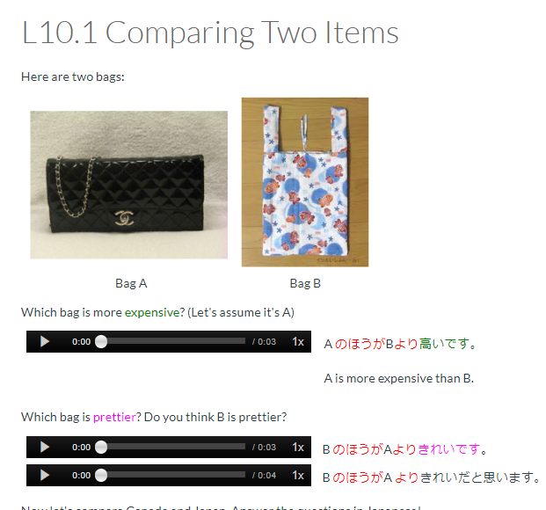
1. Interaction with the content

Slide 15
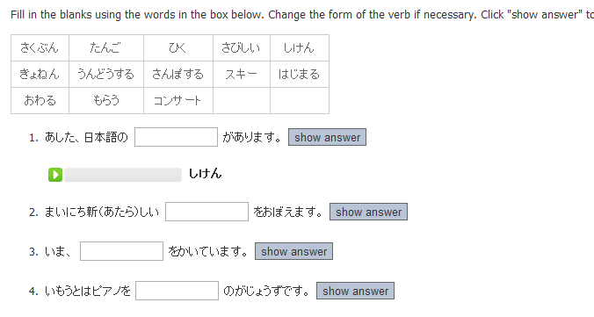
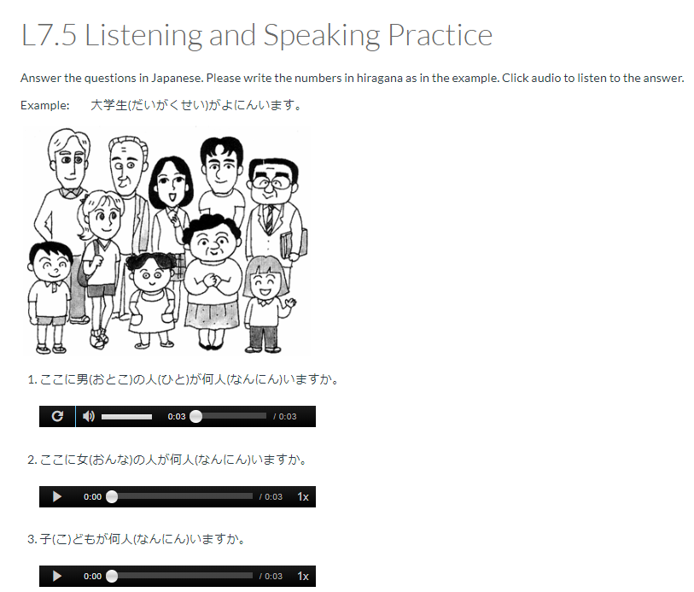
Self Exercise

Slide 16
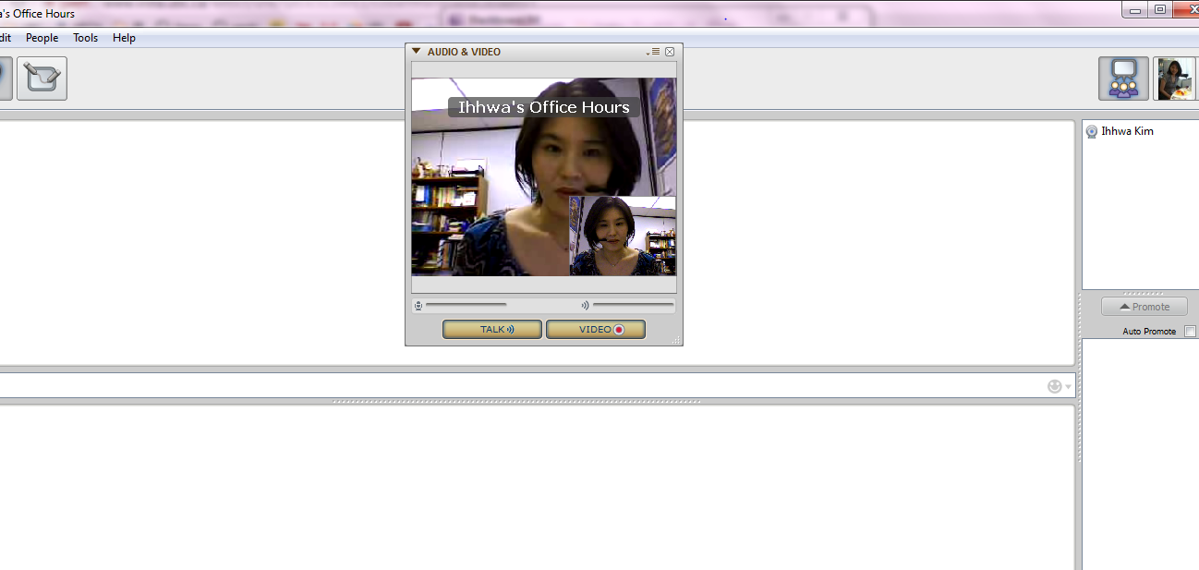
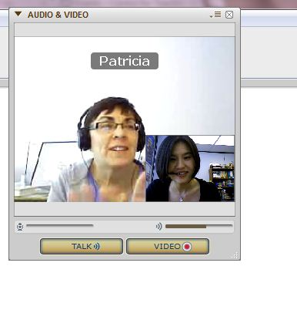


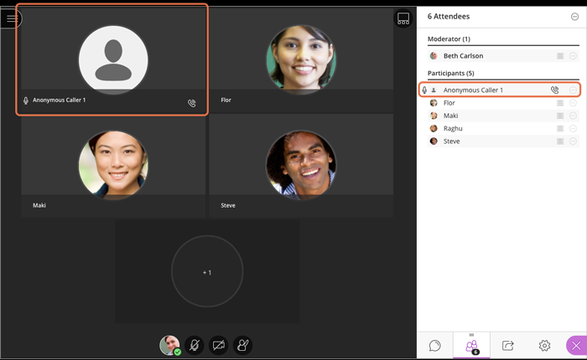
2. Interaction with the Instructor

Slide 17
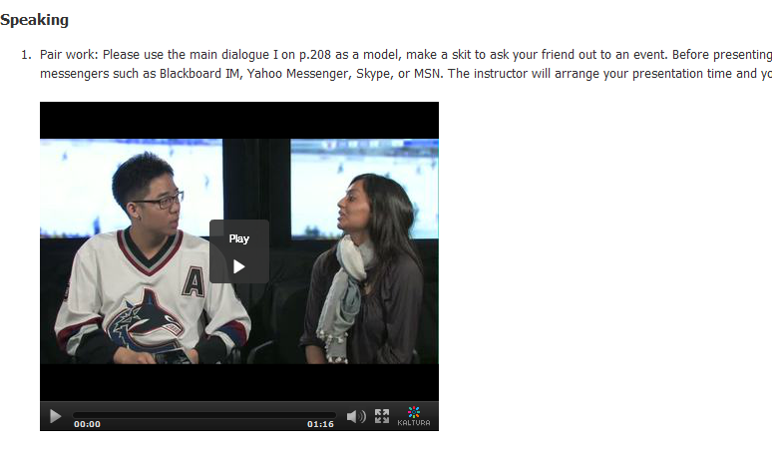
3-A. Interaction among peers (S/L)
Watch & Listen
Learn what is expected
Learn gesture, facial expression
Practice with Partner
Scribe using new grammar, vocab
Practice & Memorize
Presentation
Submit a video or make a live presentation
Feedback
👆
Sample skit video performed by UBC students

Slide 18
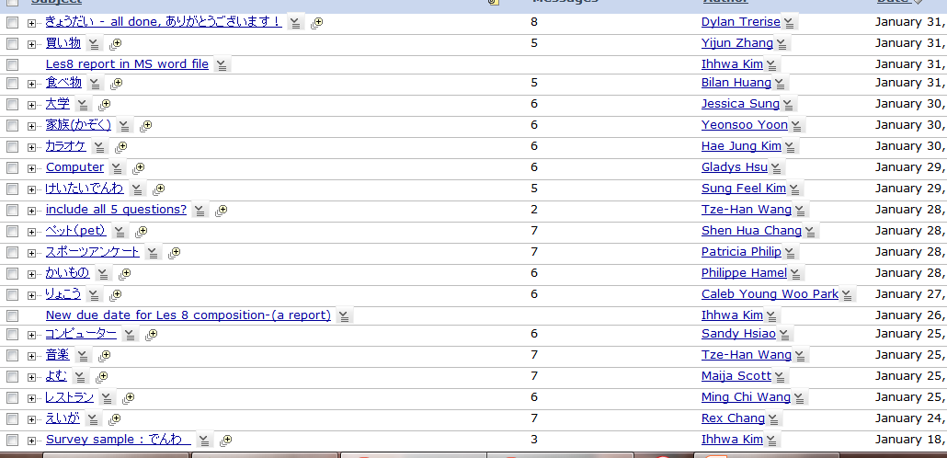
3-B Among Peers (R/W)

Slide 19
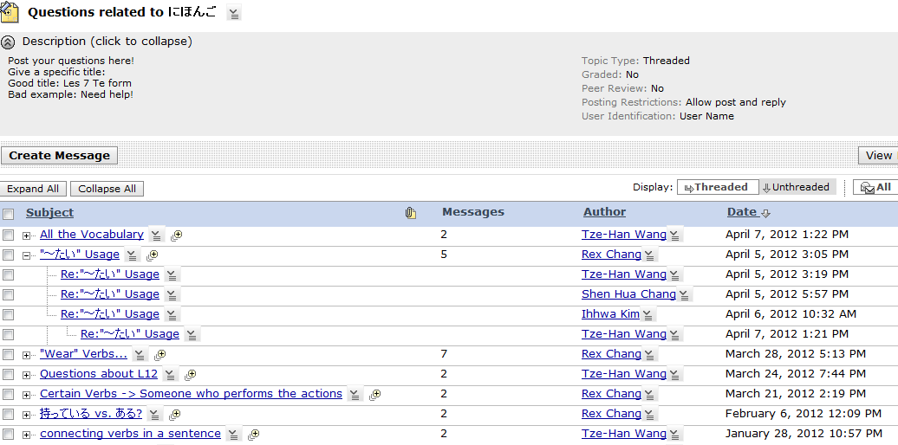
Discussion

Slide 20

II. Teaching

Slide 21
Definitions
What do we mean by a “Distance Education course”?
fully asynchronous
no live lectures or class meetings
contact with students is mostly electronic – email, announcements, etc.
office hours are by video chat (e.g. Collaborate Ultra)

Slide 22
Definitions
What do we mean by “teaching” in a Distance Education course?
completely different from “teaching” in a classroom or a fully or partially synchronous online course
main role is facilitation and communication – creating a structure that best supports students in achieving the desired learning outcomes
has its own challenges – not as easy as it sounds!

Slide 23
Role of the DE Instructor
Structure
organise the course & materials so students can easily navigate & follow them
Support
support student learning by answering questions and giving assistance
Feedback
provide feedback (marking, comments on student work, etc.)

Slide 24
Goals of the JAPN DE Courses
alignment with on-site JAPN courses : learning outcomes, assessments and course content are the same
enable students to work through the course autonomously and flexibly – in other words, to be self-directed learners
but also: create a community of learners by facilitating communication & exchange between students

Slide 25
DE Course Elements
Students
motivation & self-discipline
textbook & Canvas
Course Materials
planning, design & support
Instructor
Peers
feedback
TAs
community of learners

Slide 26
Teaching via Facilitation,
Support & Feedback
1. Resources
2. Practice
3. Assessment

Slide 27
1. Resources
Schedule
Canvas
Textbook

Slide 28
1. Resources
Schedule
whole term schedule released on day 1
provides structure to the course & keeps students on track
consistent & logical flow, e.g.:
  new chapters begin on Mondays
  chapter quizzes due on Tuesdays
  blogs due on Fridays

Slide 29
Textbook
maintains consistency & transferability with onsite courses at UBC & other institutions
provides structure for the DE courses
resource for practice exercises, activities, additional cultural information
functions as a reference for students
provides supplementary materials (audio files) for student use

Slide 30
Canvas
instructor-produced videos & texts and other materials (e.g. videos, images) give additional ways for students to study & understand the material & suit various learning styles
low- and no-mark practice exercises give students a concrete way to study & provide instant feedback with no instructor involvement
students can always go back to review previous material

Slide 31
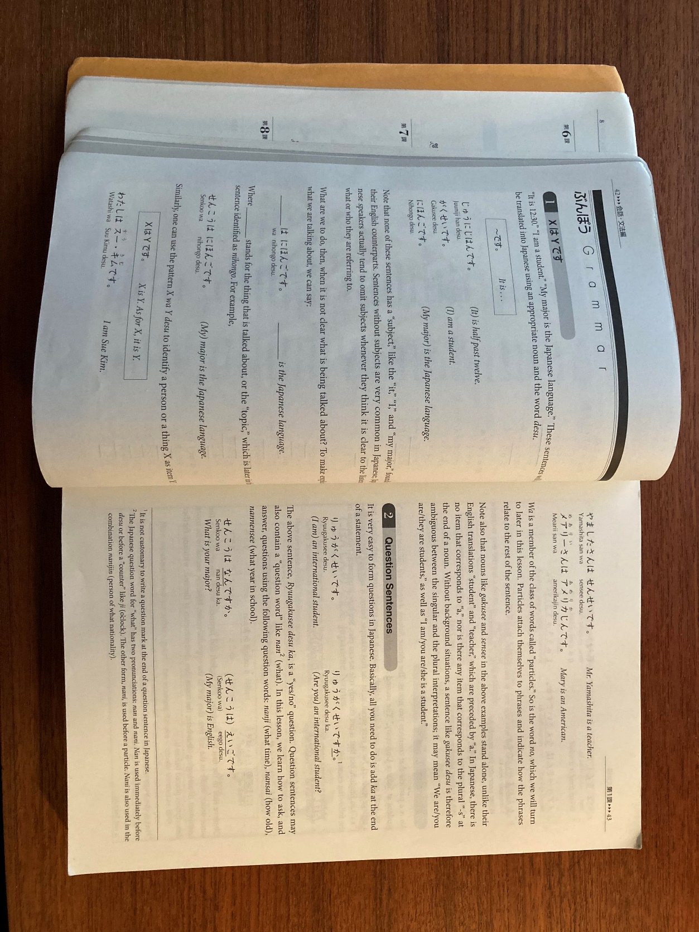
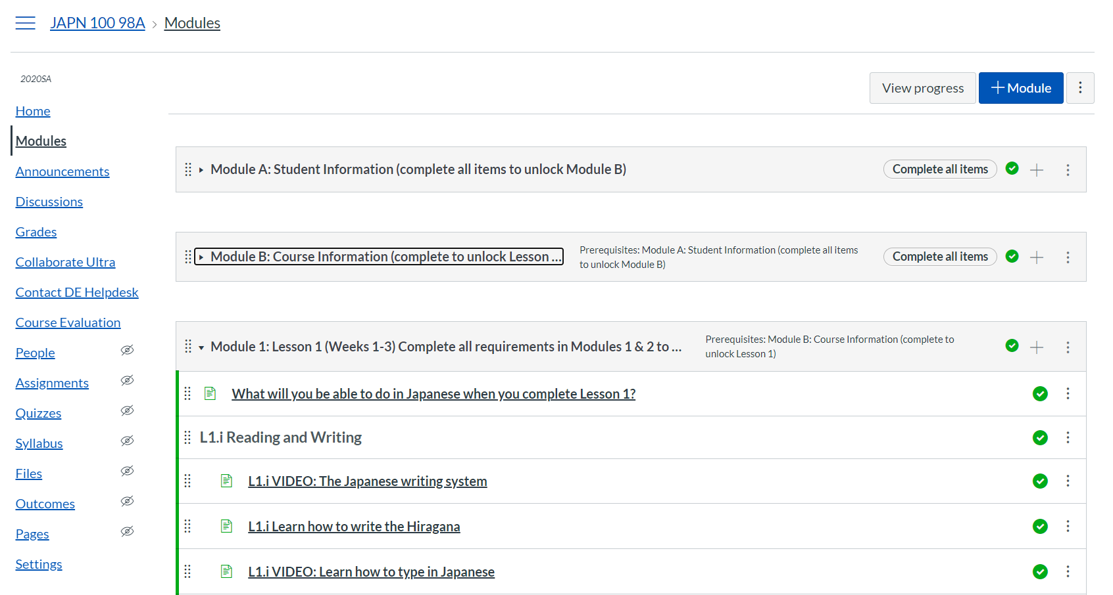
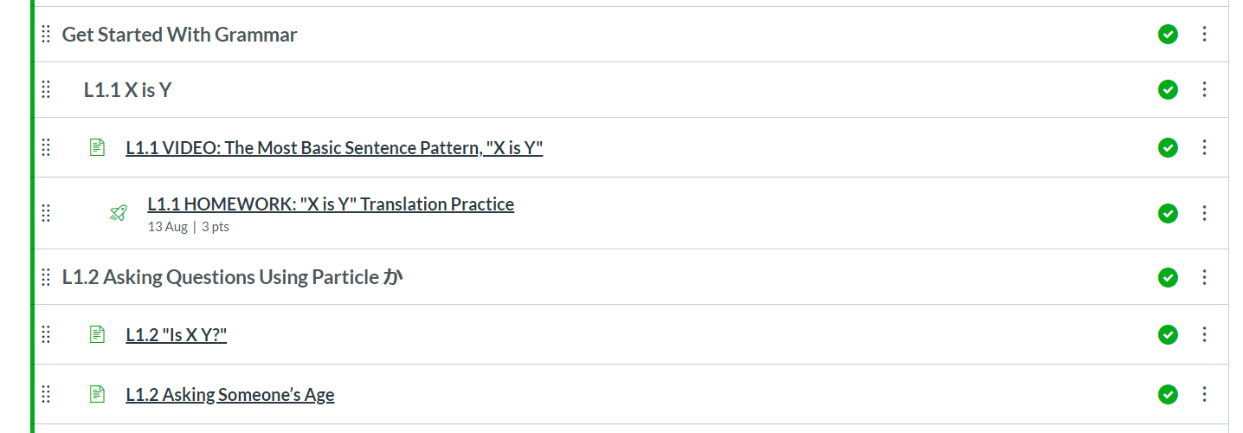
Textbook + Canvas

Slide 32
Instructor-Made Videos on Canvas
short (all are under 5 minutes)
made in each instructor’s style: not exactly the same method of explanation or examples as the textbook
incorporate elements of the book (e.g. the characters Mary, Robert, Takeshi) as well as authentic materials and examples

Slide 33
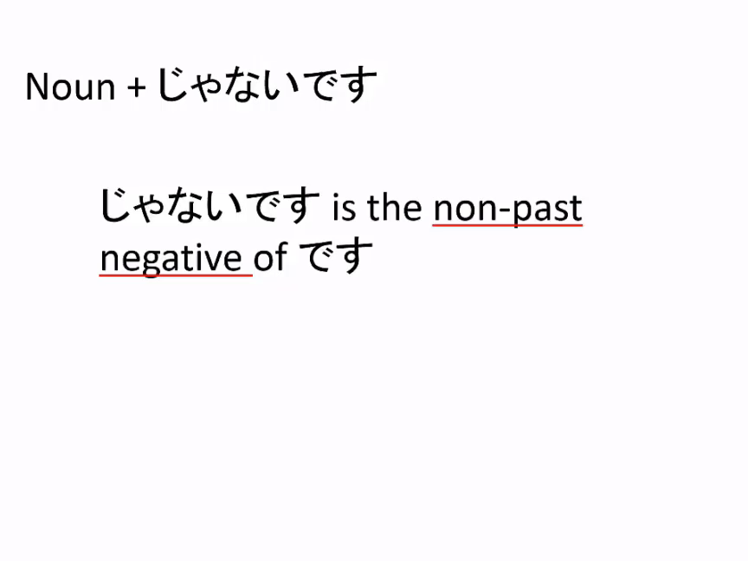
Instructor-Made Videos on Canvas

Slide 34
2. Practice
Homework
Blogs
Senpai Drill

Slide 35
2. Practice
Homework
practice quizzes covering each grammar point
text, video & audio: develop reading & listening skills
various question formats: develop reading & writing skills
unlimited attempts: students can review their weakest material & get instant feedback without instructor involvement

Slide 36
Blogs
topics provided (some are free topics)
low-stakes: marked mostly on effort, participation
develop reading & writing skills
let students practice writing about things they’re interested in
interactive: minimum number of responses & comments on other student’s blogs required
create a community of learners

Slide 37
Senpai Drill
senpai = “student in a higher year than oneself”
oral practice with programme TAs – less intimidating than practice with instructor
textbook & custom materials
provides essential speaking/conversation & listening practice, gain confidence, sense of accomplishment
helps to improve pronunciation, intonation
functions as grammar and vocab review
graded on participation/attendance & effort

Slide 38
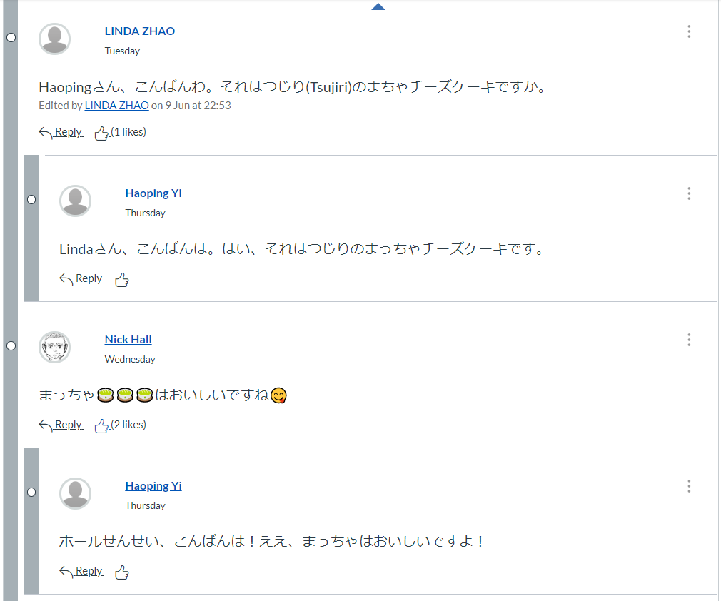
Comments on Blogs

Slide 39
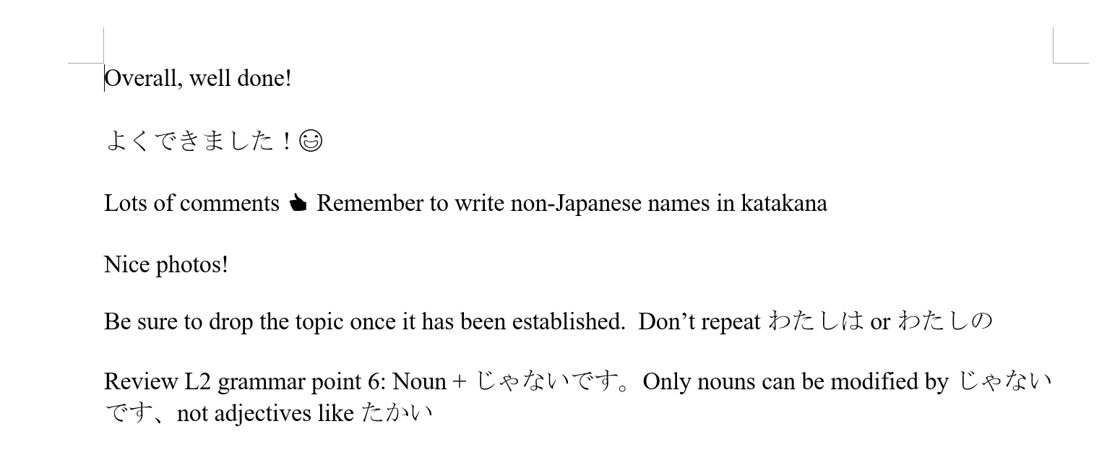
Marking Blogs
To speed up marking, create a Word file of boilerplate text to copy & paste into SpeedGrader

Slide 40
3. Assessment
Worksheets
Tests
Compositions

Slide 41
3. Assessment
Worksheets
1 per chapter (every 2 weeks)
completed by hand (not typed)
marked by hand using Canvas Teacher app & stylus/Apple Pencil
structure is the same as onsite chapter tests:
  writing new characters
  translations (English to Japanese)
  fill-in-the-blanks

Slide 42
Compositions
due after the worksheets: allows students to review & correct their mistakes before higher-stakes assessment
some typed, some written by hand
topics relate to topics/themes in the textbook
readings in the textbook provide a model for students to follow

Slide 43
Tests (summative)
6 vocabulary quizzes (1 per chapter)
  2 attempts, auto-graded
6 chapter quizzes (1 per chapter)
  1 attempt, partially auto-graded
2 listening tests
  1 attempt, auto-graded
1 oral exam
  1-on-1 with instructor via Collaborate Ultra
1 final exam
  previously on paper, now online

Slide 44
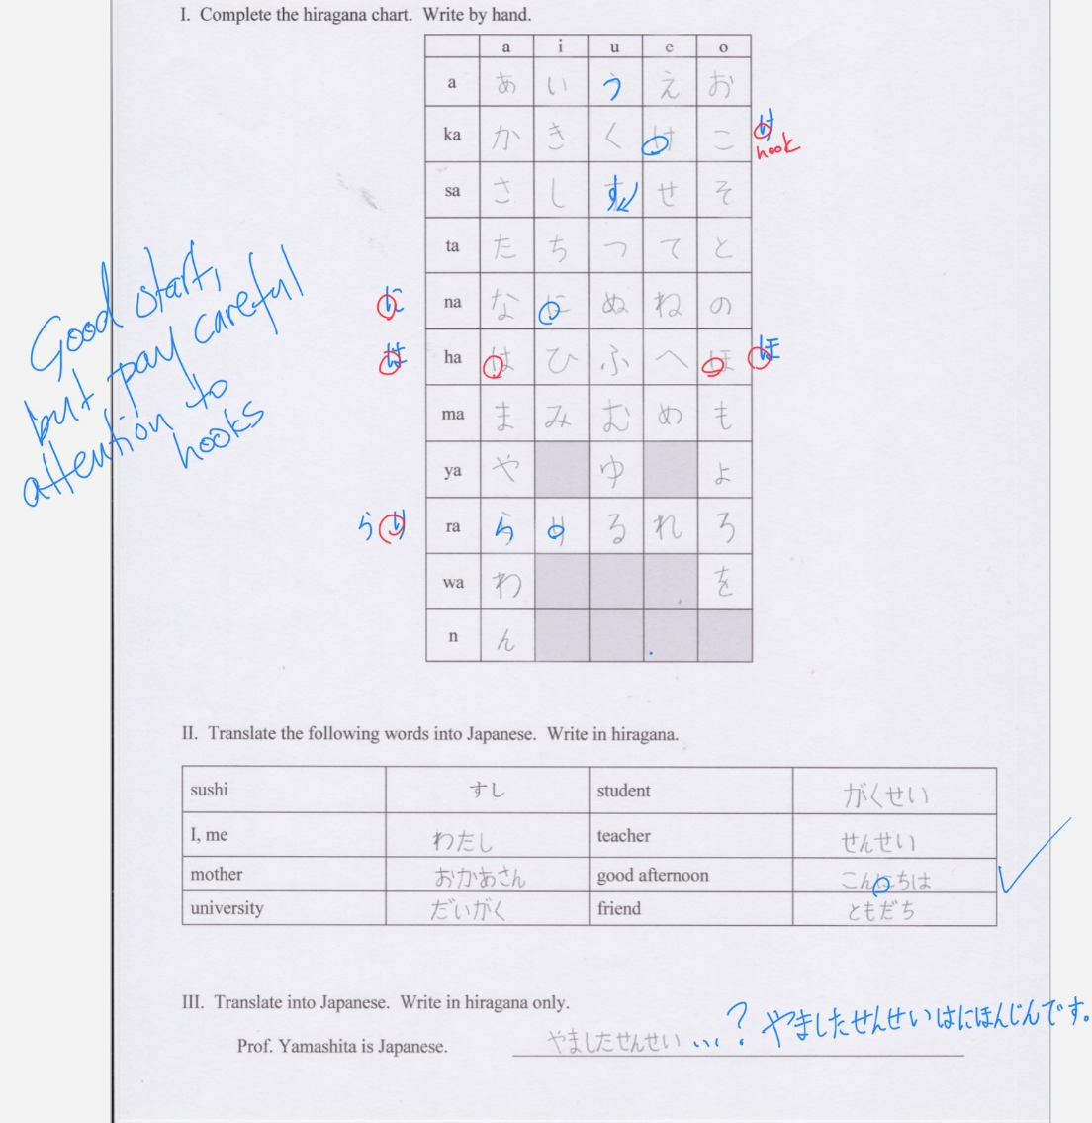
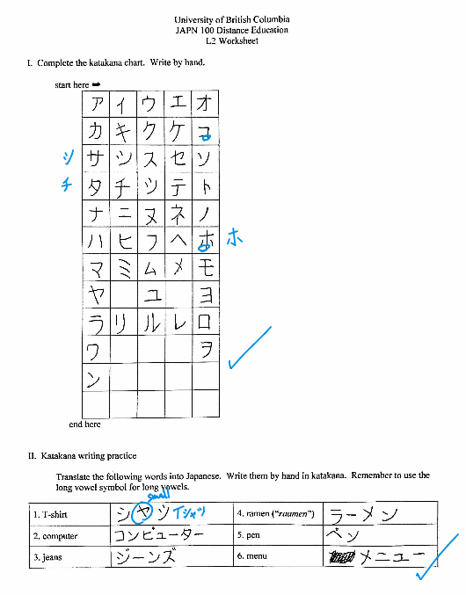
Marking Worksheets

Slide 45
Recent Updates & Feedback from Students
redesigned and simplified course structure and navigation
streamlined & simplified presentation of course info
reduced the number of required exercises based on student feedback on workload
modified some exercises based on feedback about repetitive nature of some items

Slide 46


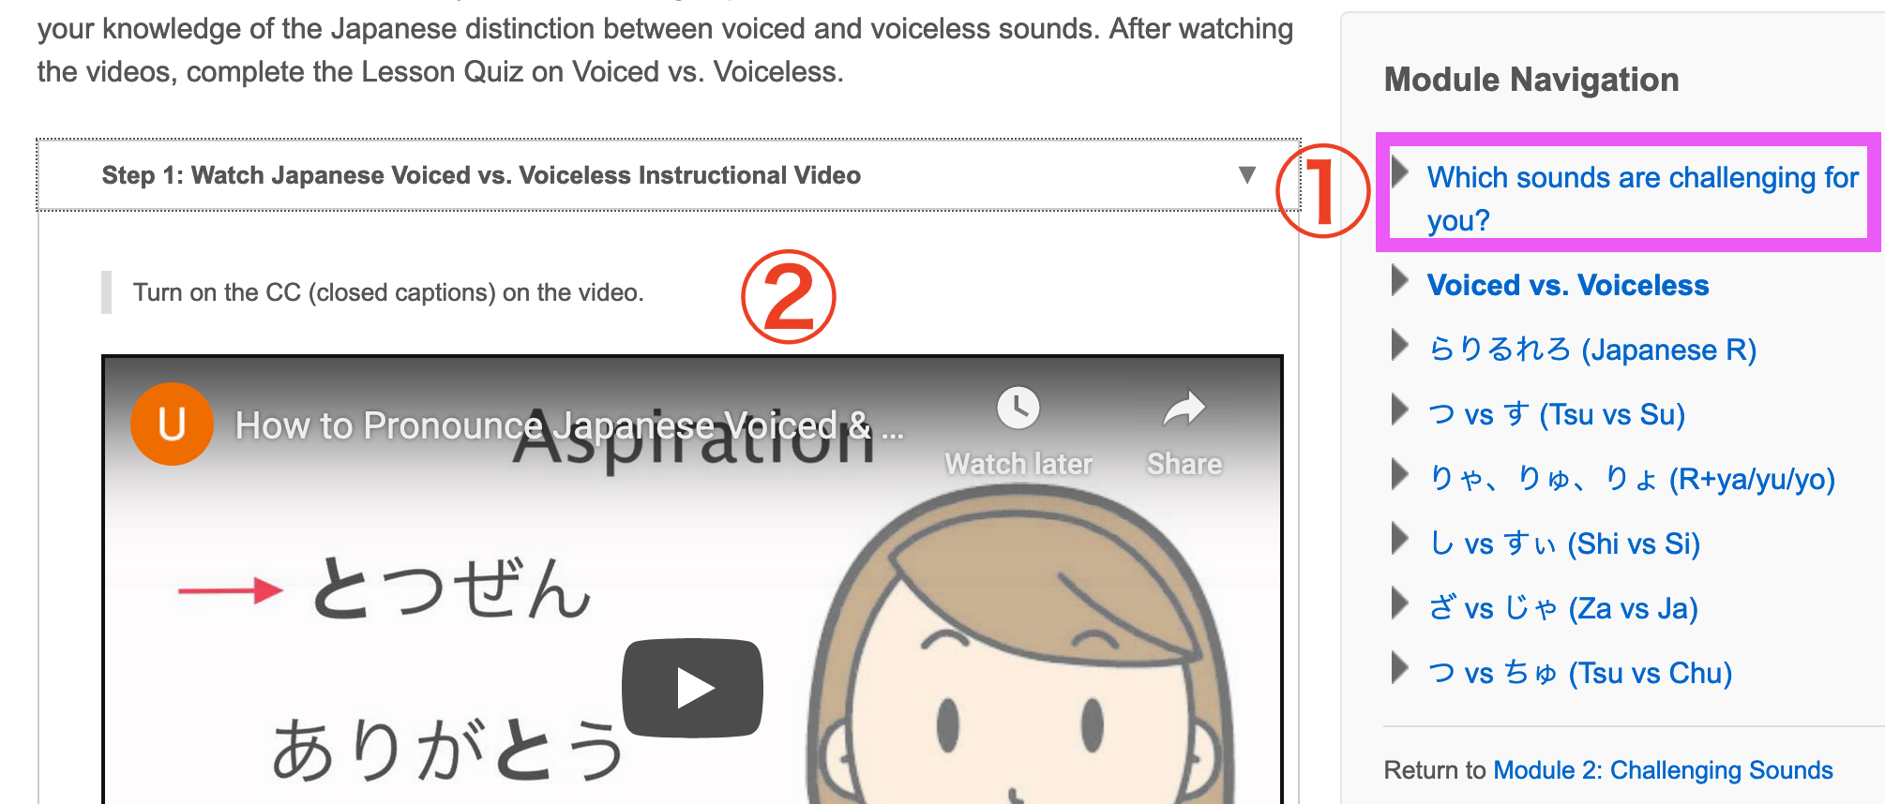
III. Senpai Drill and eNunciate
Senpai, how do you pronounce it?
…Not sure,
how to teach…
Senpai Drill (Speaking Practice session)
Students find out which sounds are challenging for them to pronounce.
TAs learn the mechanics of pronunciation from the tutorial videos.

Slide 47
IV. Future Goals & Challenges
Increase user-friendly interactive activities, e.g. voice thread, video thread
Add more videos & replace some written info with videos to reduce reading & increase student engagement
More authentic audio-visual materials to motivate learning
Design more tasks to help improve students’ spoken communication skills

Slide 48
…And finally:
Create 200 DE/201 DE (students can do a lot more in these courses; more challenging & interesting to design)

Slide 49
  Thank you!
  ありがとうございました！

Slide 50
Q&A Discussion
  To participate:
    Use the built-in chat to share any questions, comments, and resources.
  Reminder: This session is being recorded.
    Please anonymize any student information in your discussion.
    If you have any questions that cannot be anonymized, please email us at arts.helpdesk@ubc.ca and we will follow-up with you.

