Slide 1
Making use of the arts remote teaching template
Thursday, May 7, 2020

Slide 2
Overview
  Introduction
  Strategies for Design and Organization
  How to use the Template
  Show an Example of a Module
  Demo of the Arts Remote Teaching Template
  Q&A discussion

Slide 3
Housekeeping Items
  This session will be recorded for teaching and learning purposes.
  Please save your questions for the end of the session during the Q&A discussion.
  Your video streams and audio have been disabled to help with bandwidth.

Slide 4
Who are we
CTLT
    Jason Myers, Arts Faculty Liaison
    Bosung Kim, Learning Design & Educational Consultant
Arts ISIT
    Angela Lam, Learning Centre Manager
    Leanna Chow, Educational Technologist

Slide 5
Background
  Arts ISIT’s COVID-19 Faculty & TA Preparedness Survey
    393 responses from faculty, 203 from TAs
    Received feedback on:
      Online course delivery options
      Copyright & privacy
      Student assessment & support options
      Remote exam options
  Arts Remote Teaching Template:
    Ensuring instructors are provided with guidance on effective teaching strategies for remote teaching.

Slide 6


Question – Factors impacting Student Satisfaction
Based on (Tichavsky, Hunt, Driscoll and Jicha, 2015)
Notes:
Leanna to add polling icon to student view

Slide 7
“Whereas online professors are holding students more accountable for their own learning, students would like to receive much more instruction…”
Gaytan, 2015

Slide 8
Student Challenges
  Need for interaction – Both instructor and peer interaction are important, but instructor presence is especially important.
  Staying Motivated – Online students often feel isolated. Students need extra guidance, motivation and support.
  Staying Focused – Online learning requires more self-direction. Students often have trouble keeping track of what to do and when to do it, especially across multiple courses.

Slide 9
Focus on Learning Goals
  Align course elements with learning goals to focus student and instructor time on the areas where it will be most meaningful.
Learning Goals
Teaching & Learning Activities
Feedback and Assessment
L. Dee Fink, Creating Significant Learning Experiences

Slide 10
  SIMPLIFY

Slide 11
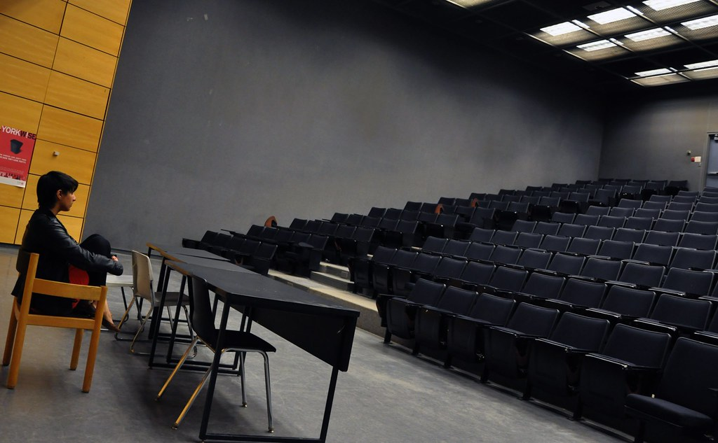
Social Presence
Humanizing the non-human online space
"Silence" by Sixth Lie is licensed under CC BY-NC-ND 2.0
Notes:
Studies show that students appreciate informal class videos that reveal your personality (Guo, 2013; Cavanagh, 2016)

Slide 12
Interaction and Social Presence
Student/Student
Student
Student/Content
Deep and Meaningful Learning
Student/Teacher
Content
Teacher
Teacher/Content
Modes of Interaction in Distance Education from Anderson and Garrison, (1998).
Notes:
Anderson, T. (2003). Getting the Mix Right Again: An Updated and Theoretical Rationale for Interaction. The International Review of Research in Open and Distributed Learning, 4(2). https://doi.org/10.19173/irrodl.v4i2.149

Slide 13
Assessment and Feedback
Frequent checkpoints for students to check their knowledge and for the instructor to see how students are doing
Important to provide timely feedback throughout the learning process, not just in summative or graded work
(Hattie & Timperley, 2007; Shute, 2008; Ambrose et al, 2010)
“…online students would like to receive more instruction from their professors and more comprehensive feedback that would allow them to engage in corrective behaviors to improve performance.”
Gaytan, 2015
Notes:
Jorge Gaytan (2015) Comparing Faculty and Student Perceptions Regarding Factors That Affect Student Retention in Online Education, American Journal of Distance Education, 29:1, 56-66, DOI: 10.1080/08923647.2015.994365

Slide 14
Inclusivity and access
Be mindful of external factors – Students have different living contexts in different locations. They may be experiencing anxiety. Be mindful and provide extra flexibility.
Accessible course design – Make sure materials are accessible and be mindful of differing access to technology.
Access to support – Provide access to support resources and information about accommodations
Build flexibility into your design where possible!

Slide 15
How to use the template
  Planning materials and resources
  Demo Site
  Template Site

Slide 16
Organizing your course materials
  Chunking into modules – Instead of lectures, organize your materials by topics and weekly modules.
  Consistent structure – Pick one module to prototype in order to fine tune the structure then copy to other modules.
  Time – Think about student time each week and where due dates are clustered. Try to balance synchronous and asynchronous time and allow for student flexibility.

Slide 17
Course Map

Slide 18
 | Asynchronous | Synchronous
When? | In depth reflection and discussion content that students can learn on their own Self-assessment activities | - Discussing less complex issues - Getting acquainted Planning tasks Interactive lecture and group activities
Why? | Student have more time to reflect, Control of their own learning (self-regulated learning) More flexibility in managing their time | - Maintain “physical presence” - Students become more committed and motivated because of quick response expected. - When immediate feedback is required (e.g. activities, assessment)
Source: https://canvas.uw.edu/courses/862829/pages/synchronous-and-asynchronous-e-learning

Slide 19
 | Asynchronous | Synchronous
Student/ Content | Short, lecture videos Self-assessment quizzes Readings | Presentation of content Poll questions / classroom response questions
Student/ Student | Discussion forum activities Group activities Peer feedback/ assessment Sharing projects | Breakout room discussions Group presentations
Instructor/Student | Weekly announcement posts or videos Discussion forum moderation and responses | Group question and answer Explaining requirements, due dates, expectations

Slide 20
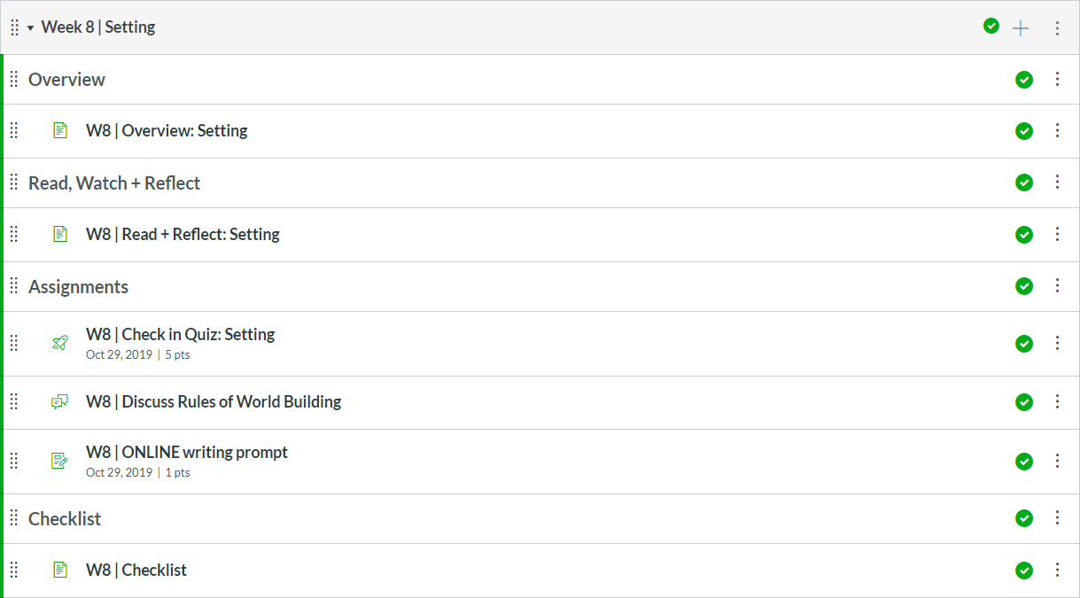
Example of a Module
CRWR 209 – John Vigna and Annabel Lyon

Slide 21
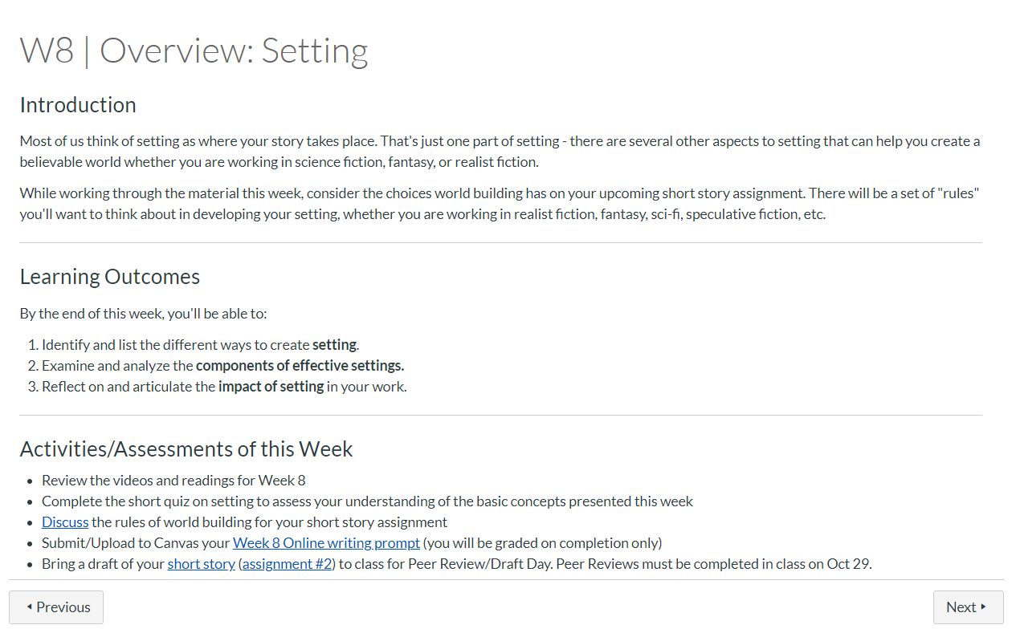

Slide 22
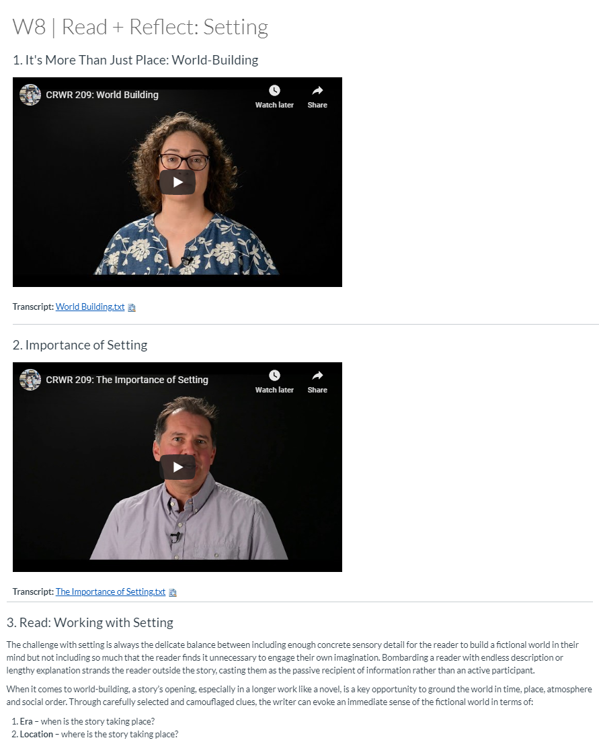

Slide 23
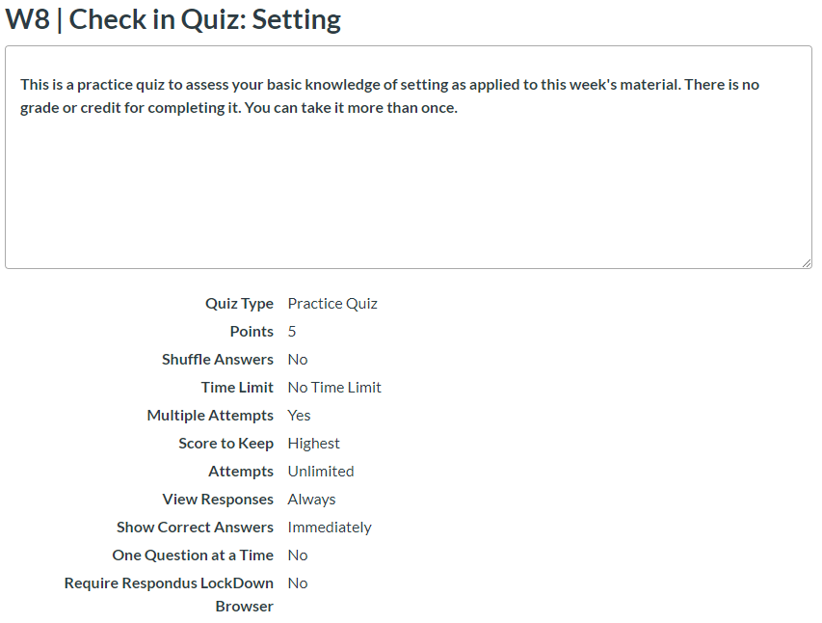

Slide 24
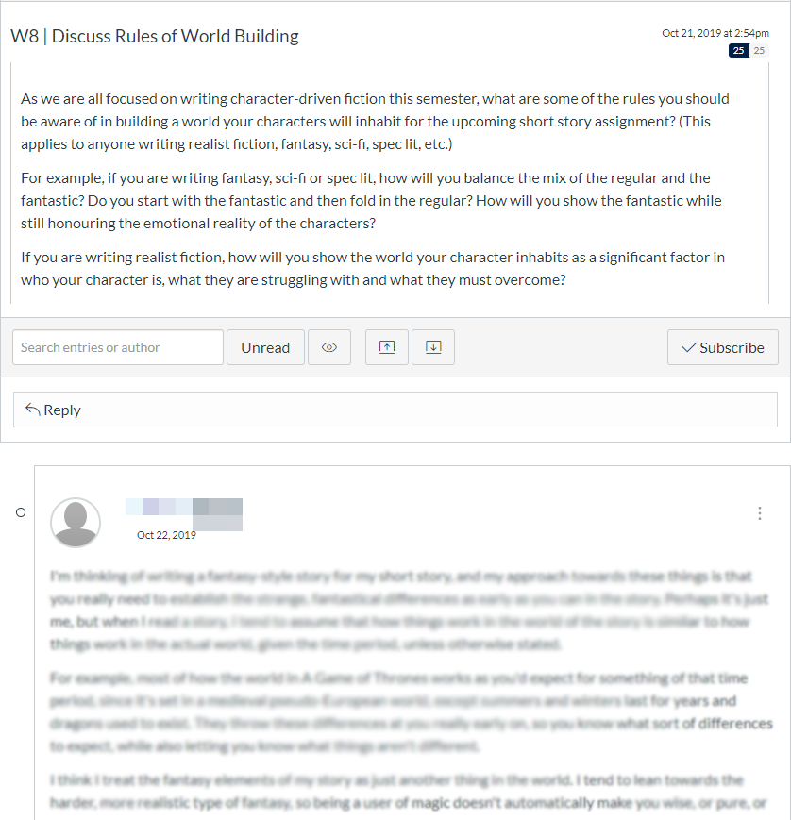

Slide 25
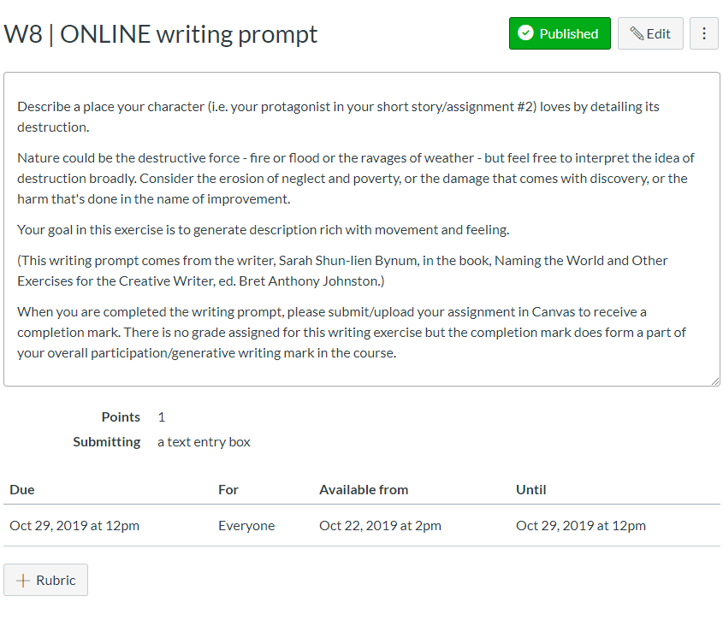

Slide 26
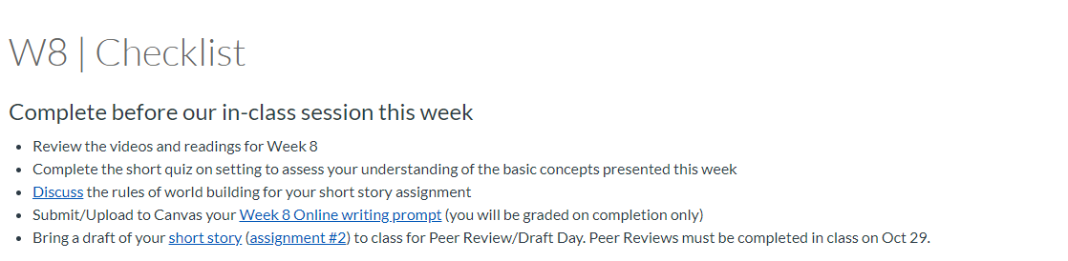

Slide 27

Remote Teaching Template
Bosung Kim, Ph.D. Educational Consultant: Learning Design, CTLT
In the following session:
Discuss the differences between Demo site and Template site
Highlight some design considerations in Remote Teaching
Discuss the best practice of using the Template site for course preparation

Slide 28
Differences between Demo site and Template site
Notes:
Please check the

Slide 29
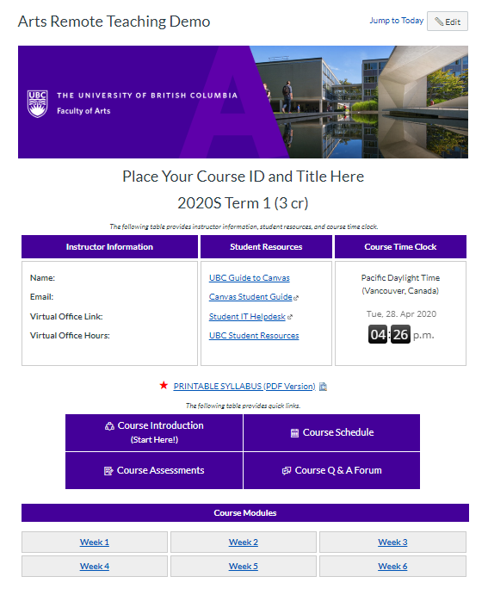
Demo Site vs. Template Site
What does the demo site offer?
Clean homepage layout
Easy, intuitive, and effective navigation
Resources for course set up and online teaching
Various templates for course materials (e.g. course introduction modules, syllabus, assessment guidelines, announcements, course schedule)
Sample wordings (e.g. announcements, assessment guidelines)
Course structure samples
Template site is a skeleton of the demo site which you can import to your course site.
Visit the Demo site for sample wordings and more templates for course materials.

Slide 30
Highlights - Design Considerations
Notes:
Please check the

Slide 31
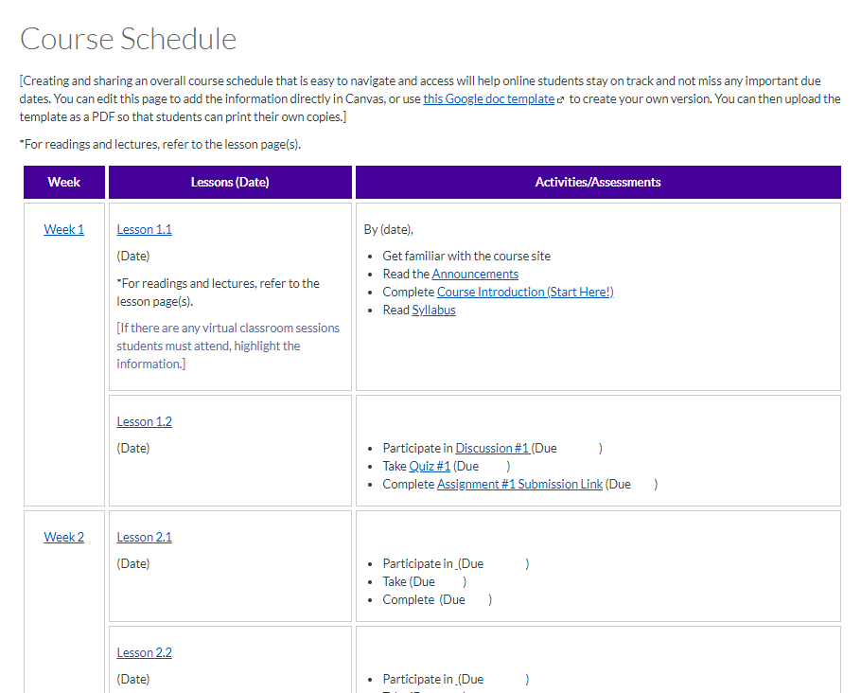
1. Make a Course Easier to Navigate

Slide 32
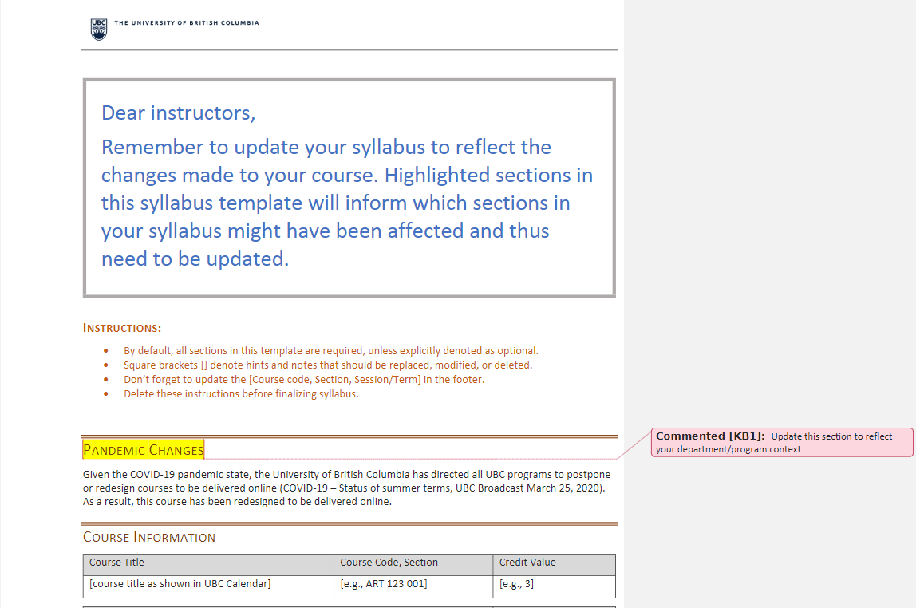
2. Update Course Syllabus
Update Syllabus
Contact Details
Course Structure / Format
Learning Activities
Learning Materials (e.g. Textbook)
Assessments for Learning
Course Schedule
Learning Resource etc.

Slide 33
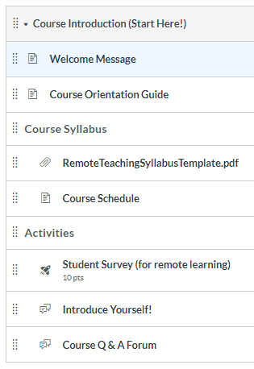
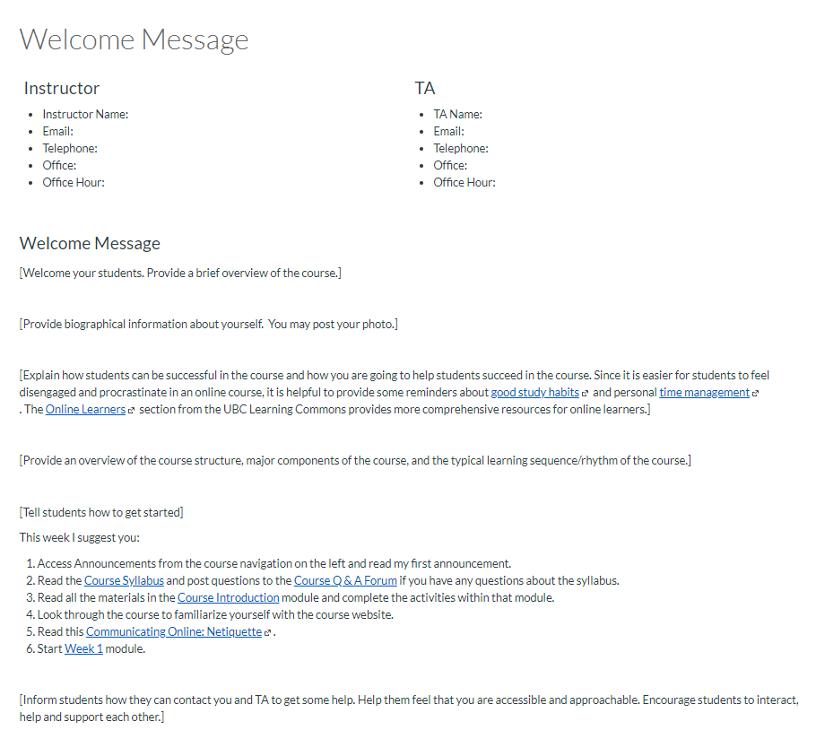
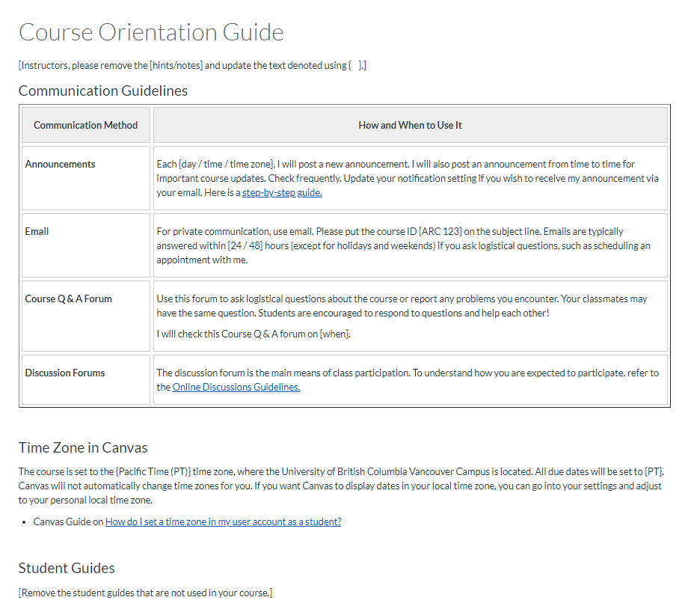
3. Make it Easy for Students to Get Started

Slide 34
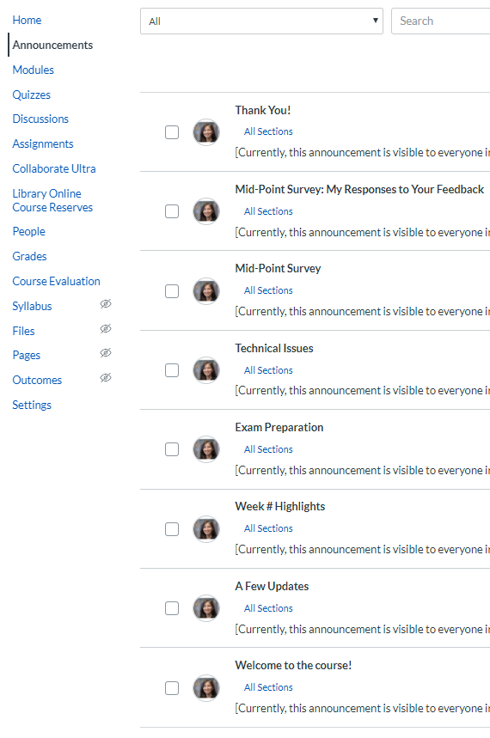
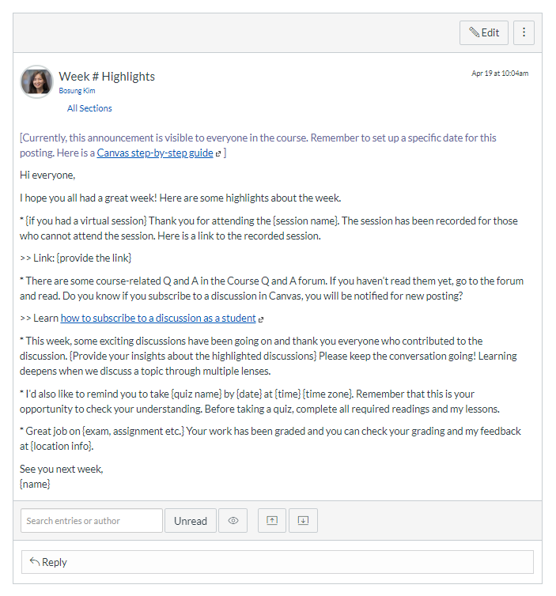
4-a. Design Spaces for Communication - Announcements

Slide 35
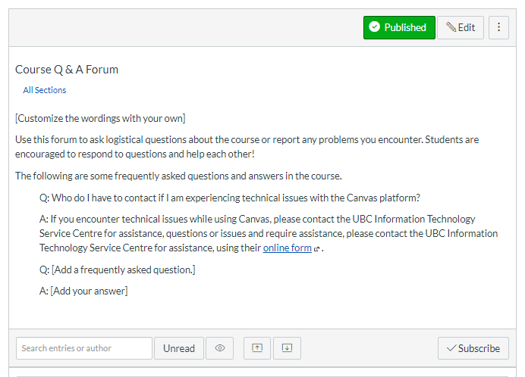
4-b. Design Spaces for Communication – Course Q & A forum

Slide 36
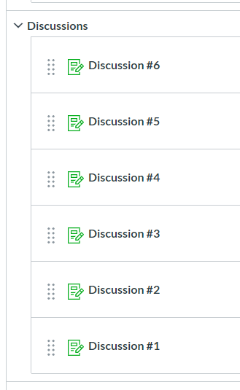
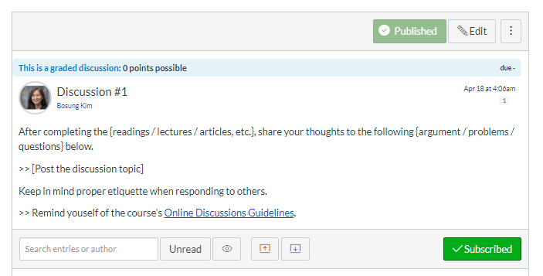
4-c. Design Spaces for Communication – Online Discussions

Slide 37
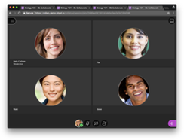
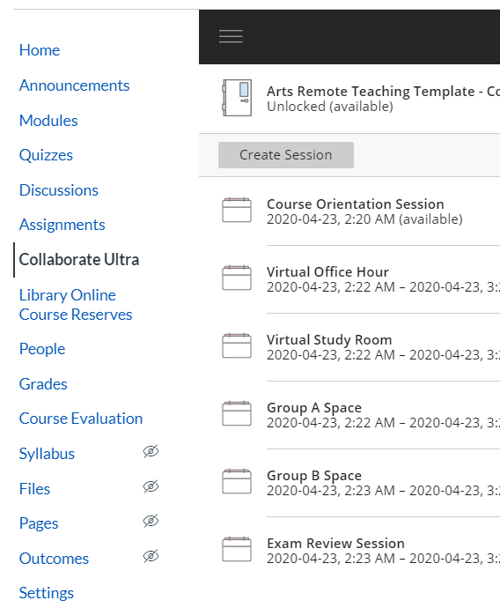
4-d. Design Spaces for Communication – Virtual Rooms

Slide 38
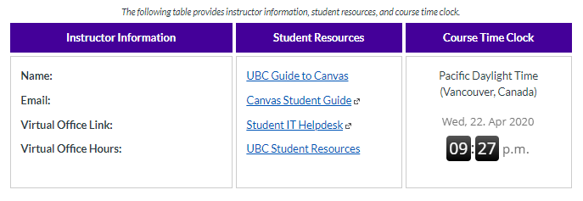
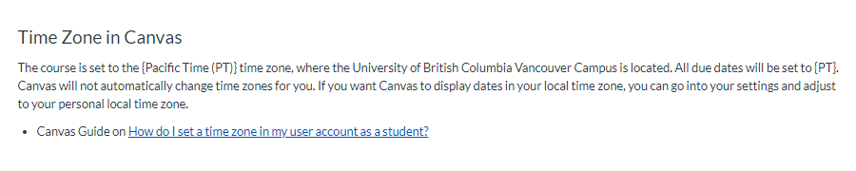
5. Be sensitive to the time zones

Slide 39
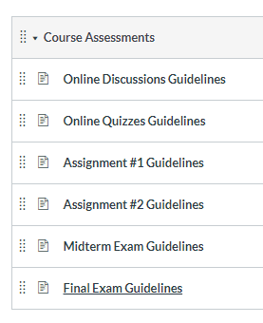
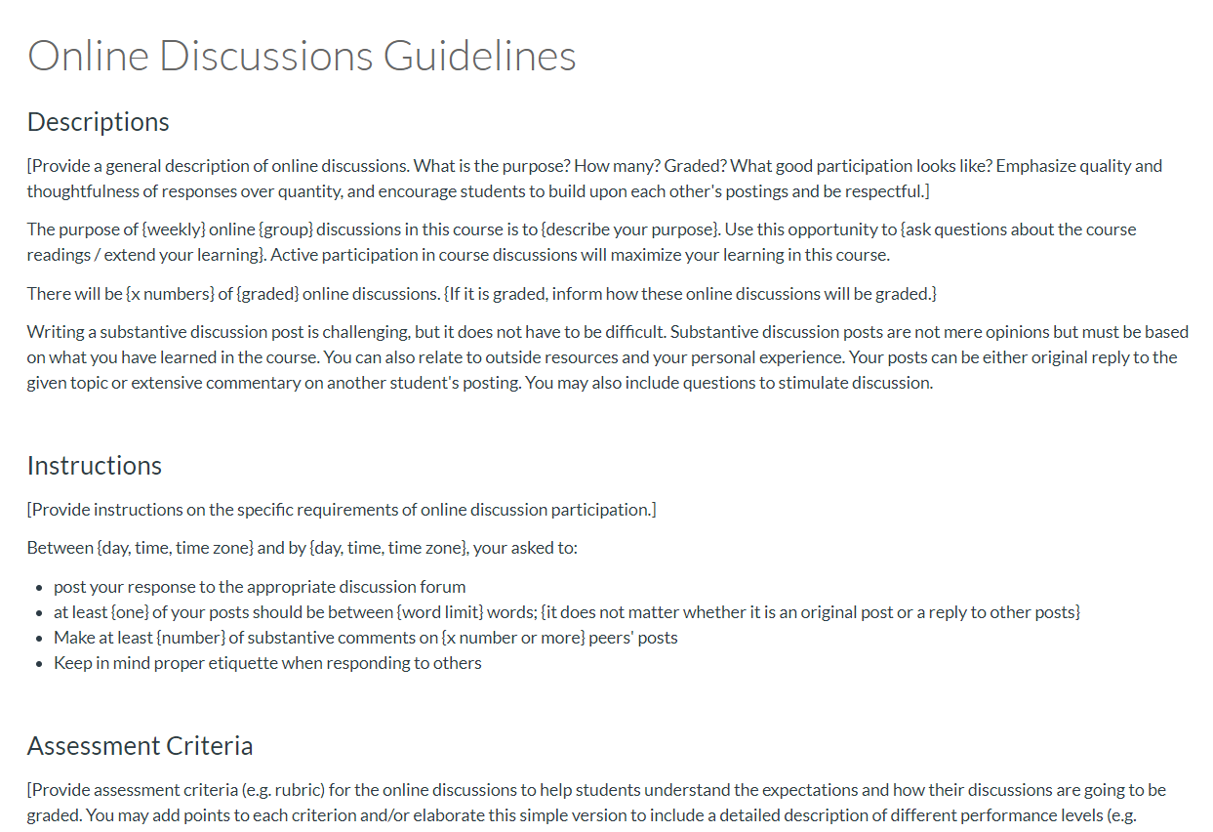
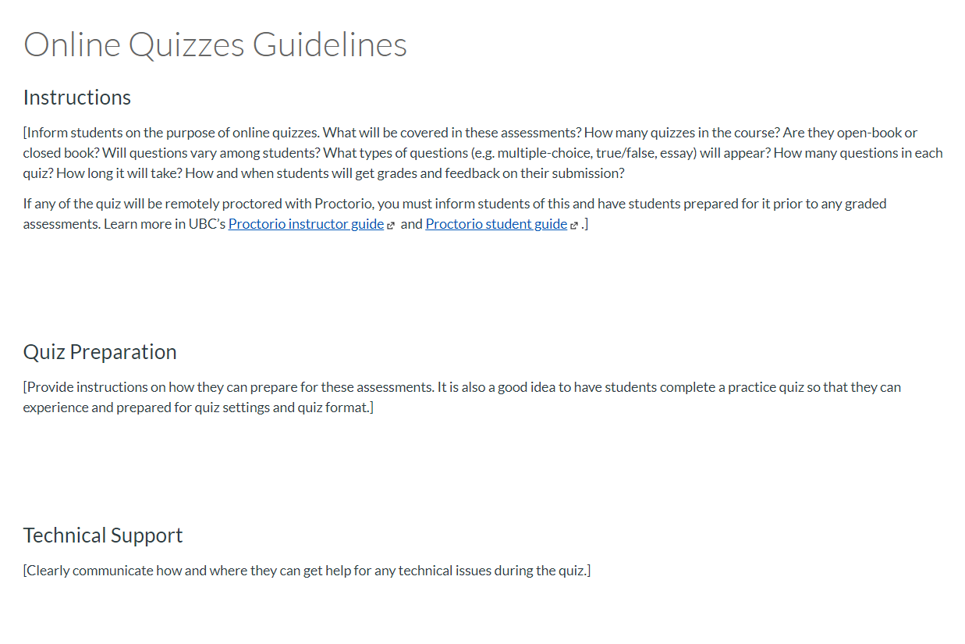
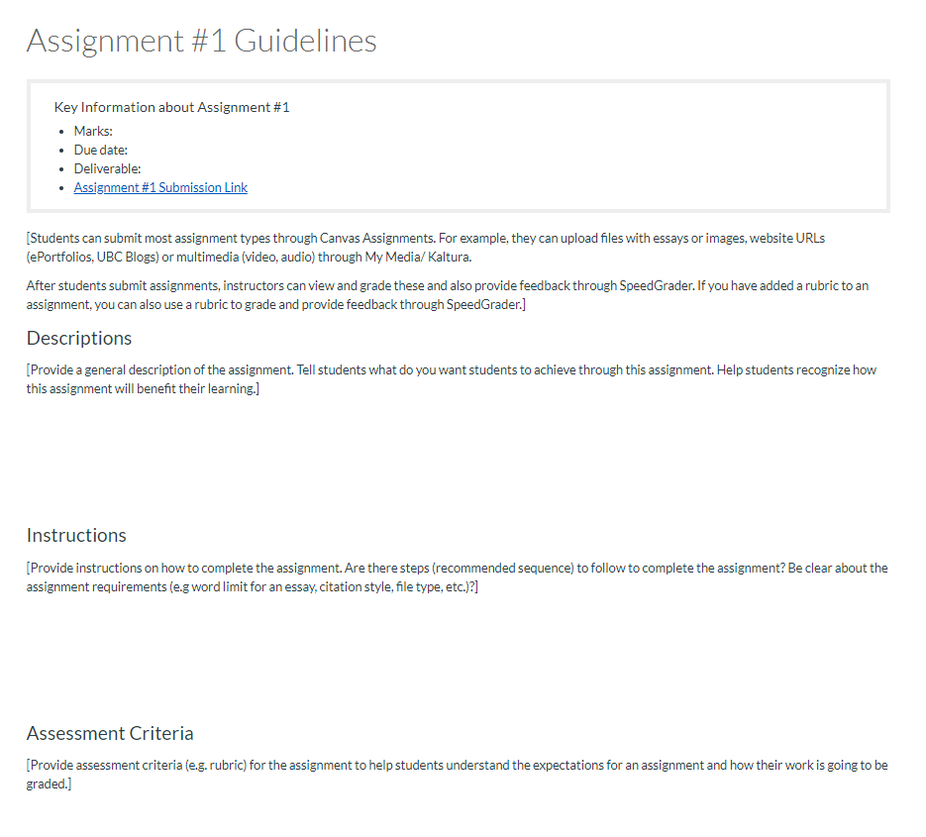
6. Provide Clear Activities/Assessment Guidelines

Slide 40
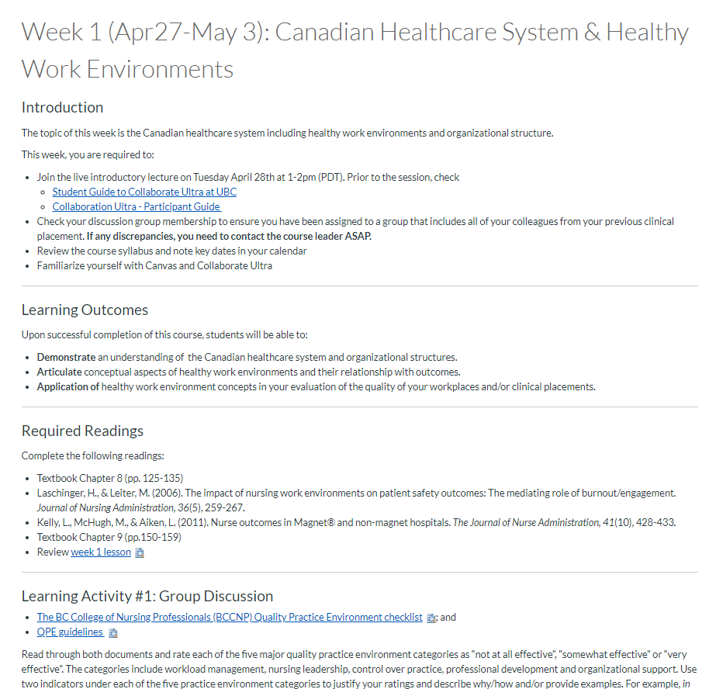
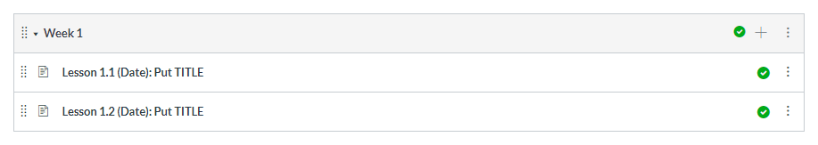
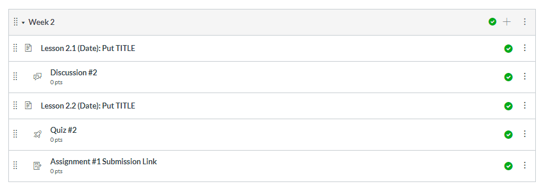
7-a. Organize and Structure Lessons/Activities/Assessments

Slide 41
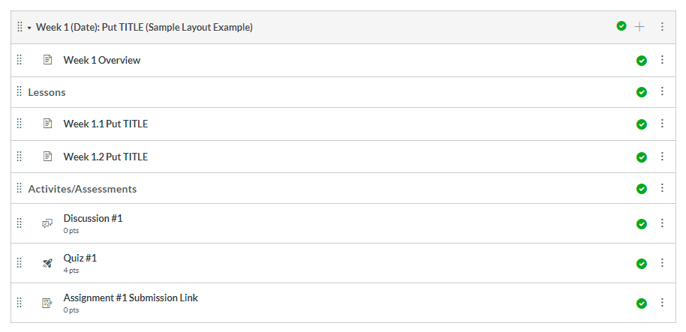
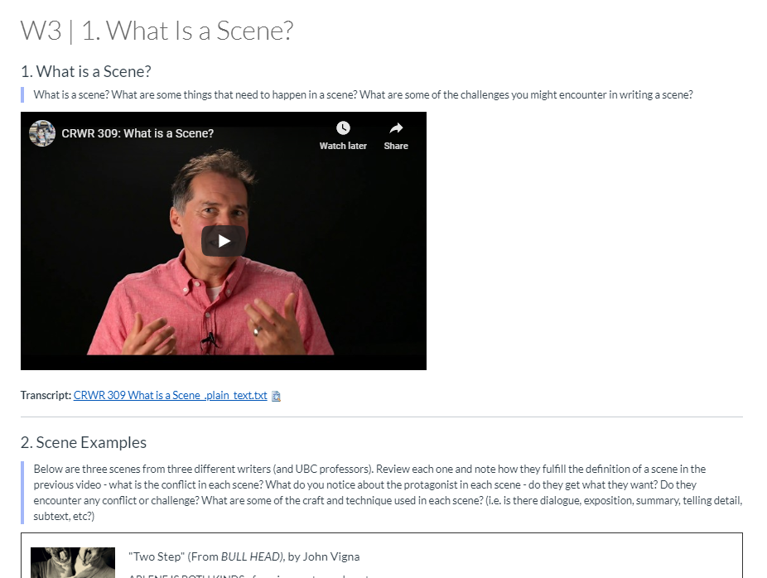
7-b. Organize and Structure Lessons/Activities/Assessments

Slide 42
How to Use the Template site
Notes:
Please check the

Slide 43
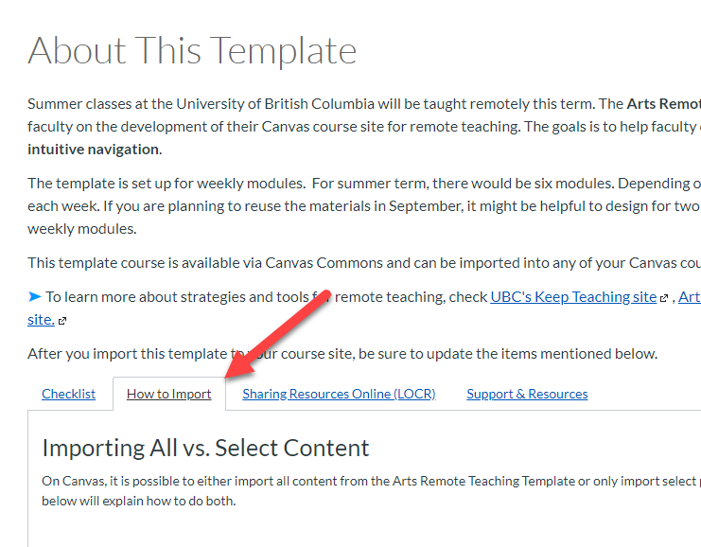
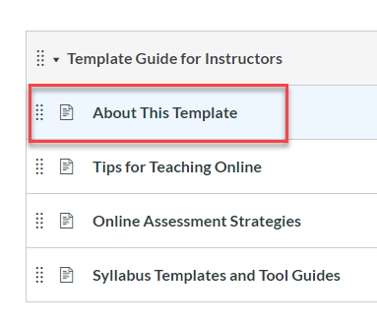
1. Import the Template to your course
Self-enroll to the Demo site:
https://canvas.ubc.ca/enroll/GJX7KJ

Slide 44

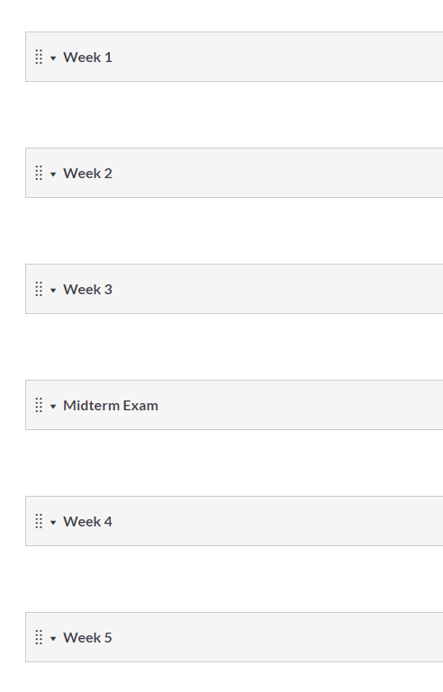
2. Customize and build your course content

Slide 45
3. update internal navigational links
How to Guide: https://community.canvaslms.com/docs/DOC-26551

Slide 46
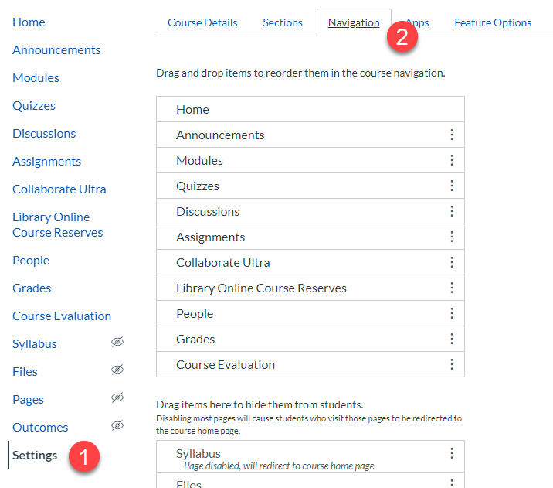
4. Disable Course Navigation menu items that are not used
How to Guide: https://community.canvaslms.com/docs/DOC-12933

Slide 47
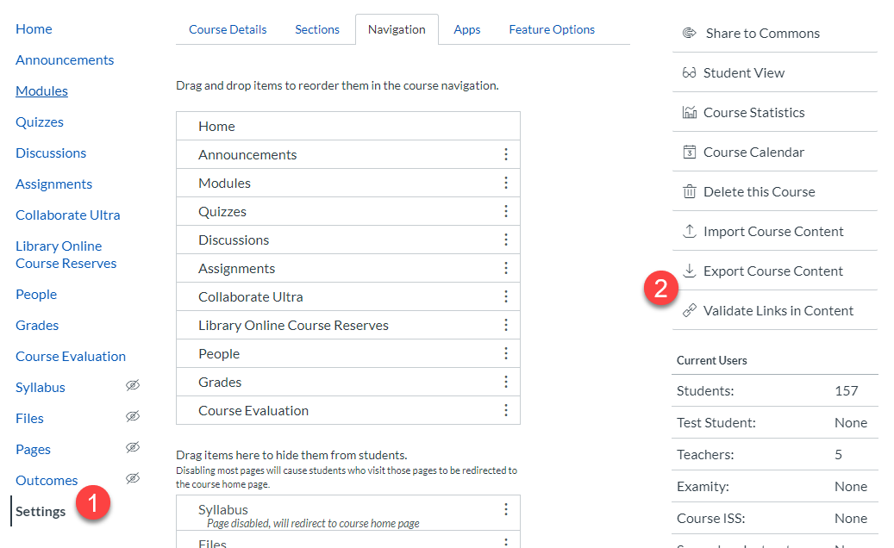
5. Validate links in Content
  How to Guide: https://community.canvaslms.com/docs/DOC-26411

Slide 48
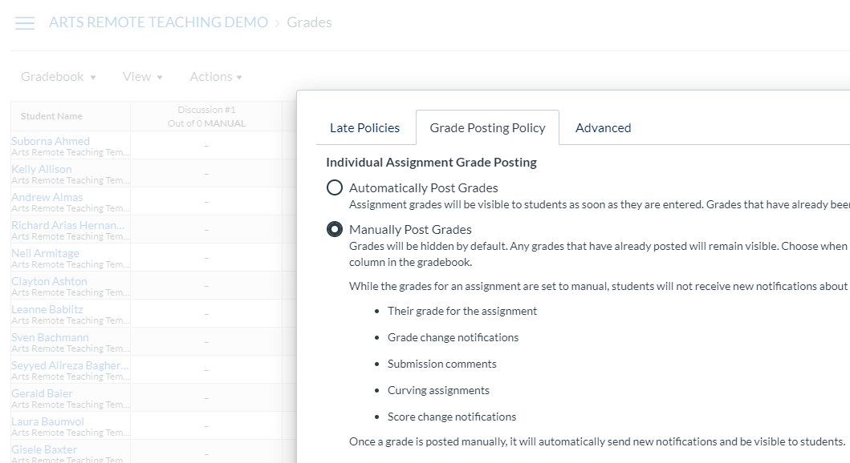
6. Check the Grade Posting Policy
  https://faculty.canvas.ubc.ca/showing-and-hiding-grades-in-the-new-gradebook/

Slide 49

Q&A Discussion
  To participate:
    Click the “Raise Hand” icon at the bottom of your screen
    You will be added to the speaking queue in order
  Reminder: This session is being recorded.
    Turn on the microphone when we call your name
    (Optional) to turn on the camera

