Slide 1
Facilitating reflection on student presentations:
Using CLAS to promote critical self-reflection and online peer review
UBC-Vancouver, Celebrate Learning Week
May 6th 2017
Dr. Kate Power
Arts Studies in Research and Writing (ARSW), UBC Vancouver
katpower@mail.ubc.ca

Slide 2
Context
2014 External Review = positive:
WRDS 150 and ASTU 400a = theoretically-informed, using a highly-respected approach to teaching writing
plentiful elements associated with student learning:
“academic rigour, extensive writing assignments, plentiful opportunities for interaction with faculty, and participation in research” (Harrison & Risler, 2015, pp.67-68)
BUT ASRW needs to do a better job “selling” its courses to students, faculty and administration (Paré, Johns, & Chapman, 2014)
© Kate Power 2017. Not to be copied, used, or revised without explicit written permission from the copyright owner.
Notes:
Students often bring negative affect to my courses because they may
resent having to take required courses, and expect them to be boring / useless
have had negative experiences of writing in high school
have heard rumours / “horror stories” about the course from other students.

Slide 3
Peer review & student engagement
Student engagement = “key to improving the quality of the undergraduate educational experience” (Brint et al., 2008, p.384).
Peer review fosters engagement by
being less intimidating than communication with faculty (Ladyshewsky & Gardner, 2008, p.245).
helping students “identify their strengths and weaknesses” (Topping 2009, p.20)
enabling formative feedback, despite faculty time constraints (Taylor et al., 2015).
Online peer review connected to improved grades (Mulder, Baik, Naylor, & Pearce, 2014).
© Kate Power 2017. Not to be copied, used, or revised without explicit written permission from the copyright owner.

Slide 4
(5.05-8.00) https://www.ted.com/talks/bill_gates_teachers_need_real_feedback

Slide 5
My courses
Fall 2016 | Winter 2017
WRDS 150 BIE (Bachelor of International Economics) 1st year writing requirement highly-selective degree program 2 sections | WRDS 150 (regular admission) 1st-year writing requirement 2nd – 3rd year students regular degree program 2 sections
 | ASTU 400a (Knowledge-making) upper-level writing course writing requirement & elective 2nd – 4th year students 1 section
© Kate Power 2017. Not to be copied, used, or revised without explicit written permission from the copyright owner.

Slide 6
Process
ARTS-IT provided
training for me
in-class registration & training for students
ongoing tech. support
Students
presented research in class
viewed their own [and group members’] videos
reflected on their own presentation
Instructor
recorded presentations
created peer review groups
uploaded videos to CLAS
scanned and graded peer review feedback
commented on and graded presentations
Grades awarded for
commenting on peers’ videos [BIE only]
research presentations
© Kate Power 2017. Not to be copied, used, or revised without explicit written permission from the copyright owner.

Slide 7
Use of CLAS
 | BIE | WRDS 150 | ASTU 400a
Presentations recorded | ☺ | Optional (43%) | Optional (46%)
Viewing presentation videos | ☺ | Optional (43%) | Optional
Peer review | ☺ | Optional (9%) | —
Instructor feedback | ☺ | Optional | —
© Kate Power 2017. Not to be copied, used, or revised without explicit written permission from the copyright owner.

Slide 8
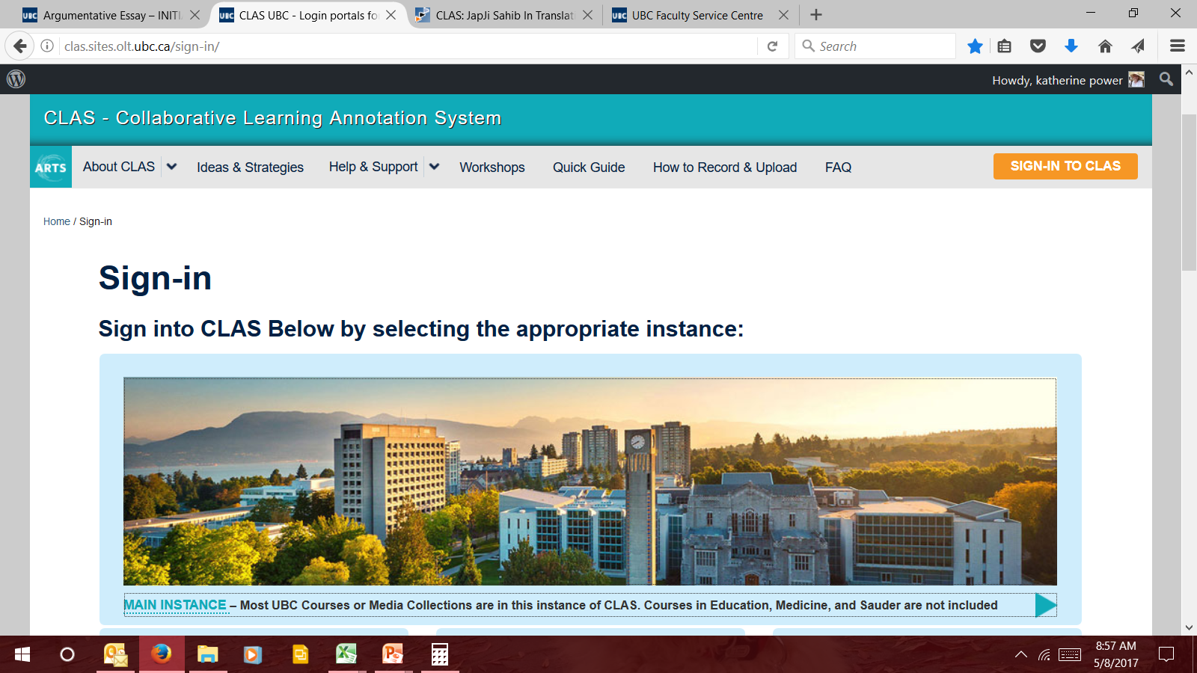
© Kate Power 2017. Not to be copied, used, or revised without explicit written permission from the copyright owner.

Slide 9
© Kate Power 2017. Not to be copied, used, or revised without explicit written permission from the copyright owner.

Slide 10
© Kate Power 2017. Not to be copied, used, or revised without explicit written permission from the copyright owner.

Slide 11
Student feedback
BIE:
I found CLAS rather difficult to use when looking at reviews.
I didn’t like that on CLAS everyone could see your presentation and what people said about it.
The only thing I would suggest is just less technological issues (viewing comments on CLAS).
CLAS was useful for making comments, but they are difficult to view when quickly looking between comments.
I found peer reviewing using CLAS to be very complicated.
© Kate Power 2017. Not to be copied, used, or revised without explicit written permission from the copyright owner.

Slide 12
Other comments
BIE:
Use one platform and stick with it. It was frustrating to keep having to remember which thing I was supposed to post my work to.
Overall, the programs have their flaws but it’s better than printing out a tree’s worth of papers.
Somehow find a program that includes both written and visual peer reviewing options. Maybe Google Classrooms?
I liked how we used different technologies to best fit the activity / assignment we are doing.
ASTU 400a:
Perhaps group writing assignments through Google docs associated with the partner presentations.
No. The human interaction was novel and that’s both heartening and very sad in a university where you’re expected to develop thought from slides taken straight from a text or absolutely horrible animations.
© Kate Power 2017. Not to be copied, used, or revised without explicit written permission from the copyright owner.

Slide 13
Things to consider…
peer review participants ≠ anonymous
I didn’t like that on CLAS everyone could see your presentation and what people said about it.
considerable time involved in
setting up the assignments online
trouble-shooting technological issues
evaluating student participation
© Kate Power 2017. Not to be copied, used, or revised without explicit written permission from the copyright owner.

Slide 14
References
Brint, S., Cantwell, A.M., & Hanneman, R.A. (2008). The two cultures of undergraduate academic engagement. Research in Higher Education, 49(5), 383-402.
Harrison, L.M., & Risler, L. (2015). The role consumerism plays in student learning. Active Learning in Higher Education, 16(1), 67-76.
Kahu, E.R. (2013). Framing student engagement in higher education. Studies in Higher Education, 38(5), 758-773.
Laird, T.F.N., & Kuh, G.D., (2005). Student experiences with information technology and their relationship to other aspects of student engagement. Research in Higher Education, 46(2), 211-233.
Paré, A., Johns, A. M., & Chapman, M. (2014). External Revew of Arts Studies in Research and Writing.
© Kate Power 2017. Not to be copied, used, or revised without explicit written permission from the copyright owner.

